Slide 1
AutoDrone
Ye Bai
Isaac Berrios
Qian Shao
Qinshuang Wei

Slide 2
Agenda
Introduction
Project Goals
Technical Specifications
Design Approaches
Schedule and Milestones
Current status

Slide 3
Agenda
Introduction
Project Goals
Technical Specifications
Design Approaches
Schedule and Milestones
Current status

Slide 4
Introduction
Autodrone is an autonomous drone that can fly to a designated area and collect data
The data can be sent to a remote computer where an algorithm will be used to reconstruct a model of the area

Slide 5
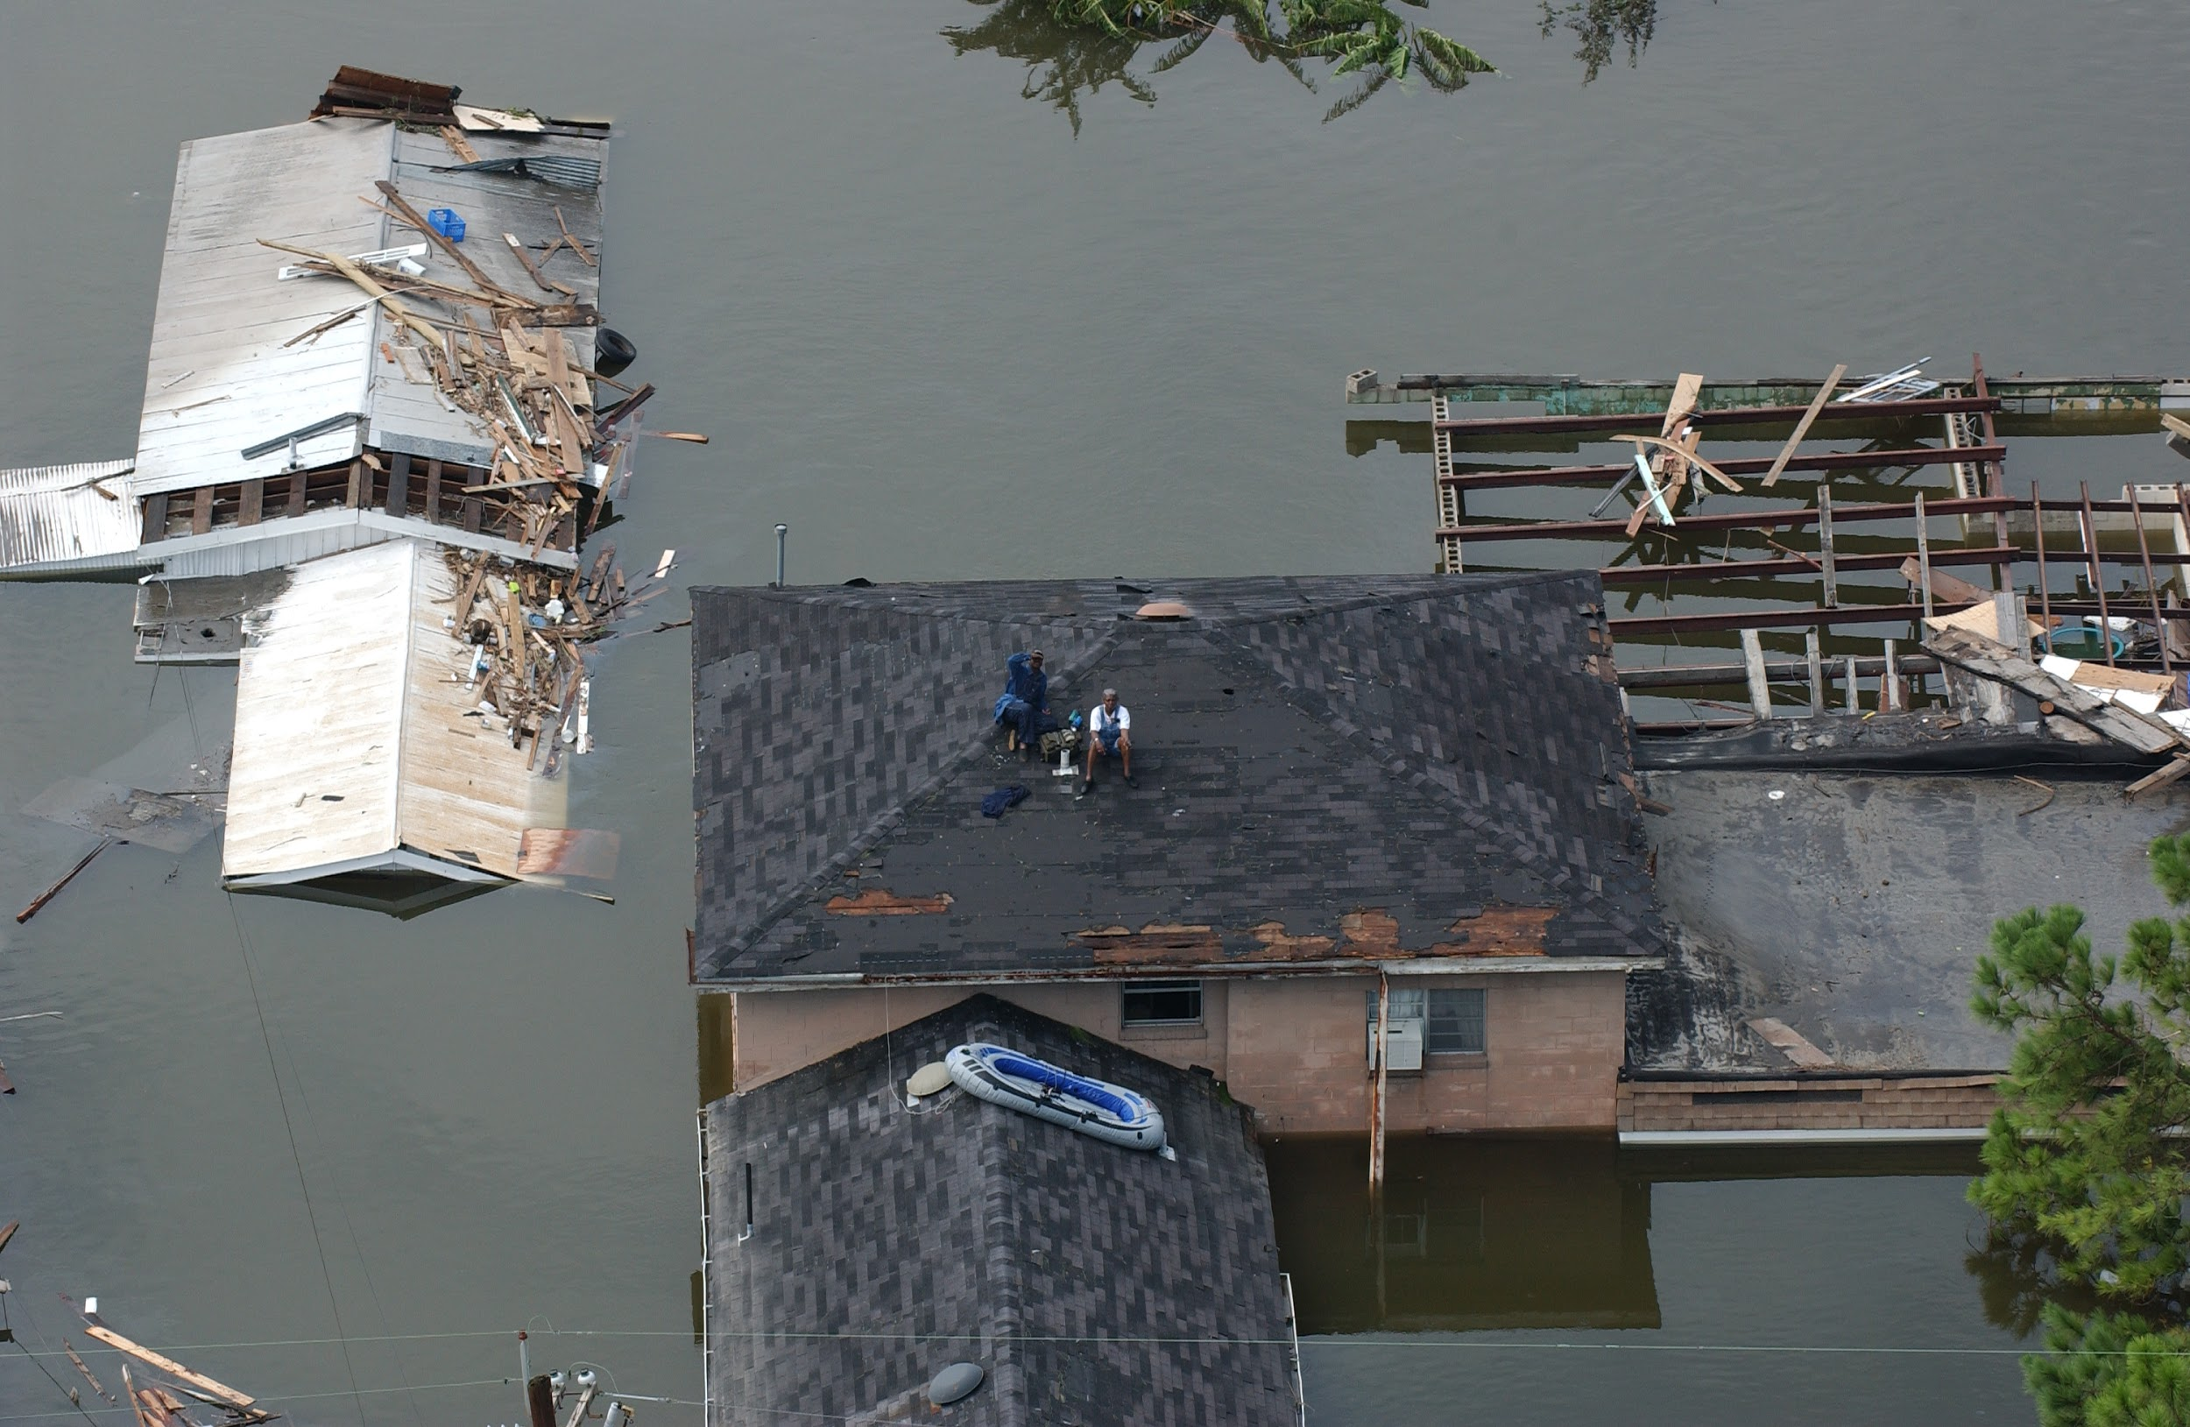
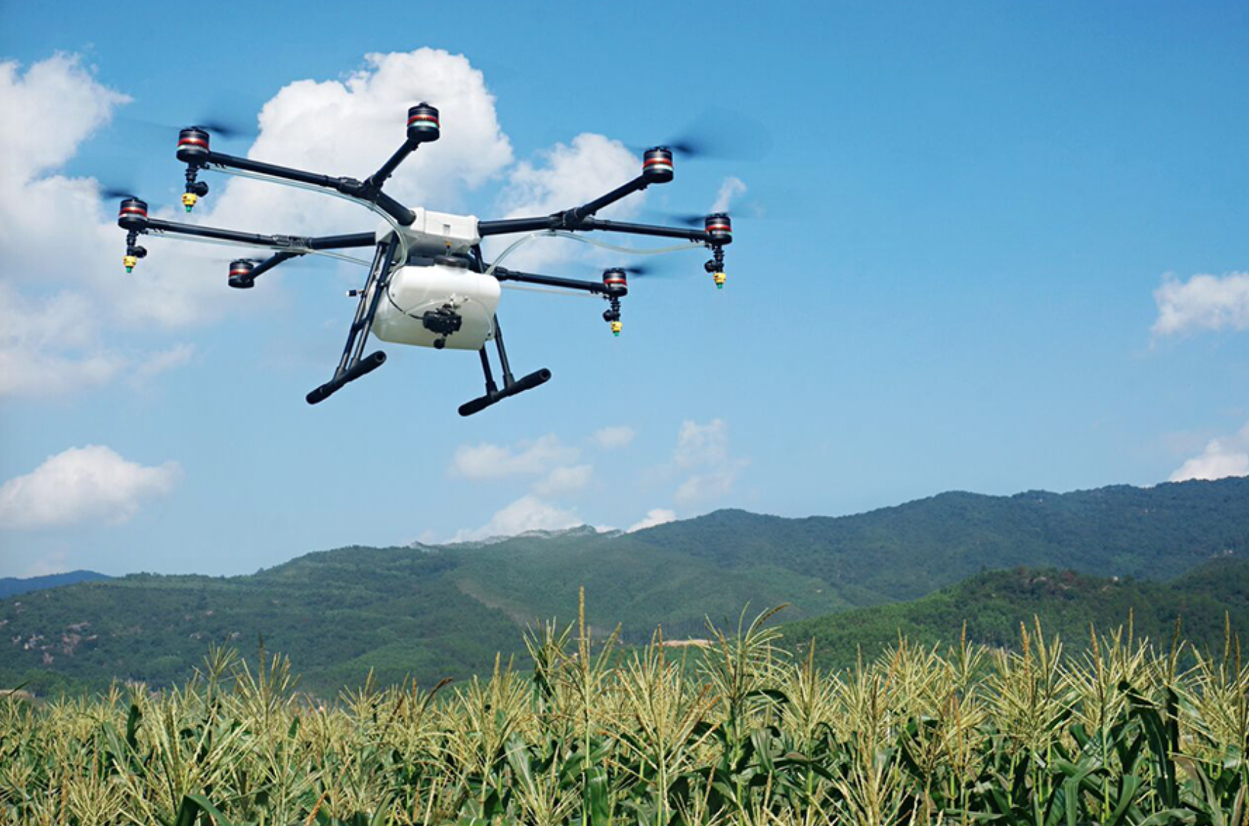
Applications
Infrastructure Inspection
Large-scale disasters
Agriculture
Extreme Sports
Notes:
isaac
https://commons.wikimedia.org/wiki/File:Katrina-14512.jpg
https://www.dji.com/newsroom/news/dji-introduces-company-s-first-agriculture-drone
https://www.dronezon.com/learn-about-drones-quadcopters/introduction-to-uav-photogrammetry-and-lidar-mapping-basics/
http://www.asctec.de/en/industrial-civil-infrastructure-inspection/
http://jamesbenham.com/drones-for-construction-architecture-engineering-surveying
http://bestdroneforthejob.com/drone-buying-guides/agriculture-drone-buyers-guide/
An autonomous drone can quickly reach a remote spot and provide high resolution imagery safely and efficiently
Skycatch has drone where a user can input a scan area, and the drone can choose its own waypoints for its flight and proceed to collect data
Frequent monitoring of infrastructure can ensure quality and safety of assets
Aerial images are very helpful in large disaster zones and drones can safely provide images at a low cost
Drones can provide more frequent and more detailed data of crops that can be used to improve the farm's production
A drone can also be used to more effectively perform jobs on a farm such as field surveying before planting, nitrogen recommendation, assessing crop health due to pests and disease
An autonomous drone can also be used to film extreme sports such as snowboarding

Slide 6
Agenda
Introduction
Project Goals
Technical Specifications
Design Approaches
Schedule and Milestones
Current status

Slide 7
Project Goals
Autonomous flying with GPS waypoints
The drone will auto take off, fly to waypoints indicated by user, then auto land
Track and follow object
The drone will take off, find a red ball, then track/follow the ball
Reconstruct explored environment
The drone will fly within GPS coordinates and send back information to ground control computer to reconstruct a 3-D model of the area
Notes:
Qinshuang
The team is going to design an unmanned aerial vehicle that can perform three specific tasks without a drone operator.
The final product will include an autonomous drone, and a website where the drone’s users can give basic instructions and view the mapping.
Once the second point is achieved, we can change the red ball into more complicated objects.

Slide 8
Agenda
Introduction
Project Goals
Technical Specifications
Design Approaches
Schedule and Milestones
Current status

Slide 9
Specifications
Hardware Specifications
On-board Computer Specifications
Depth Camera and Other Sensor Specifications
Software Specifications
Notes:
Qinshuang

Slide 10
Hardware specification
Weight | 800g - 1600g
Payload (depending on rotors) | 1400g - 1600g
Dimension | 450mm (diagonal length, motor to motor)
Battery | 4S LiPo, 3300mAh, 25C
Operating Power | 3.3V - 5V, Max. 20A/rotor
Autopilot | Using Pixhawk to assist flight control
Notes:
Weight: specified by the drone frame.
Payload: specified by the motors which is 350g to 400g per rotor.
Diagonal length: from motor to motor.

Slide 11
2. On-board Computer Specification
Frequency | 2 GHz
Memory | 2 GB
Power | 5V/4A
Operating System | ROS
Communication Portal | Wi-Fi

Slide 12
3. Depth Camera and Other Sensor Specifications
Frame Rate | 30-60 FPS
Resolution | Depth: 320x240, 480x360 Color: 320x240, 640x480, or 1920x1080
Depth Range | Inside range: 0.5-3.5 m Outside range: up to 10 m
GPS Resolution | <3m
Notes:
Resolution can be changed by changing frame rate
Note: Range is very dependent upon the module and the lighting.

Slide 13
4. Software Specification
On Board Tracking Processing Speed | <100 ms per frame
Local Mapping Processing Speed | <300 ms per frame
Graphic User Interface | Yes
Localization Accuracy | <1 m
Communication between On Board Computer and Flight Controller | MavLink
Communication between On Board Computer and Local Computer | Self-Designed Protocol
User Sensor Information | RGBD images, GPS location, orientation, and distance
Notes:
There will be graphic user interface, so users can give basic instructions to drone, and view the mapping of the area.
Self-Designed Protocol to send instruction from local computer, and to send position and gathered area information from drone

Slide 14
Agenda
Introduction
Project Goals
Technical Specifications
Design Approaches
Schedule and Milestones
Current status

Slide 15
Hardware Design
All components must be compatible with each other
GPS needed for localization and navigation
What has been done before?
Flight time, battery, and weight
Notes:
Isaac
The flight controller must have features such as self takeoff and landing, waypoint navigation, telemetry, and have an open source firmware
The choice of flight controller limited our options for the onboard computer
Quality of camera will greatly impact the accuracy of the data recorded
A higher quality camera will provide more data per frame and will require more computing power to process the data

Slide 16
Hardware Constraints
Quality of camera will affect accuracy of recorded data
Tradeoff between weight and durability
Affects flight time
FAA regulations
Notes:
constraints

Slide 17
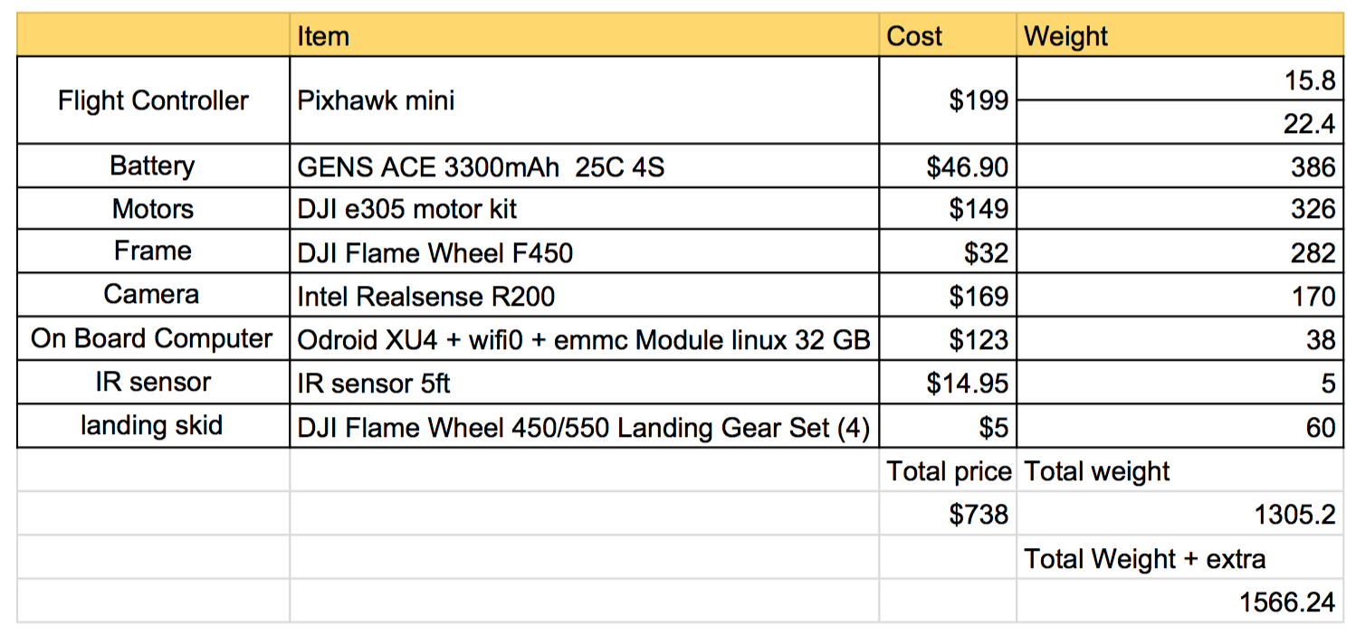
Hardware list
Notes:
YAOYAO

Slide 18
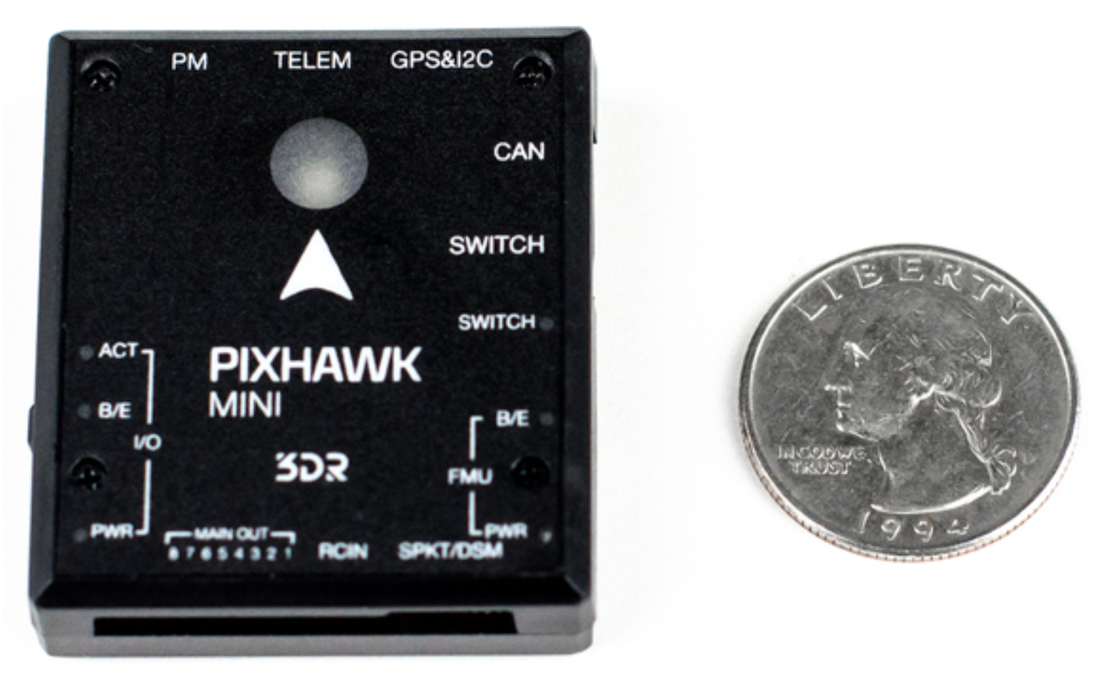
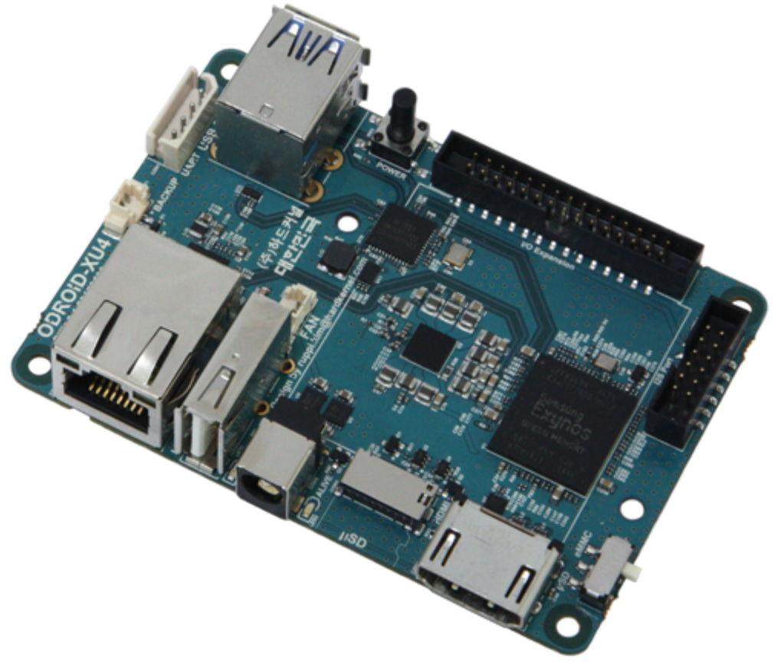
Flight Controller and On-Board Computer
Pixhawk mini
Comes with GPS module
Designed for PX4 flight stack
Open source firmware
Odroid XU4
Compatible with Pixhawk
USB 3.0 for Depth camera
Really good computing power (8 cores)
** note: Quarter only to scale for Pixhawk
Notes:
yaoyao

Slide 19
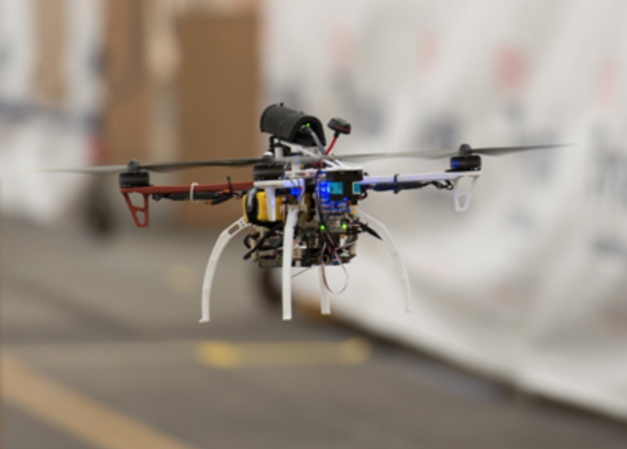
Frame, Motors, and Battery
DJI Flame Wheel F450
Frame used by DARPA FLA research
DJI e305 Motor kit
Includes Motors, ESC, Propellers
Take-off weight up to 1600 g total
Battery
4S minimum required by motors
Should run 15-30 minutes

Slide 20
Sensors
Intel Realsense R200
Range of 3-4 meters inside, more outdoors
Color, Depth, and Infrared Video
IR sensor
For auto landing
Range of 20-150 cm

Slide 21
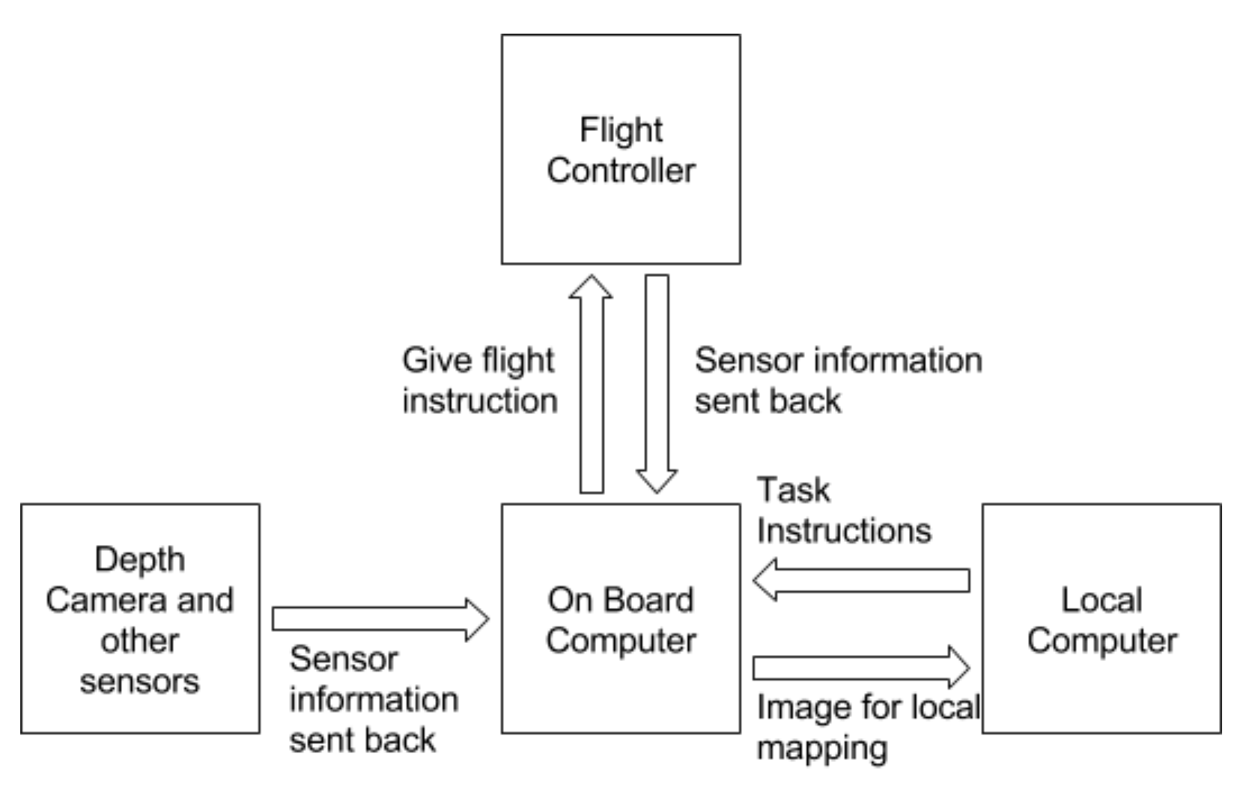
Software Design

Slide 22
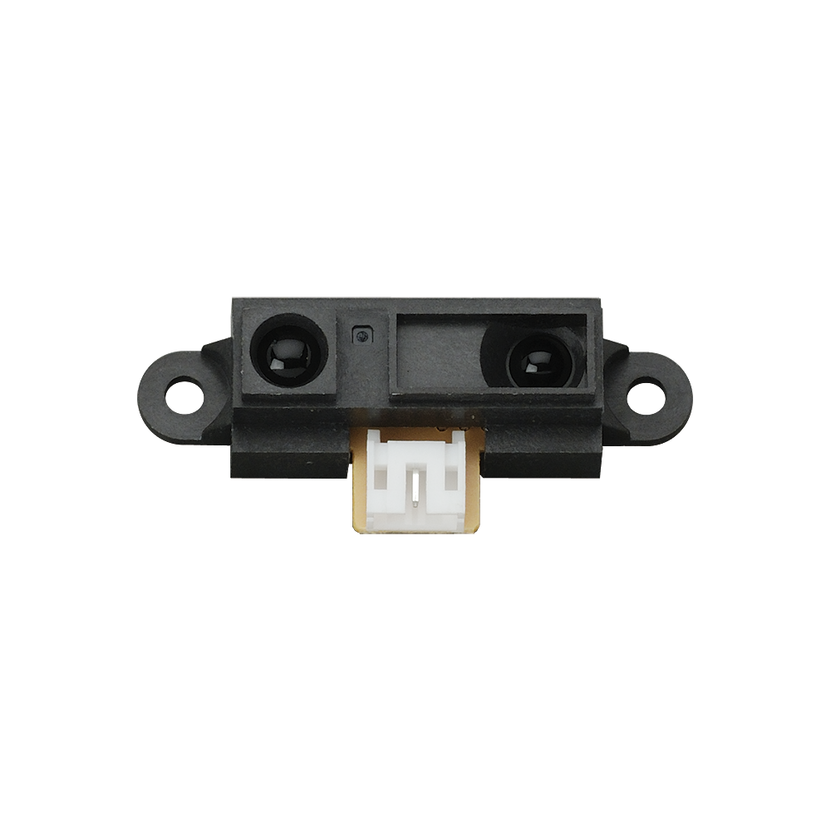
Setup of Sensors and Autopilot
External sensors such as depth camera can be set up to feed information to onboard computer.
Pixhawk can be tuned to our drone, and communicated through MAVlink protocol.

Slide 23
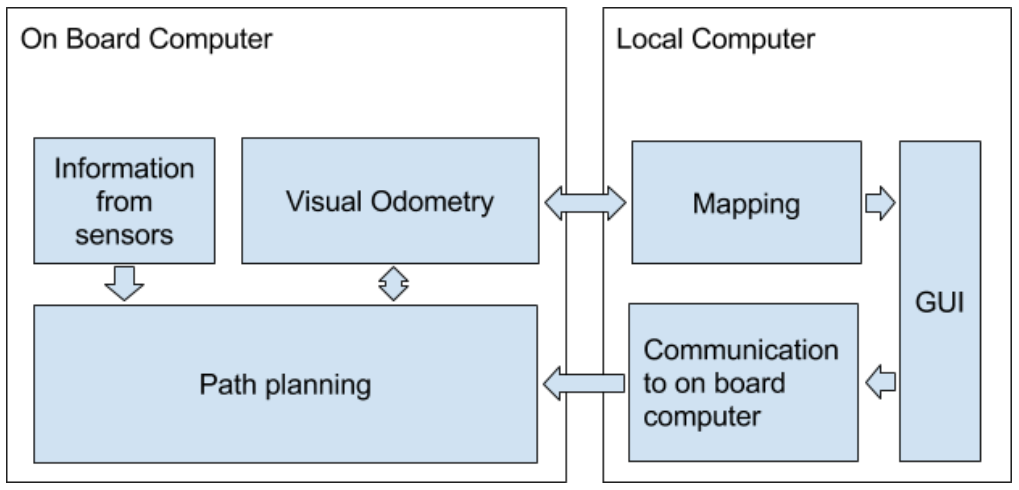
Module Interaction

Slide 24
SLAM Algorithms
SVO: Semi-direct monocular visual odometry (2014)
LSD-SLAM: Large-scale direct monocular SLAM (2014)
ORB-SLAM: a ORB feature based SLAM (2015)
Each system has its advantages
Need to find a system that best suites our project needs
Things to consider
Limited resource (computing and energy)
Frame processing speed

Slide 25
Path Planning and 3D Reconstruction
There are many path finding algorithms. We will try to combine several of them to create one good for our situation.
We will research on 3D reconstruction algorithms, and since the reconstruction will be done on a local computer. The energy and computing power will not be a concern.

Slide 26
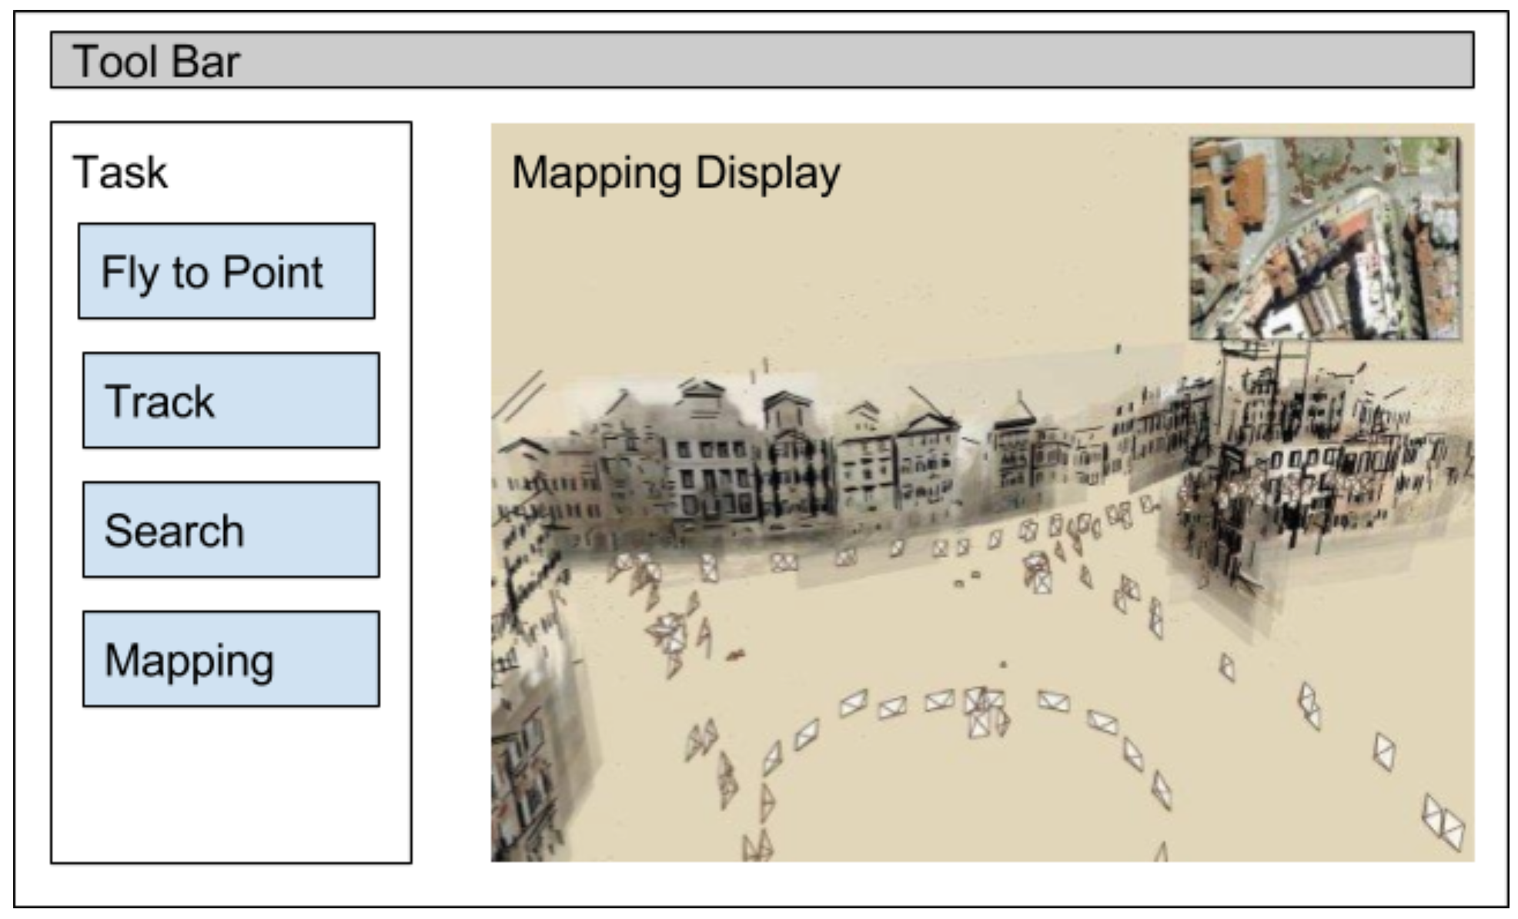
Mockup of GUI

Slide 27
Software Constraints
The limited resources, computing power and energy
The trade off between accuracy and speed
Notes:
constraints

Slide 28
Agenda
Introduction
Project Goals
Technical Specifications
Design Approaches
Schedule and Milestones
Current status

Slide 29
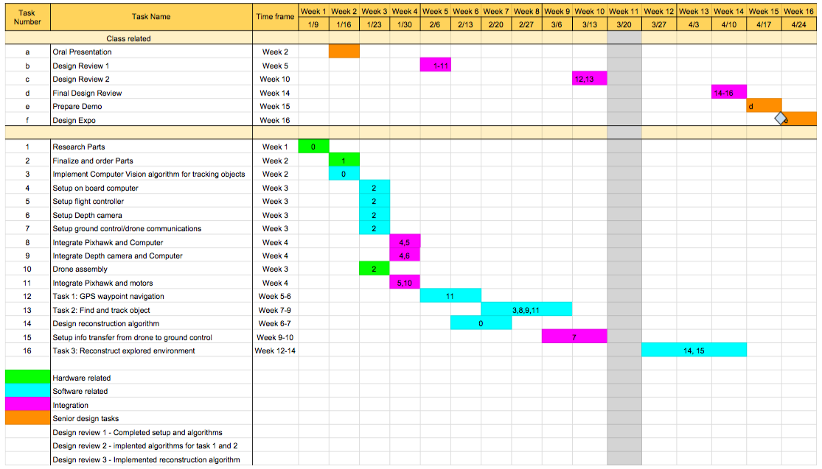
Schedule
Notes:
yaoyao

Slide 30
Milestones/Timeline
Order, setup, and integrate parts
Completed by week 4
Autonomous flying with GPS waypoints
Completed by week 6
Track and follow object
Completed by week 9
Reconstruct explored environment
Completed by week 14
Design Review 1
Minimum Requirement
Design Review 2
Design Review 3
Notes:
yaoyao

Slide 31
Agenda
Introduction
Project Goals
Technical Specifications
Design Approaches
Schedule and Milestones
Current status

Slide 32
Current Status
Late research phase
Components have been checked for compatibility
Finalized parts
Started algorithm research

Slide 33
Questions/Comments

