Slide 1
Autodrone
Final Presentation
Ye Bai
Isaac Berrios
Qian Shao
Qinshuang Wei

Slide 2
Agenda
Introduction
Project Milestones
Technical Specifications
Design Approaches
PX4 Flight Stack
Testing
Conclusion

Slide 3
Introduction
Autodrone is an autonomous drone that can fly to GPS waypoints and record camera data and drone information
The camera data is sent to a remote computer where an algorithm will reconstruct a 3D model of the drone’s environment
Notes:
yao1

Slide 4
Introduction
Purpose is to create a system first responders can utilize drone technology without having to know how to fly.
Can be used for: people finding, infrastructure inspection, area inspection.
Source: http://www.cnn.com/2016/04/16/asia/japan-earthquake/
Notes:
yao2

Slide 5
Agenda
Introduction
Project Milestones
Technical Specifications
Design Approaches
PX4 Flight Stack
Testing
Conclusion

Slide 6
Project Milestones
Autonomous flying with GPS waypoints
The drone will auto take off, fly to waypoints indicated by user, then auto land
Track and follow object
The drone will take off, find a green ball, then track/follow the ball
Reconstruct explored environment
The drone will fly within GPS coordinates and send back information to ground control computer to reconstruct a 3-D model of the area
Notes:
yao3

Slide 7
Agenda
Introduction
Project Milestones
Technical Specifications
Design Approaches
PX4 Flight Stack
Testing
Conclusion

Slide 8
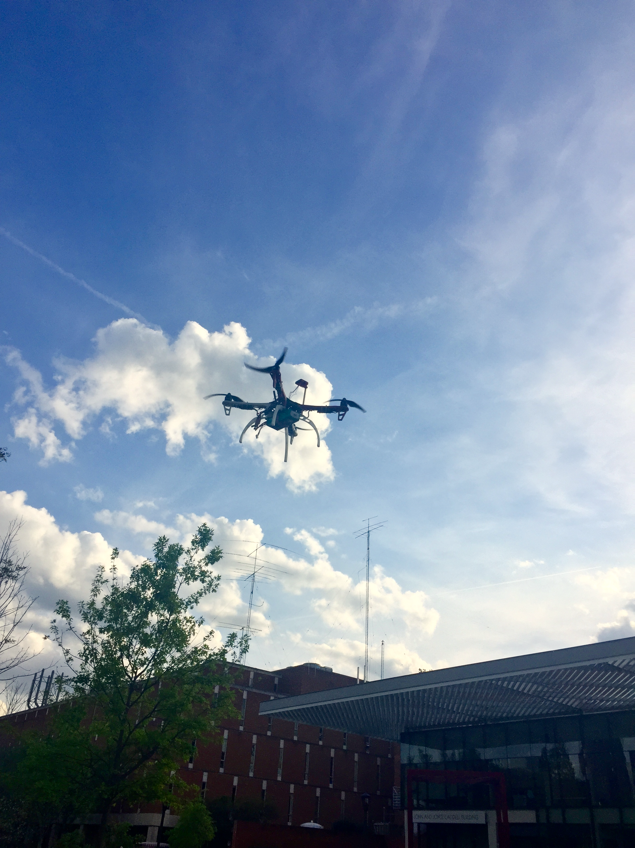
Hardware Specifications
Weight | 1600g
Payload (depending on rotors) | 1600g
Dimension | 450mm (diagonal length, motor to motor)
Battery | 4S LiPo, 6600mAh, 10C
Operating Power | 3.3V/5V PWM input signal level compatible, Max. 17.4V*20A/rotor
Flight Control Unit | Pixhawk Mini
Notes:
qinshuang1

Slide 9
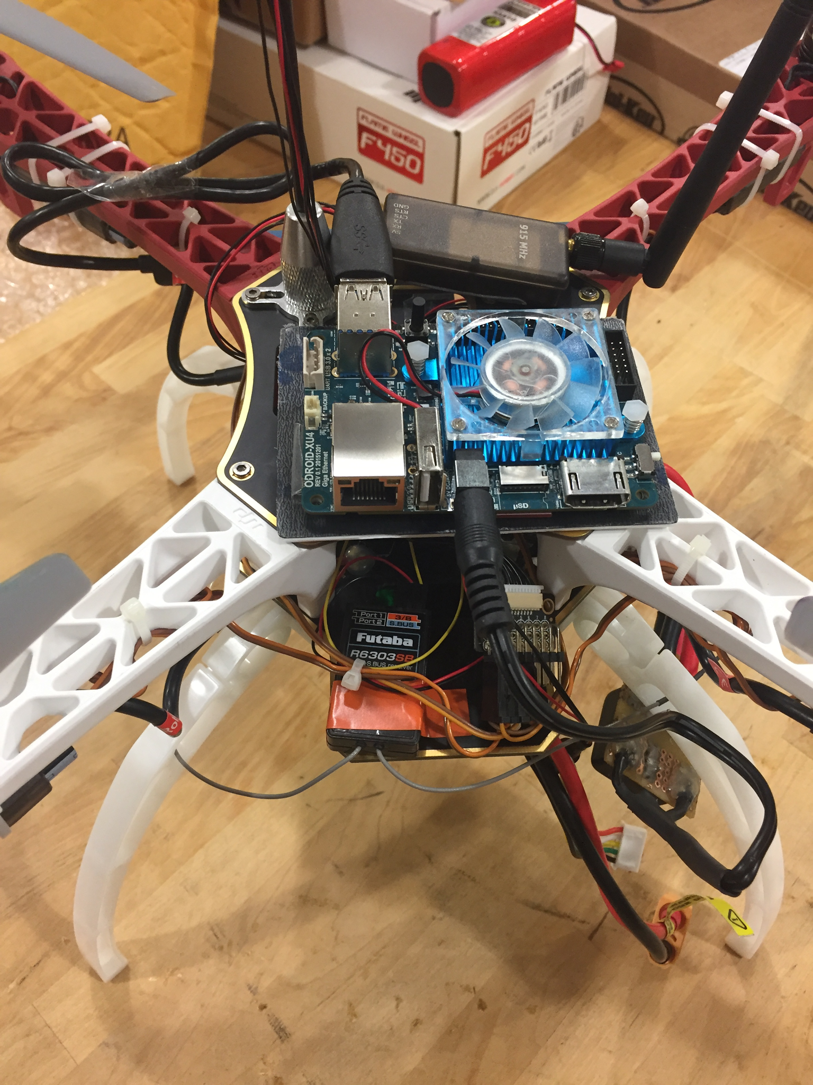
On-board Computer Specifications
Frequency | 2 GHz / 8 cores
Memory | 2 GB
Power | 5V/4A
Operating System | ROS on Ubuntu Mate
Communication Portal | Wi-Fi
GPIO interface | Input: 1.8V signal level Output: 3.3V signal level
Notes:
qinshuang2

Slide 10
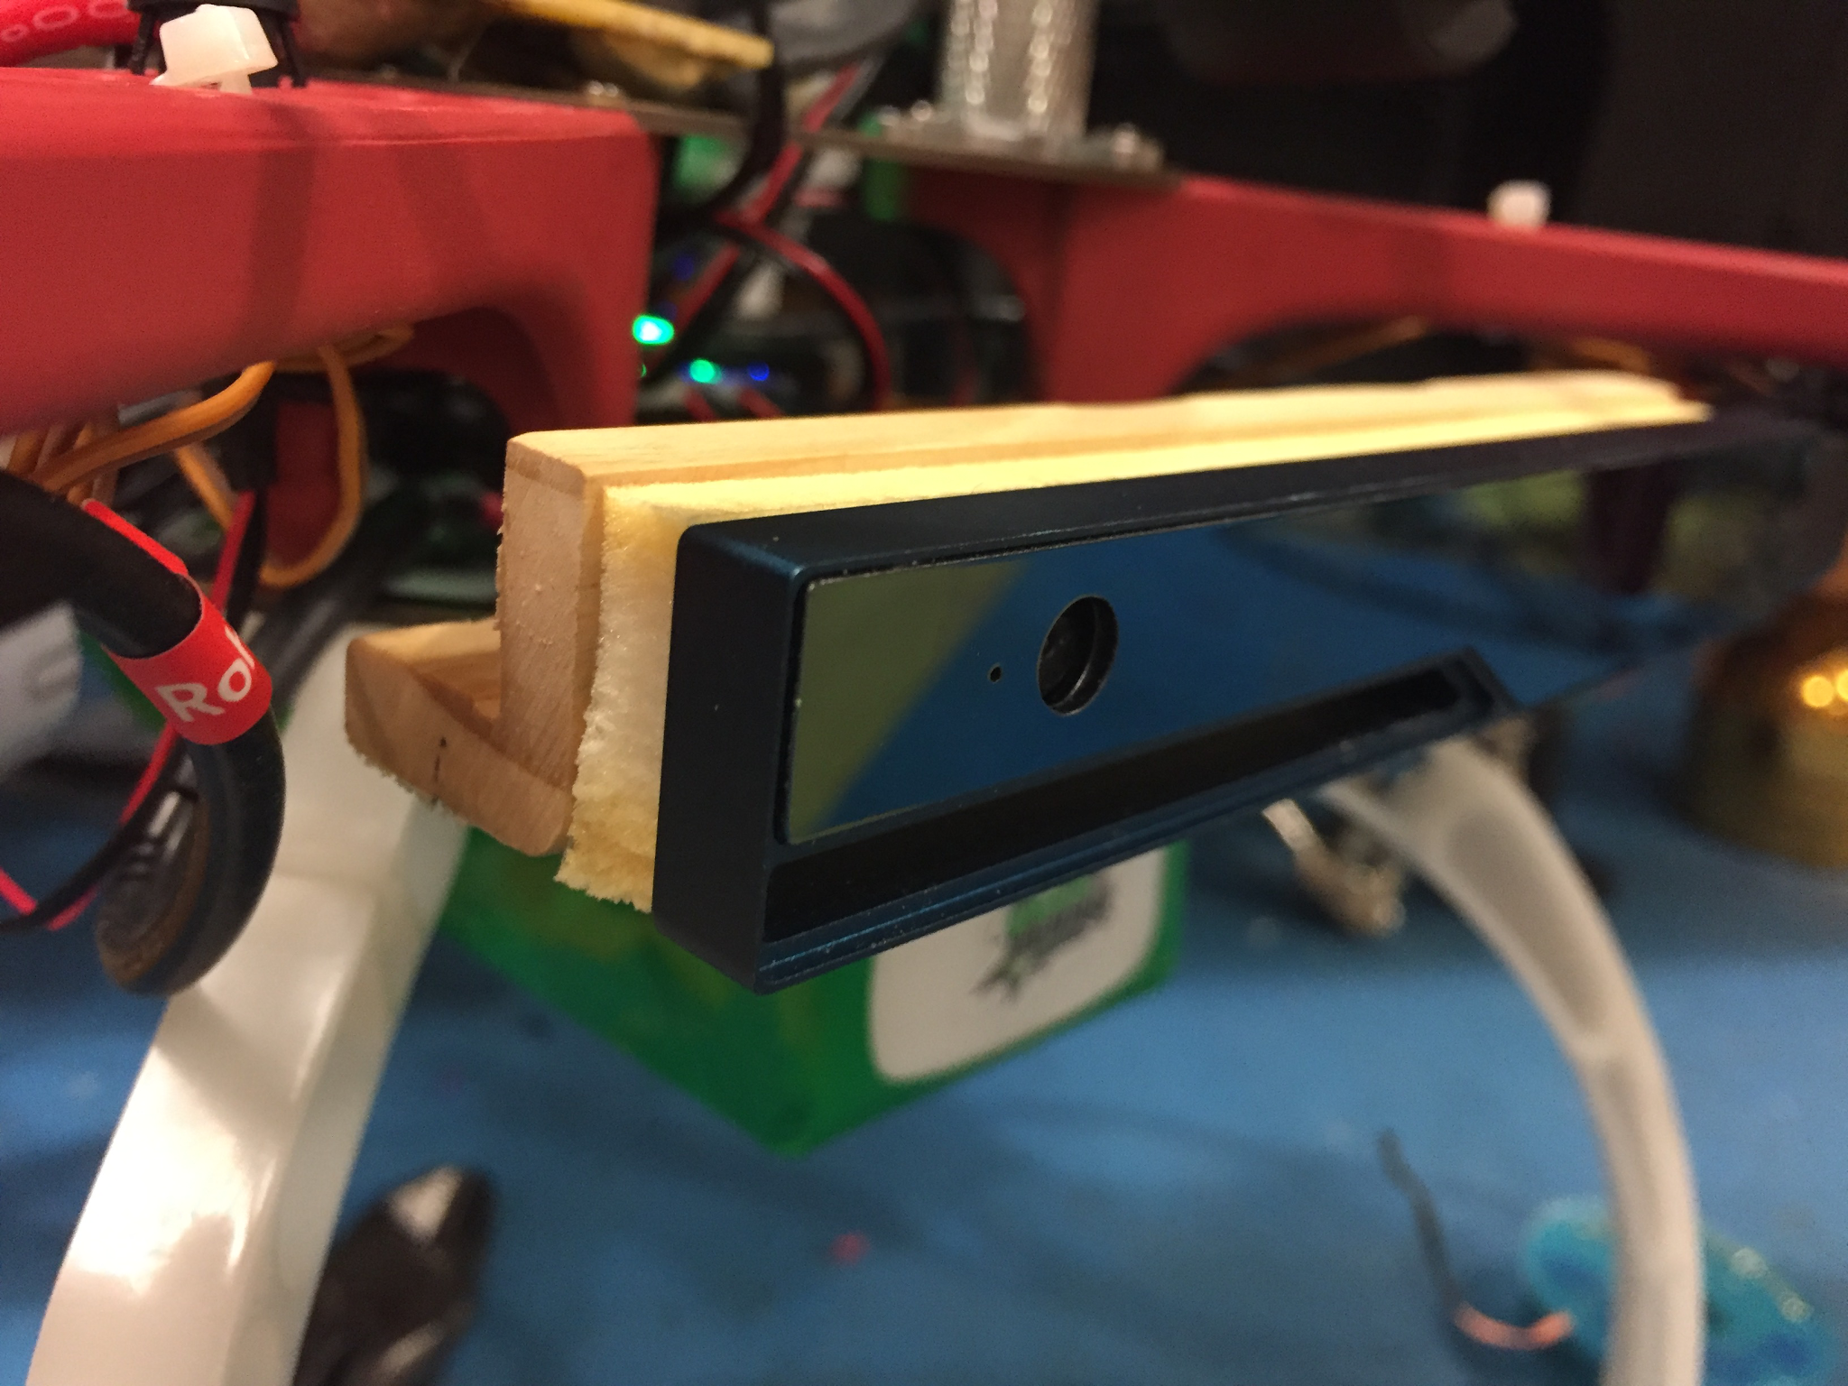
Depth Camera Specifications
Frame Rate | 30-60 FPS
Resolution | Depth: 320x240, 480x360 Color: 320x240, 640x480, or 1920x1080
Depth Range | Inside range: 0.5-3.5 m Outside range: up to 10 m
GPS Resolution | <3m
Notes:
qinshuang3

Slide 11
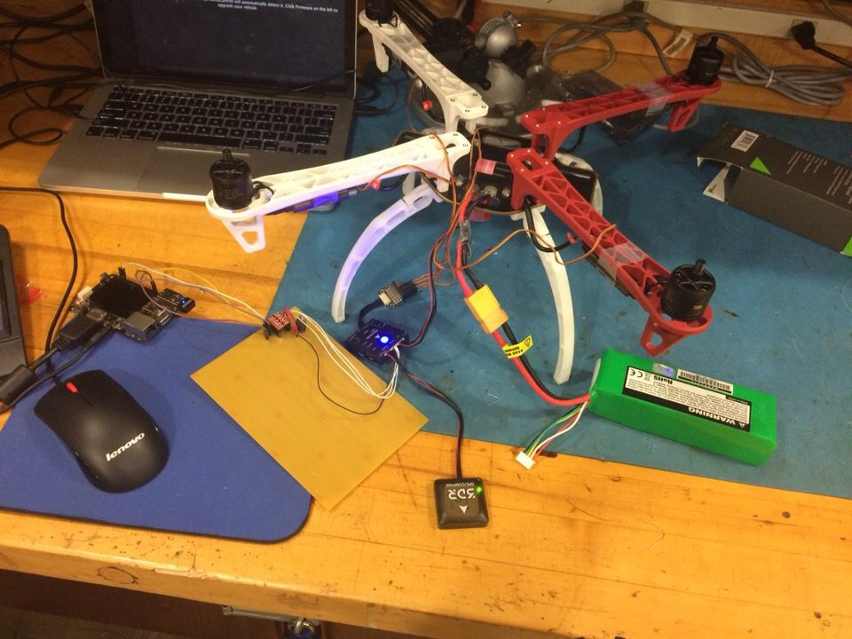
Other Hardware Specifications
Voltage Converter | 36V-5V Buck converter to power Odroid
Level Shifter | 3.3V-1.8V bidirectional voltage level shifter
Voltage Regulator | 3.3V voltage regulator
Notes:
Qinshuang 4
Step up/down the voltage level to connect Odroid UART (1.8V) with the Pixhawk telemetry port (3.3V).
Change Vcc from Pixhawk telemetry to provide a 3.3V voltage reference. Convert voltage up to 15V to 3.3V.

Slide 12
Software Specifications
On Board Tracking Processing Speed | <100 ms per frame
Local Mapping Processing Speed | <300 ms per frame
Graphic User Interface | Yes
Localization Accuracy | <1 m
Communication between On Board Computer and Flight Controller | MavLink
Communication between On Board Computer and Local Computer | Through ROS Master
User Sensor Information | RGBD images, GPS location, orientation
Notes:
Qinshuang 5

Slide 13
Agenda
Introduction
Project Milestones
Technical Specifications
Design Approaches
PX4 Flight Stack
Testing
Conclusion

Slide 14
Design Approaches
Pixhawk mini used for flight control
Futaba T7C transmitter and R6303SB S-Bus receiver are readily compatible with each other and the Pixhawk mini
GPS will be used to localize drone for outdoor flight
Odroid XU-4 has eight cores and will be used for image processing
3DR telemetry units provide wireless communication between Pixhawk and a remote computer
Intel R200 provides color, depth and infrared data and has an effective range up to 10 meters (32 ft)
Notes:
isaac1

Slide 15
Power System Design
Battery must be able to power motors, Pixhawk, and Odroid XU-4 simultaneously
Quadcopter frame includes a power board with five terminals connected in parallel
At the terminal where the battery is connected, a power board to supply the Pixhawk and a 36V-5V buck converter to power the Odroid are both connected in parallel
Notes:
isaac2

Slide 16
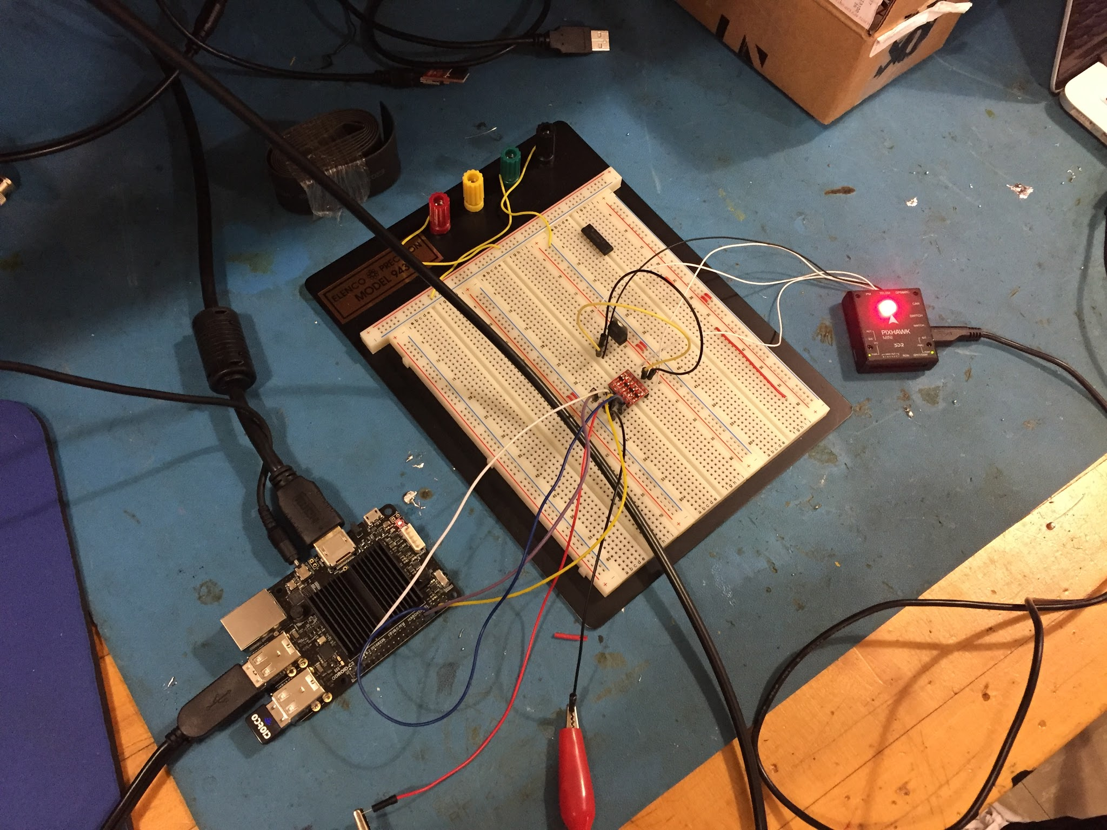
Odroid and Pixhawk
Telemetry unit is used to communicate between Pixhawk and remote computer.
Odroid communicates to pixhawk with level shifter and voltage regulator circuit.
Pixhawk is mounted with vibration dampening foam
Notes:
isaac3

Slide 17
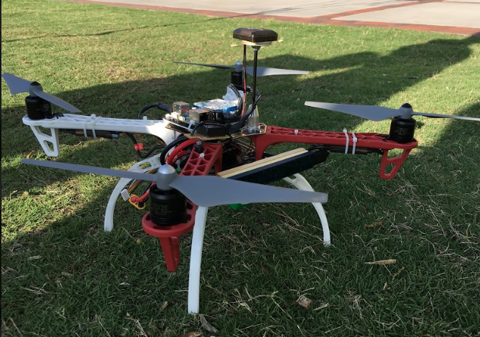
Camera and GPS mounting
The GPS was mounted using a purchased GPS mounting stick that screwed into the frame
The Camera was mounted using a wooden L-bracket and vibration dampening foam
Camera added a noticeable weight to the front of the drone
Notes:
isaac4

Slide 18
Hardware Constraints
Power drawn from Odroid and Pixhawk had an impact on battery selection
Weight of the battery limited the total flight time
The communication between odroid and local computer is not reliable through WiFi
Barometer on Pixhawk was not always accurate
Battery reader was not accurate
Notes:
isaac5

Slide 19
Software Design
Realsense Camera compatibility issues
The communications between each computing component
GPS navigation capability
Flight control instructions
Object tracking capability
Autonomous/3D reconstruction capabilities
User Interface
Notes:
qian1

Slide 20
Realsense Camera
Hardware requirement: 3.0 USB and x86 architecture. Odroid XU4 has 3.0 USB ports, and modified driver available for ARM architecture.
System requirement: Linux kernel 4.4 +. The one come with Odroid is 3.10, so we have to patch the kernel.
Register depth image to RGB: the calibration parameters give by the camera are not accurate
The powering the camera messes up the USB buses.
Notes:
qian2

Slide 21
Communications between Odroid, Pixhawk, and PC
Pixhawk and PC: connect to ground control software through micro USB cable/telemetry, to calibrate sensors, set parameters, and create missions
Pixhawk and Odroid: connect with MavROS through level shifter/telemetry, to send instructions (such as mode change/arming), read sensor information, and control by script.
Odroid to PC: connect with WiFi, and communication through ROS master (ROS system on multiple machines), to send sensor data and instructions.
RC controller can always override the instructions from Odroid/PC
Notes:
qian3

Slide 22
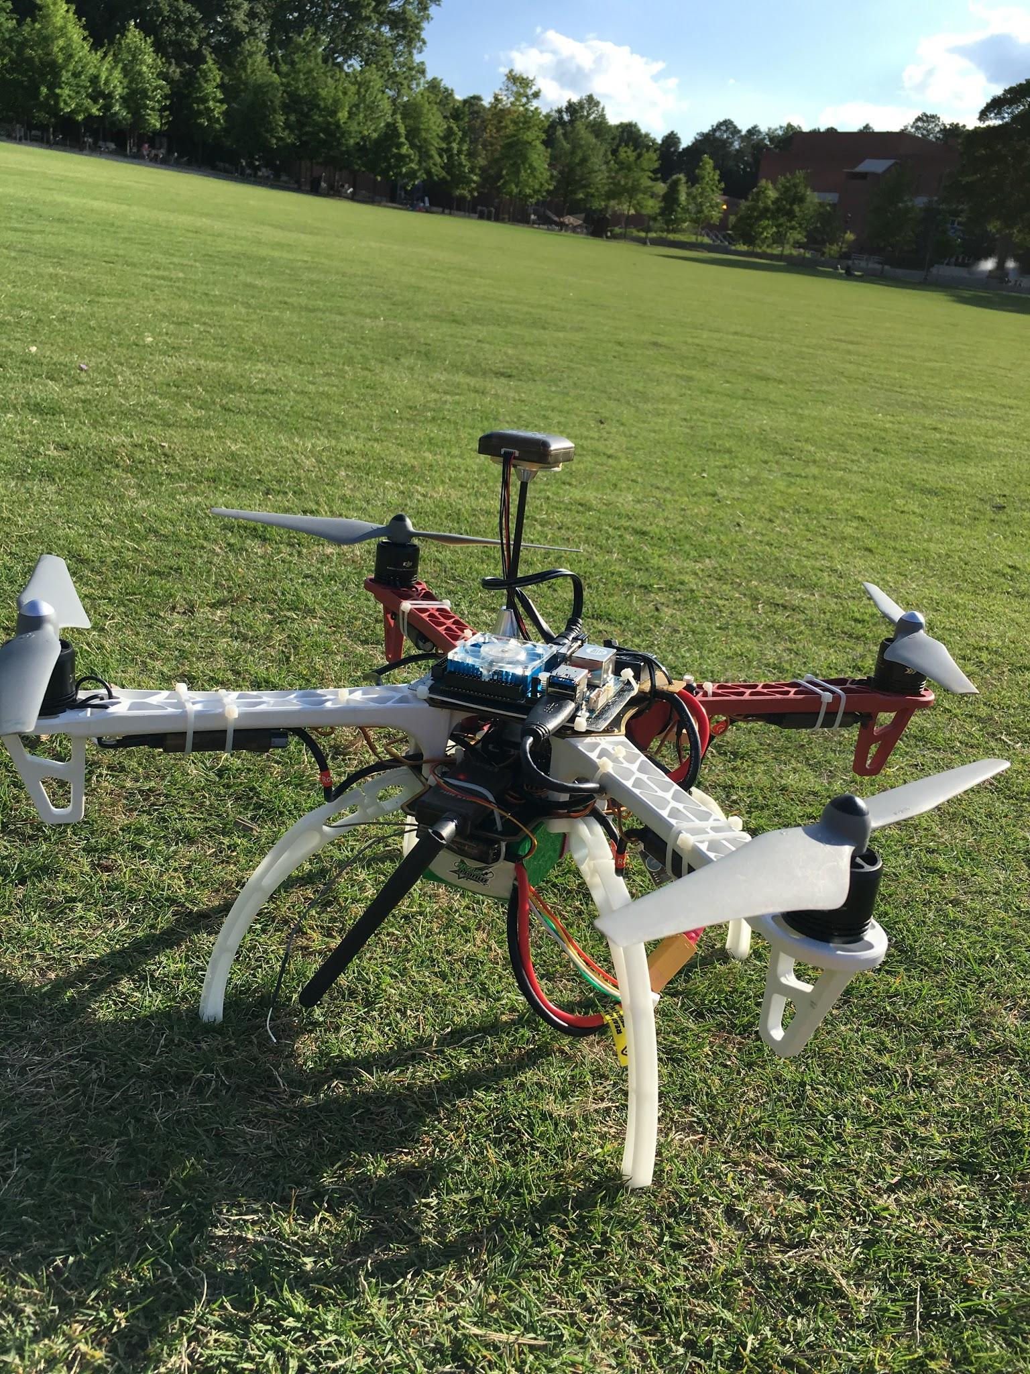
GPS Navigation
From ground station software: able to create mission (setup take off location, waypoints, and land location), and fly by switching to mission mode
MavROS commands to set local waypoints and global waypoints
Problem: can not set to OFFBOARD mode to let the script control the drone
Notes:
qian4

Slide 23
Color Tracking
Camera can track objects based on their color
Currently a green circle
Future work:
Facial recognition
Object recognition
Notes:
qian5

Slide 24
Other Capabilities
Registered depth image correction, and frequency adjust (camera frequency is higher than the rate ORB-SLAM can process)
ORB-SLAM: able to run as a ROS node, take in RGBD images. (tried with 10 Hz in real time, and 30 Hz offline)
Notes:
qian6

Slide 25
Software Constraints
The registered depth image is corrected by hard coding.
A camera calibration should be conducted
Local position information from Pixhawk is not accurate
SLAM algorithm current processing rate can not give a stable localization and mapping.
Notes:
qian7

Slide 26
User Interface
A GUI created with TkInter ROSPY
Display camera input, and quadcopter information
Takes in GPS coordinate from user, and publishes it to ‘GUI_GPS_CMD’ topic
Notes:
qinshuang6

Slide 27
Agenda
Introduction
Project Milestones
Technical Specifications
Design Approaches
PX4 Flight Stack
Testing
Conclusion

Slide 28
PX4 Flight Stack
Mode | Description
Manual | No stabilization. All RC inputs are passed directly to the outputs.
Takeoff | Drone flies vertically to set altitude.
Land | Drone will slow it’s throttle until the altitude is no longer changing.
Stabilized | Simple stabilization, drone will level.
Hold | Stabilization and maintained altitude. Can not move drone.
Offboard | Pushes RC inputs offboard to another source. RC inputs can be overridden at any time by the RC transmitter.
Notes:
qinshuang

Slide 29
Flight Instructions and Coordinate Systems
With local frame, can set local position in NED coordinate system
With global frame, can set global position in GPS coordinate system
Can set yaw, pitch and roll
Can set velocity and accelerations in NED coordinate system.
Notes:
Qinshuang
Within the local frame, we can set local position in NED coordinate system and the origin is the position that the pixhawk is turned on.

Slide 30
Agenda
Introduction
Project Milestones
Technical Specifications
Design Approaches
PX4 Flight Stack
Testing
Conclusion

Slide 31
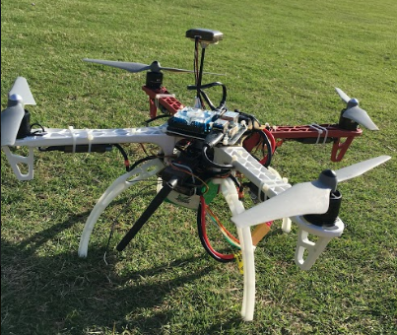
Integration and Preparing for flight
Checkoff list integrating components
Integrate things one at a time
Test different flight modes
Test GPS localization
Test Instructions
Notes:
isaac

Slide 32
How we fly
Plug in battery
Wait until pixhawk starts, plug in Odroid (to make sure the voltage level has stabilized)
Wait for ESC to calibrate
Set the quadcopter to stabilize mode
Arm motors using flight controller/ mavros command/ script
Set the quadcopter to AUTO TAKEOFF mode
Set the quadcopter to OFFBOARD mode to fly according to waypoints
Set the quadcopter to AUTOLAND
Disarm motors
Notes:
isaac

Slide 33
Auto takeoff/ Auto landing
Notes:
isaac

Slide 34
GPS Flight Testing
Set waypoints in QGroundControl for drone to fly to
Drone must be armed in STABILIZED mode and can then be switched to MISSION using the RC controller
Notes:
isaac

Slide 35
In Flight Video
Notes:
isaac

Slide 36
Agenda
Introduction
Project Milestones
Technical Specifications
Design Approaches
PX4 Flight Stack
Testing
Conclusion

Slide 37
Design Challenges
Odroid XU-4 and Intel Realsense R200 were not compatible
Updated Kernel to fix
Final weight was at maximum payload - 1.6 kg
+/- 0.1 kg
Voltage converter from battery to Pixhawk
Upgraded to a DC-DC compatible for 10S batteries.
Local Position from Pixhawk not stable
Future work: take in camera input to determine local position.
Notes:
yao

Slide 38
Current Status
Drone build complete
GPS waypoint navigation successful through QGroundControl
Drone is able to arm, takeoff, hover, and land through modes selected offboard control
Camera can track color and find distance from color.
ORB-SLAM is able to run on a ROS node
Fully autonomous off board computer control not implemented yet
Notes:
yao

Slide 39
Future Work
Integrate more sensors
Test in OFFBOARD mode
Integrate object tracking into flight
Let ORB-SLAM publish feature information
Create path planning module, which takes in feature information and other sensor information and publish flight instructions to MavROS
Look into other communication methods between drone and ground control computer

Slide 40
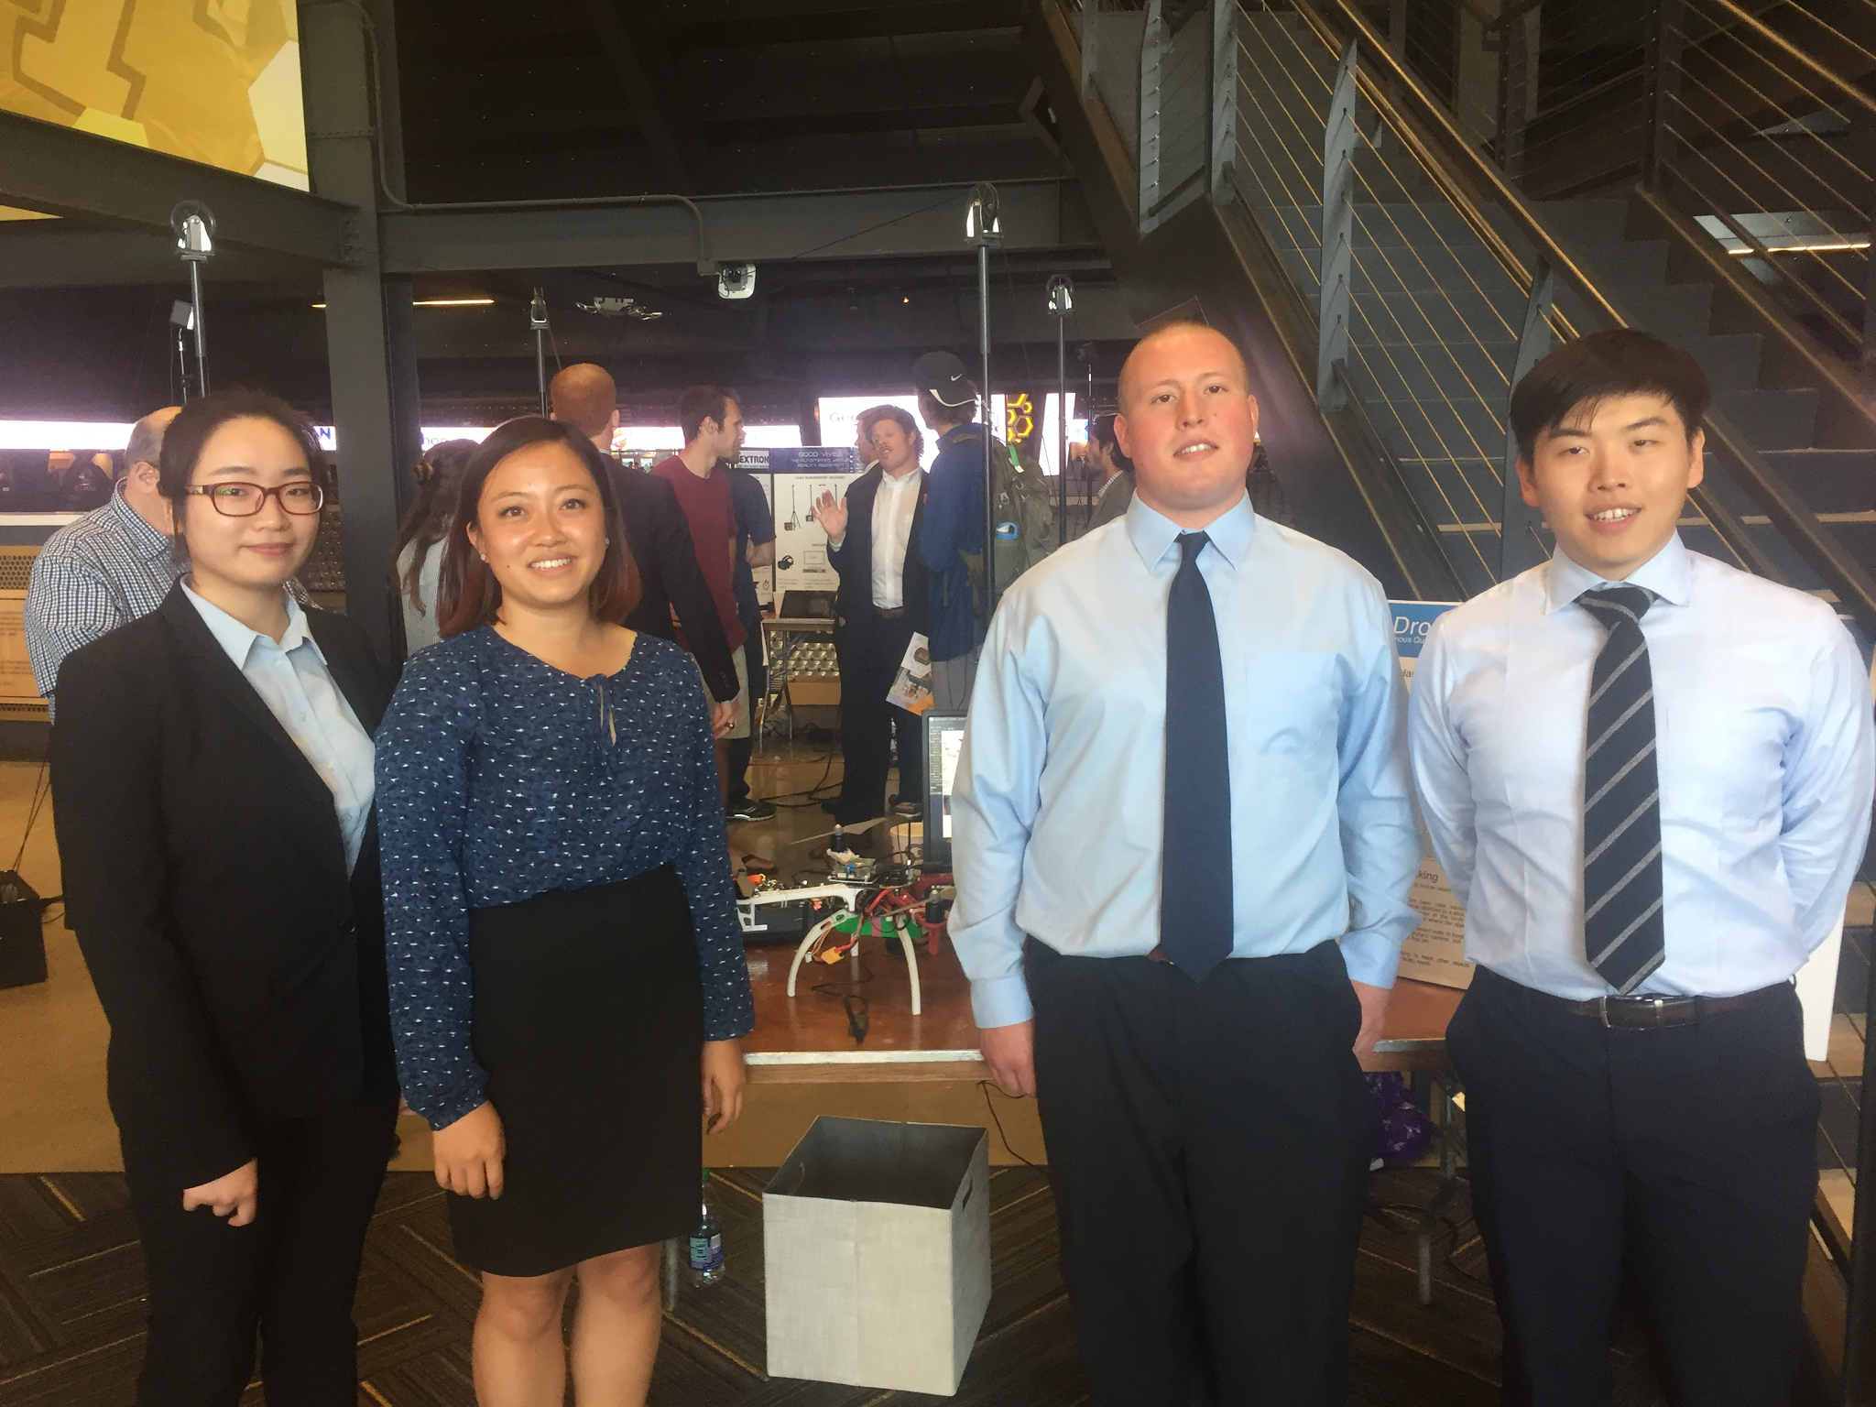
Capstone
Notes:
yao

Slide 41
Questions/Comments
Notes:
yao

