Slide 1
Haptic Smart Glasses
Adwait Lele
Varun Nambiar
Samir Vedantham
Abraham Kancherla

Slide 2
Vision and Goals

Slide 3
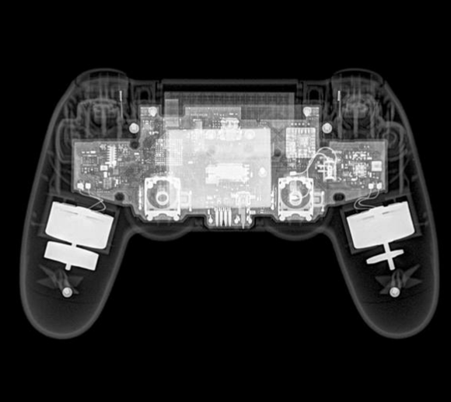
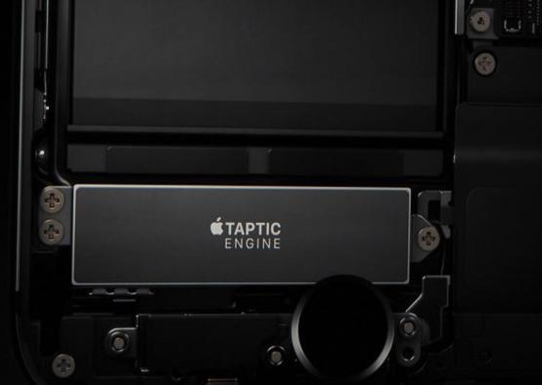
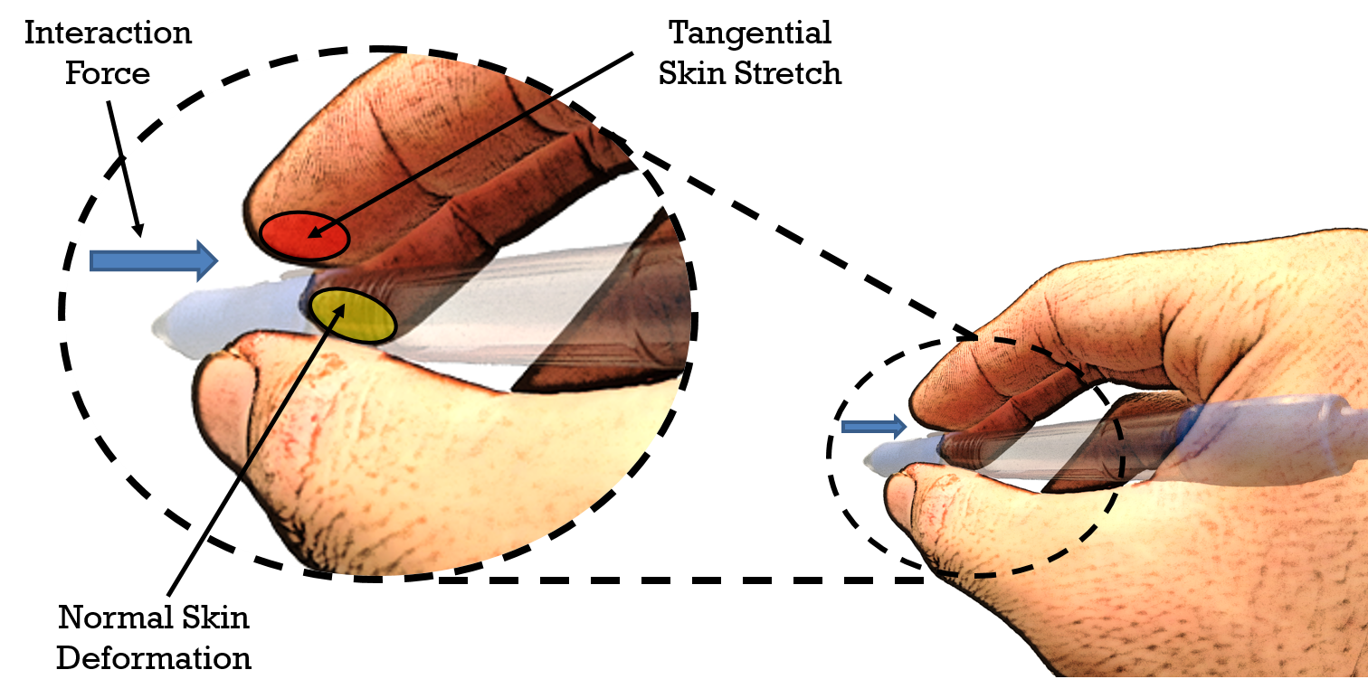
Vision
Develop a better user interface experience for augmented reality users through haptic feedback.
source: www.kotaku.com, www.apple.com, www.stanford.com

Slide 4
Goals and Deliverables
Should be able to do ….
Make an AR capable headset
Receive feedback through peripherals
Design a UI which contains:
  The ability to draw, mimicking a “Paint” application
  Pick up and move virtual objects

Slide 5
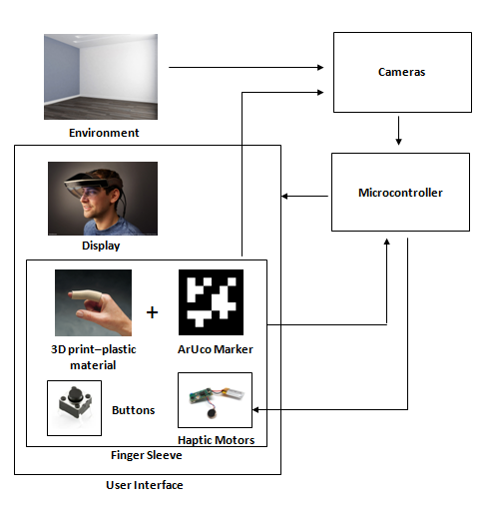
Overall Design

Slide 6
Technical Specifications - Hardware
Item | Specification
Glasses Dimensions | 25 cm wide
Field of View | Temporarily undecided
Finger Sleeve Dimensions | Adjustable Size
Processor | 1.2 GHz ARM-8 Cortex
Number of Buttons | 1 Capacitive Button
Camera(s) | 1 stream of 1080p @ 30fps
Haptic Motors | 2 Linear Resonant Actuators
Screen Display | 4.3" 40-pin TFT Display - 480x272

Slide 7
Technical Specifications - Software
Item | Specification
Sensor Software | OpenCV
UI Software | Google Cardboard

Slide 8
Design Steps

Slide 9
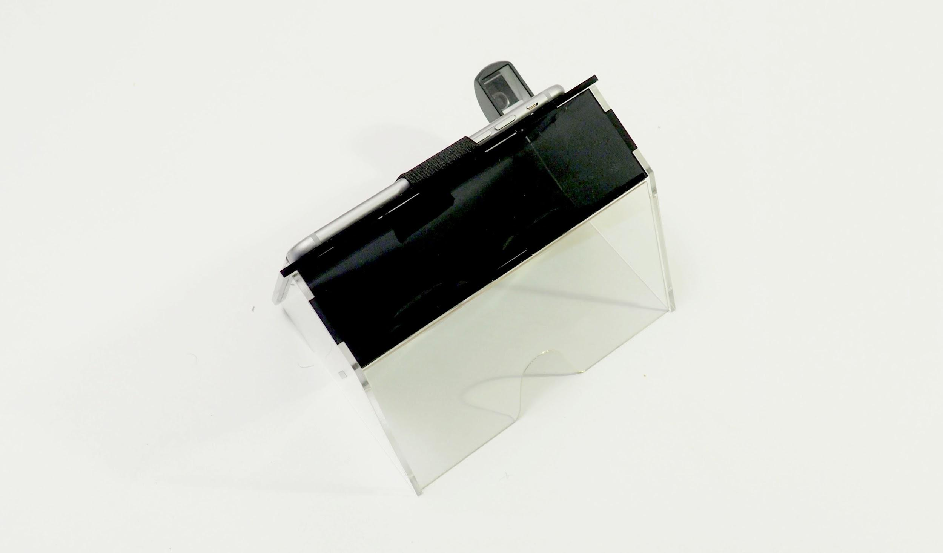
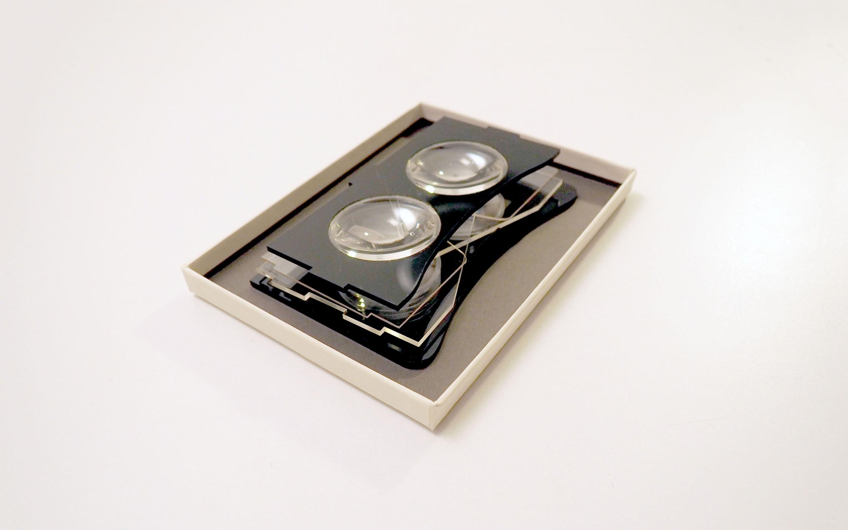
Glasses Construction
Building off Polylens Schematic
Lenses: Plastic aspheric lens, 49.80mm FL, 51.00mm diameter
May change lenses to improve FOV.
source: www.polylens.io

Slide 10
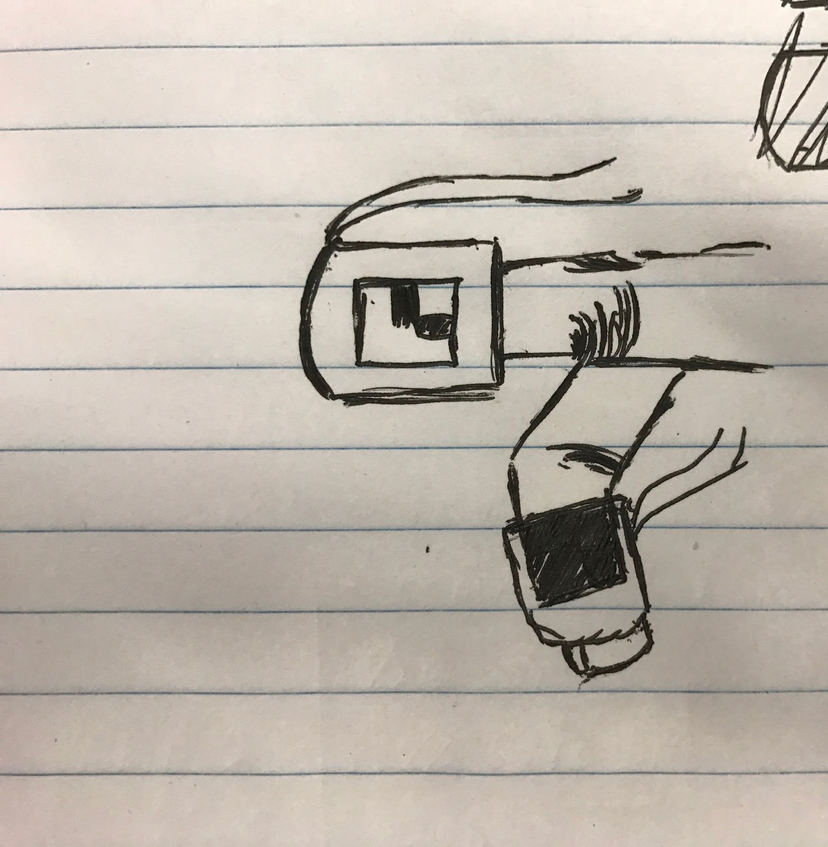
Finger Sleeves Construction
Aruco Markers on Index Finger Sleeve.
Capacitive Button on Middle Finger Sleeve.
Linear Resonant Actuators on the Two Sleeves.
  Located at tip of index finger and on one side of the middle finger sleeve.

Slide 11
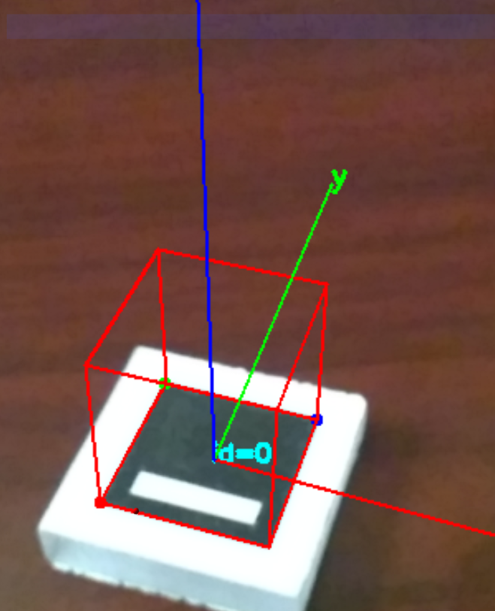
Finger Sleeves - ArUco Markers
ArUco Markers are generated and put on the finger sleeve
There is an OpenCV library that can use these to track location and orientation.
With these on 4 locations around the finger, the direction and location can be determined - this will help the user interact with the virtual objects.
source: https://paradigmshiftright.files.wordpress.com/2014/12/wp_ss_20140522_0001.png

Slide 12
Virtual User Interface Design - Demo 1
Movable Object Demo:
  Virtual Objects like cubes, spheres, or other everyday objects
  User will be allowed to grab and move these virtual objects and place them wherever in space using a button.
  When picking up, placing, or hovering over objects, user will be provided feedback from the haptic motors.
  This feature can help in fields like architecture, interior design, or even health care - anything where visualizing things in space can be beneficial.

Slide 13
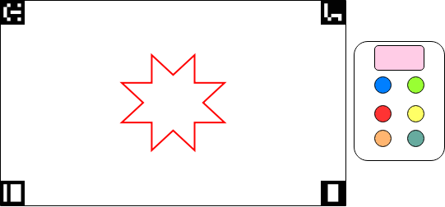
Virtual User Interface Design - Demo 2

Slide 14
Potential Issues
Dealing with physics for virtual objects
  Objects falling
Calibrating the finger sleeve with glasses
  Pointing and calculating correct angles
Getting images and screens to project onto a wall?
  A screen might be bigger than
“Remembering” where drawings are in a view
  Turning your head and turning back - will your drawings still be there?

Slide 15
Division of Work

Slide 16
Schedule - Major Deadlines
Oral Presentation - Jan 19
Start Building/Ordering - Jan 24 (Pending approval)
Capstone Design Expo - April 25
Project and Website Demonstration - Before May 4

Slide 17
Work Breakdown Structure
Planning: All
Glasses Construction: Abraham Kancherla, Varun Nambiar
Finger Sleeve: Adwait Lele, Samir Vedantham
Development of Paint Demo: Adwait Lele, Varun Nambiar
Development of Objects Demo: Abraham Kancherla, Samir Vedantham
Debugging: All
Testing: All
Medical Device Demo for Capstone: All
Presentations: All
Communications: Adwait Lele
Website Management: Samir Vedantham

Slide 18
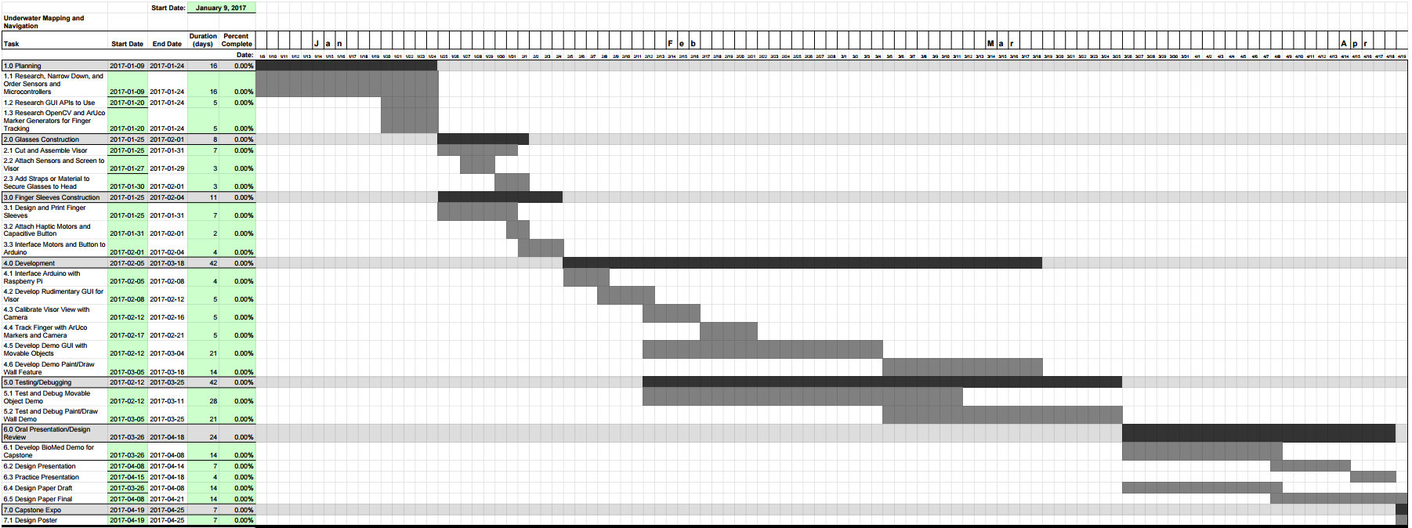
Gantt Chart

Slide 19
Questions?

Slide 20
Citations
-- mostly for images--
http://www.roadtovr.com/2-vr-gloves-promising-haptic-feedback-2-different-approaches/
http://muro.ucsd.edu/Localization/localization.html
http://www.tomshardware.com/news/meta-2-augmented-reality-glasses,31314.html
http://projects.mbientlab.com/metawear-and-coin-vibrating-motor/

