Slide 1
MedCap Project Proposal
Matthew Allen
Michael Balourdas
Nicole Barcori
Miheer Bavare
Tyler Nguyen
Raj Patel
Notes:
Raj

Slide 2
Motivation
Everyone who spends long periods of time in the sun is at risk for heat illness, especially those who are extremely active
Every person has a different tolerance for heat, based on a wide variety of factors
Estimated 9,000 heat illnesses in high school athletes annually leading to death and disability
Notes:
Michael
3rd Point is reason for our target audience

Slide 3
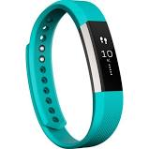
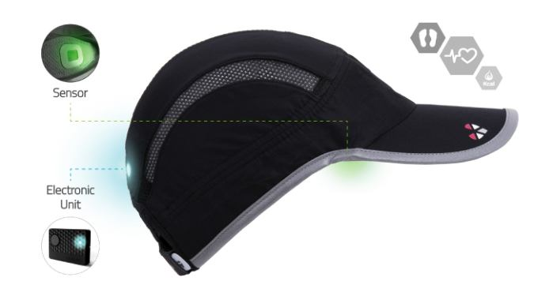
Existing Products
The wearable technology market is rapidly advancing and expanding (Fitbit, Apple Watch, etc.)
LightBEAM SmartHat: Fitness data only
No product extracts meaningful data from dynamic PPG processing
Notes:
Michael
Photoplethysmogram

Slide 4
Requirements: Shall
Gather body metrics to determine heat illness
Transmit sensor data from microcontroller to smartphone app
Store and process data for immediate and historical trends
Output a red, yellow, or green to indicate user’s stress level
Graphs shall be displayed to track trends in levels of heat stress
Notes:
Miheer

Slide 5
Requirements: Will
Send a text message/alert to directly alert user and user’s followers
Use machine learning to better estimate blood pressure from PPG data
Notes:
Miheer

Slide 6
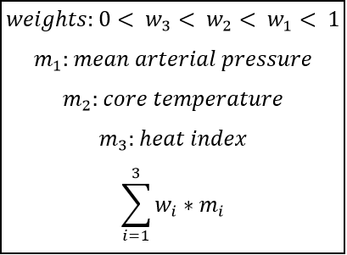
Indication Algorithm
Heat illness determined by three measurements
  Independent
  Weighted
Data stored and analyzed
  Organized for raw and processed
  Processing framework
Analysis based on data over time
  Change in MAP
  Core temperature
  Local heat index
Notes:
Raj

Slide 7
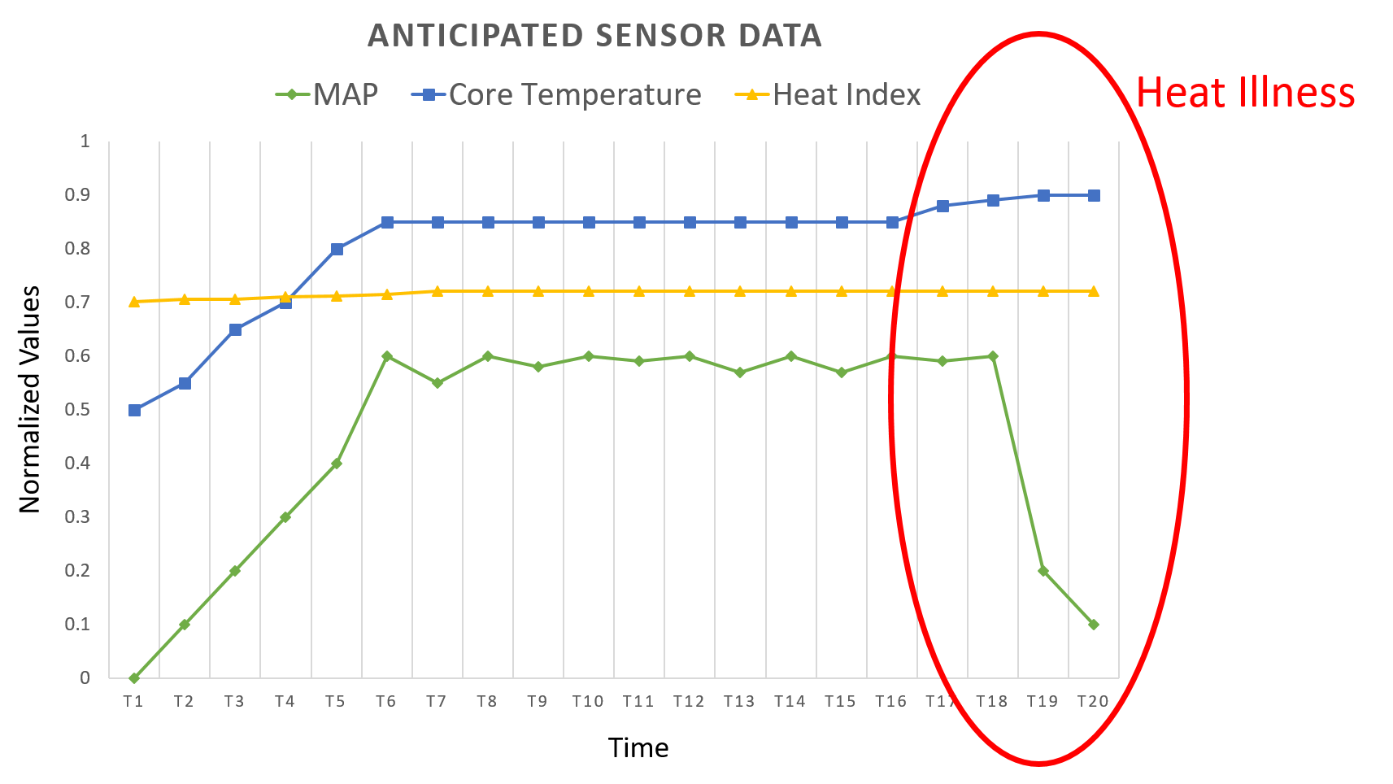
Trends

Slide 8
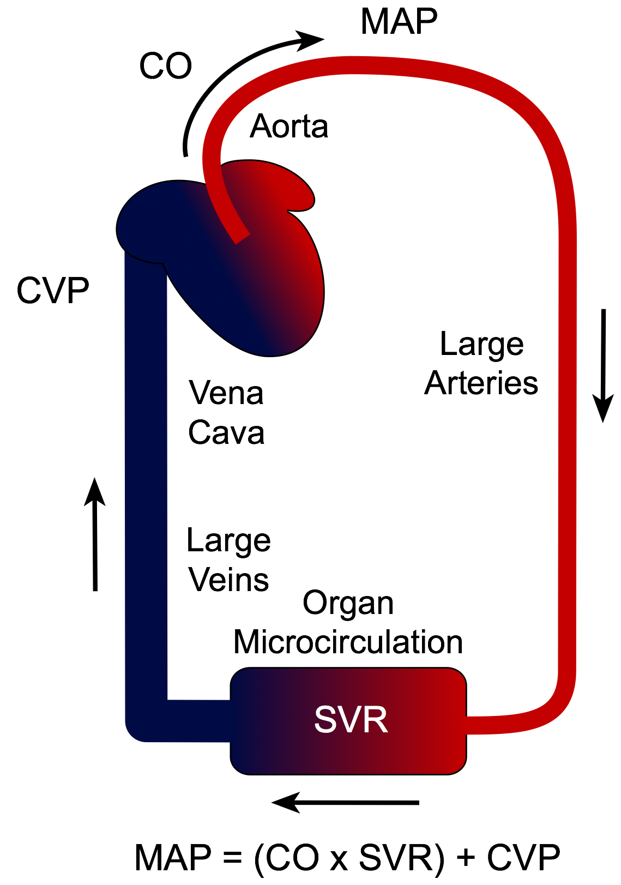
Design Approach: Medical Research
Heat Stress -> Body goes through measurable thermoregulatory response
Clinical Definition of Heat Stroke
  Core temperature of 40°C+
Problem: Core Temperature is not sufficient to solely determine heat illness early
Notes:
Tyler
Body needs to regulate heat to maintain stable core temp.
Physiological parameters related to Heat Stress -> Core Temperature: Rectal is most accurate, Tympanic (ear) least accurate. CO2 output, sweat output (dew point hygrometry) , Arterial Pressure
How the body responds to thermoregulation -> Increasing core temperature and Cardiac Output increases
Clinical Definition of Heat Stroke, 40 C+
As onset of heat exhaustion occurs, Arterial Pressure Curve begins a downward trend
Sawka (Thermoregulatory Response):
https://www.ncbi.nlm.nih.gov/books/NBK236240/
Mayo Clinic (Clinical Definition of Heat Stroke):
http://www.mayoclinic.org/diseases-conditions/heat-stroke/basics/definition/con-20032814

Slide 9
Design Approach: Sensing Data
Solution: Team has focus on the arterial pressure curve
Pulse Point: Temporal Artery
PPG as cardiac output estimator
  Directly maps arterial pressure curve
Core Temperature as secondary cardiac output estimator
Notes:
Tyler
Physiological parameters that can be sensed on the head -> Tympanic, Arterial Pressure. Could use Skin temperature using Venous occlusion plethysmography but not ideal for dynamic setting
PPG as cardiac output estimator -> Sensing trends after reaching peak. Mapping the Arterial Pressure Curve as Cardiac Output increases. Watching for downward trends as onset of heat exhaustion occurs.
Core temperature as secondary cardiac output estimator -> watching for spikes in core temperature, also watching for clinical definition threshold

Slide 10
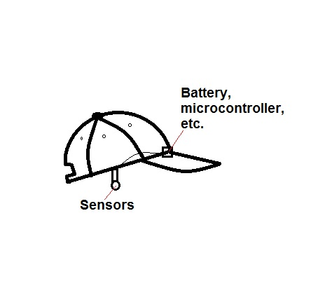
Design Approach: Cap Design
Soft cap
One-size-fits-all
3D-printed earpiece
Notes:
Michael

Slide 11
Design Approach: Power Considerations
Max amperage pull
  PPG sensor: 4.5mA
  Accelerometer: 11uA
  Microprocessor: 10mA
  Thermometer: 27mA
  Total: 41.5mA
2 AAA battery shield for microprocessor outputs 100mA
ON/OFF switch on RFduino battery shield
25mm x 77mm x 22.86mm footprint
540-1200mAh depending on AAA battery type
Safe estimate: 9.1 hr
Fancy batteries est: 20.24 hr
Notes:
Matt

Slide 12


Design Approach: Communication Protocol
Major Tradeoff: Bluetooth vs Zigbee
 | Bluetooth | Zigbee
Transmission Distance | ~100m | ~300m
Occupies WiFi Signal | NO | YES
Occupies Bluetooth Signal | YES | NO
Hardware Available on Smartphones | YES | YES
Notes:
Nicole

Slide 13
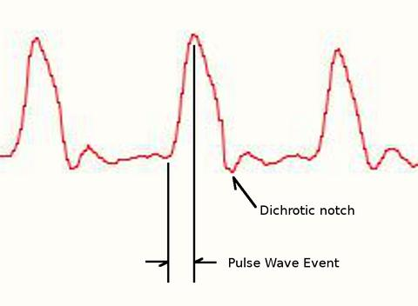
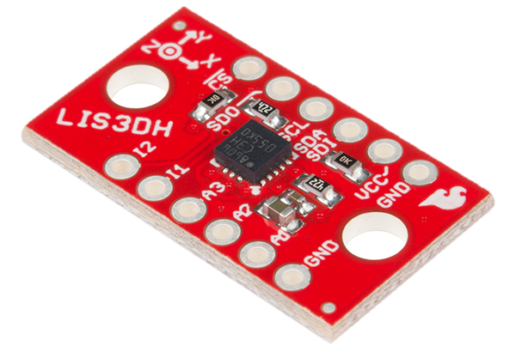
Design Approach: Data Transfer
Program microcontroller to transmit data over Bluetooth
Reduce noisy signal:
  Transmission interval determined by accelerometer
  Active filter within pulse sensor
Notes:
Nicole

Slide 14
Design Approach: Data Processing
Raw data points received by MedCap Mobile Application
  REST API
Input into unprocessed database table
Analytics framework pulls from unprocessed table
  Poll from the last n seconds
  Scan for differences and values
Gather processed data and consolidate time intervals
Input into processed database table
Processed data available to MedCap Mobile Application
Notes:
Raj

Slide 15
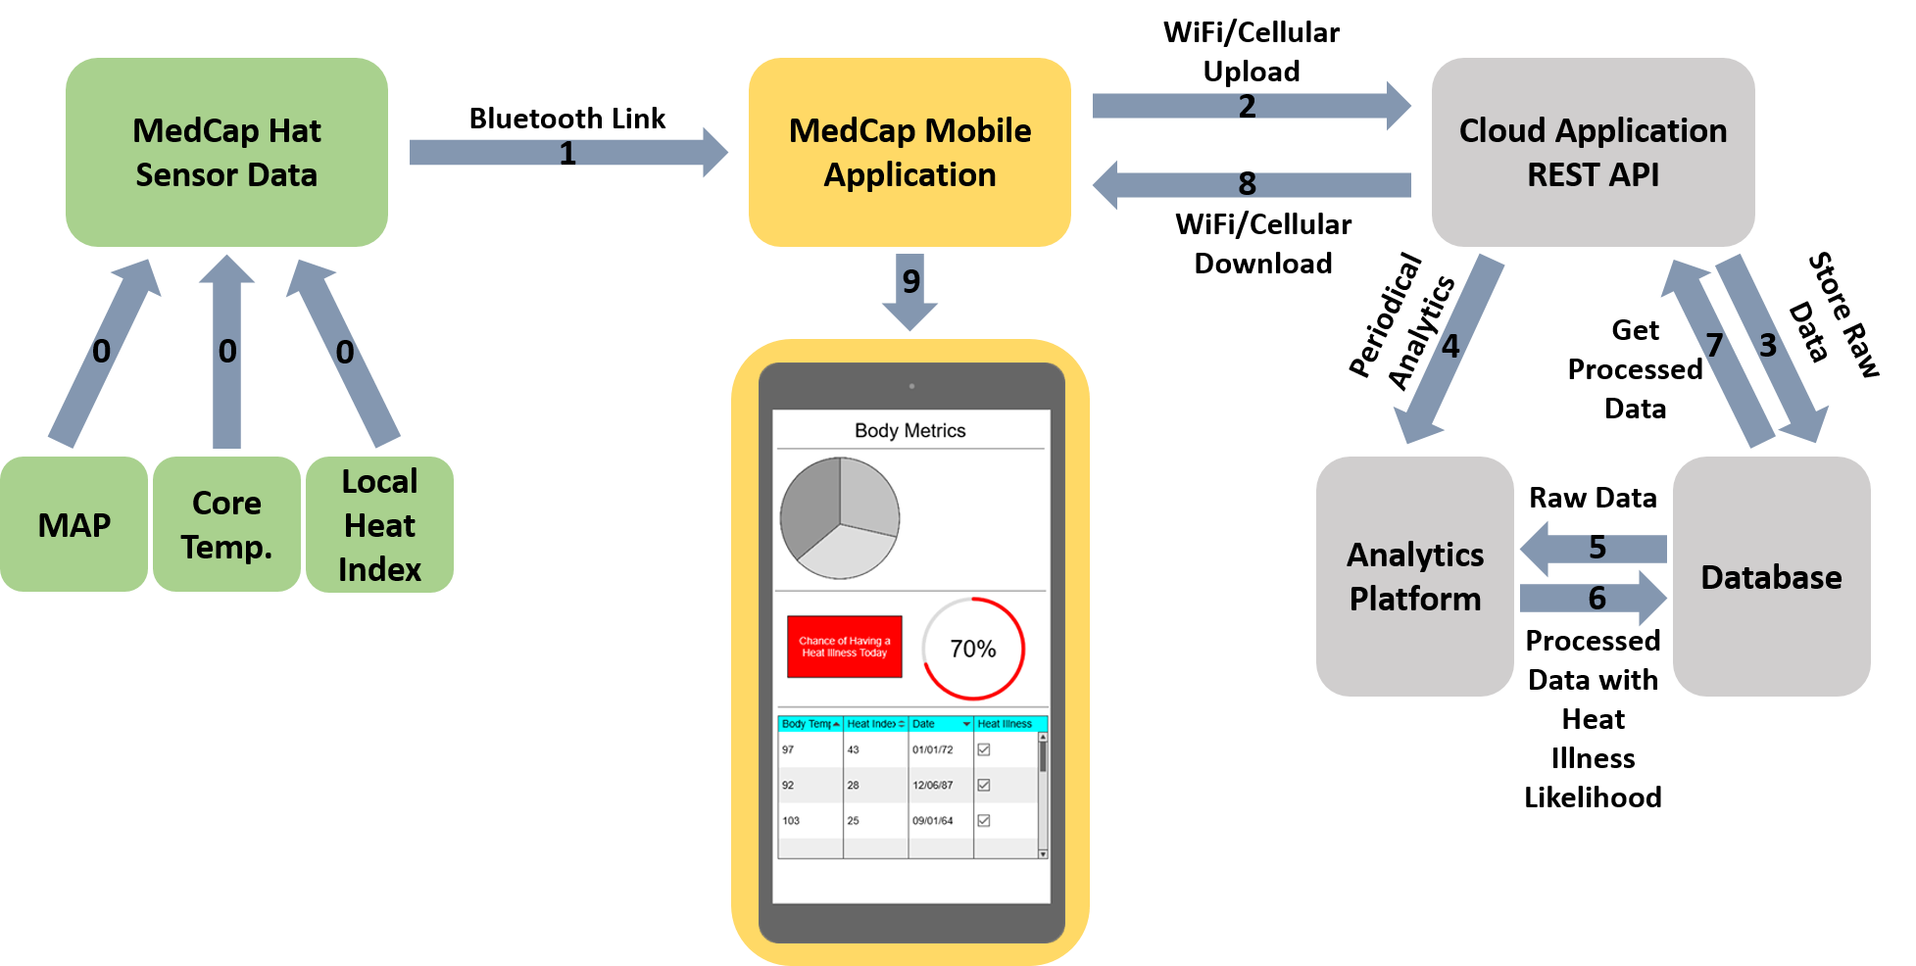
Data Flow and Cloud Architecture

Slide 16
Design Approach: User Interface
React Native
  Reusable components
Open-Sourced Bluetooth Integration Modules
UI/UX will be derived from Fitbit’s mobile application
  Graphs, Tables, and Interactive Flowcharts
  Minimalistic
User Profile
  Facebook and Email Login
  Handle multiple users
Notes:
Miheer
React Native - provides a native app using javascript, can easily adapt it to both android and ios,

Slide 17
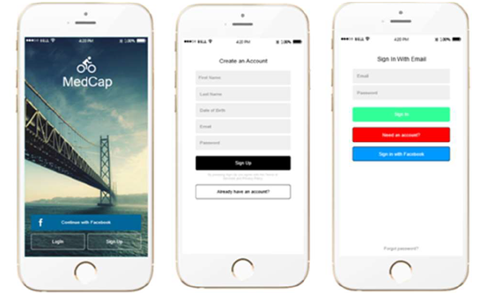
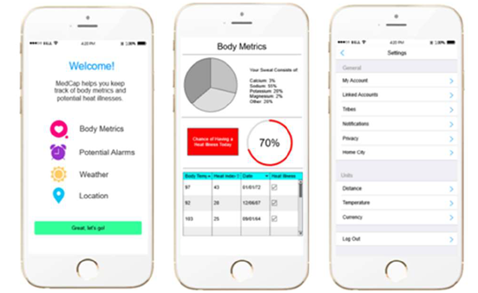
User Interface Flow
Notes:
Miheer

Slide 18
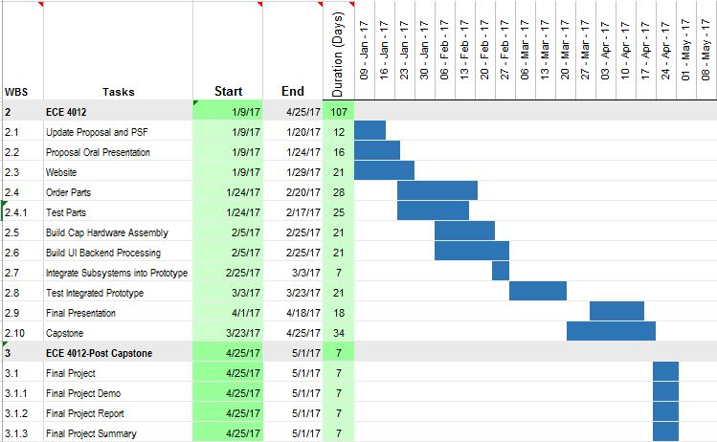
Schedule
Notes:
Nicole

Slide 19
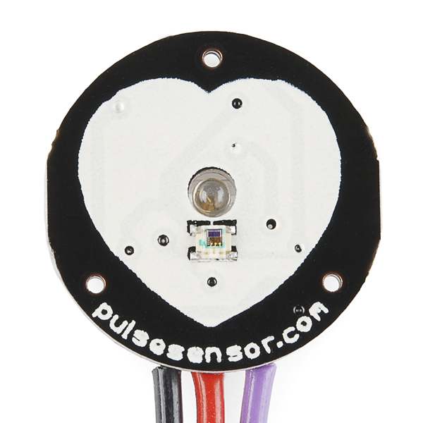
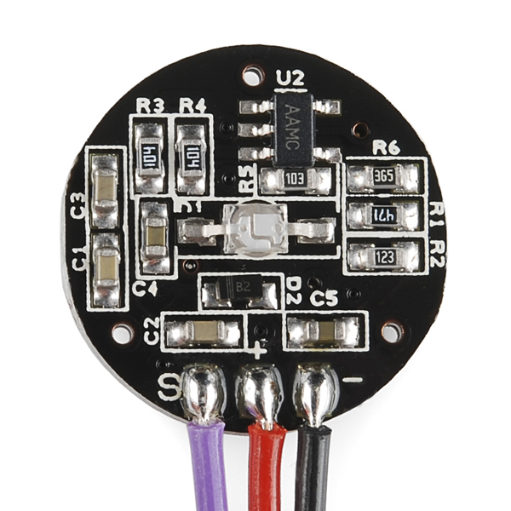
Status
Confirming part choices
System integration
PPG signal noise
  Top of board: sensor
  Bottom of board: everything else
  Allows for placement close to skin
  Noise reducing
  FFT (backend)
Device housing
  Hot Glue
  Spring

Slide 20
Thank You!
Questions?

