Slide 1
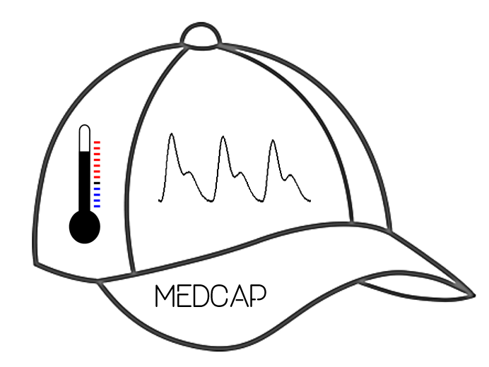
MedCap
Matt Allen
Michael Balourdas
Nicole Barcori
Miheer Bavare
Tyler Nguyen
Raj Patel
Notes:
Raj

Slide 2
Motivation
Everyone who spends long periods of time in the sun is at risk for heat illness, especially those who are extremely active
Every person has a different tolerance for heat, based on a wide variety of factors
Estimated 9,000 heat related events in high school athletes annually leading to death and disability
Notes:
Tyler

Slide 3
Accomplished Requirements: Shall
Gathered body metrics to determine heat illness
Transmitted sensor data from microcontroller to smartphone app
Stored and processed data for immediate and historical trends
Output a red, yellow, or green to indicate user’s stress level
Graphs have been displayed to track trends in levels of heat stress
Notes:
Miheer

Slide 4
Accomplished Requirements: Will
Send a text message/alert to directly alert user and user’s followers
  Alert sent to wearer of the MedCap via an LED in peripheral vision
Use machine learning to better estimate blood pressure from PPG data
Notes:
Miheer

Slide 5
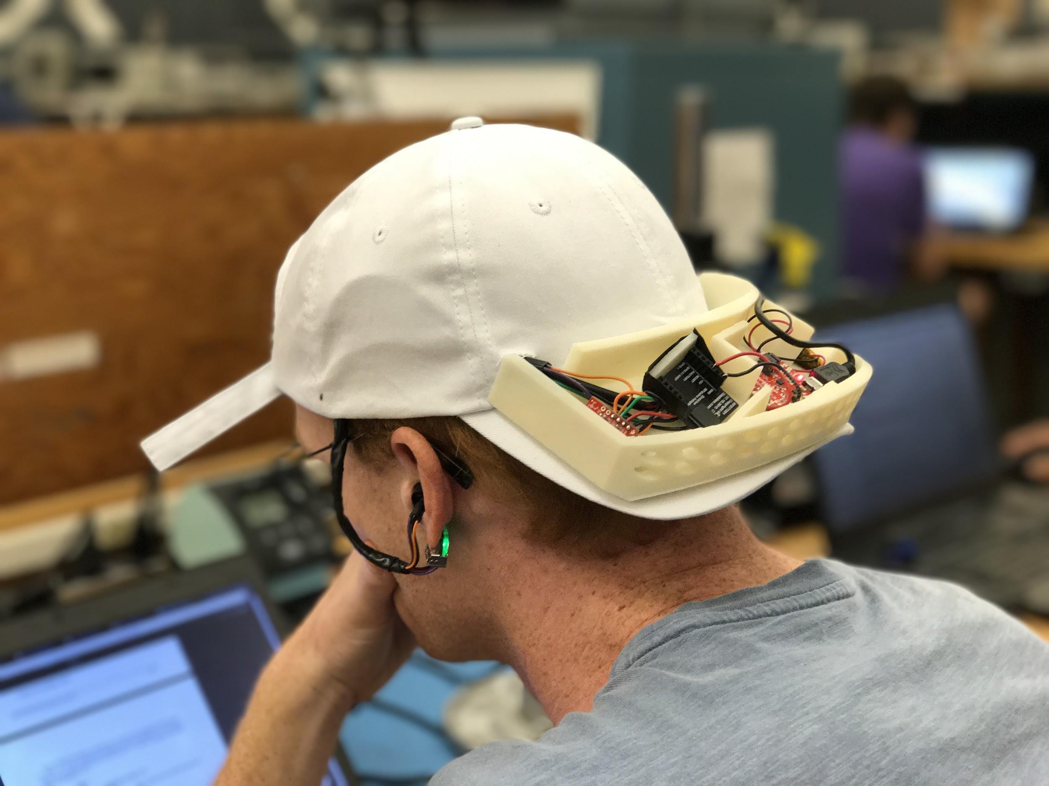
Design Process
Research - Indication and Processing
Cap Design
Selecting/Testing Parts
  Integrating code
  Designing circuitry
Ensuring a secure solution
Transferring data real-time
Storing and analyzing data
Displaying and alerting
Notes:
Matt

Slide 6
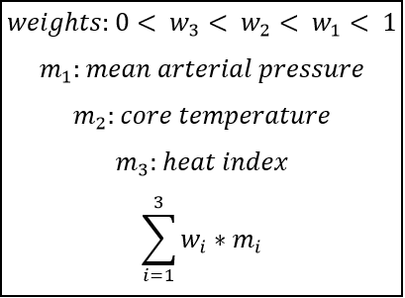
Design Process: Indication Algorithm
Heat illness determined by three measurements
  Independent
  Weighted
Data stored and analyzed
  Organized for raw and processed
  Processing framework
Analysis based on data over time
  Change in MAP
  Core temperature
  Local heat index
Notes:
Raj

Slide 7
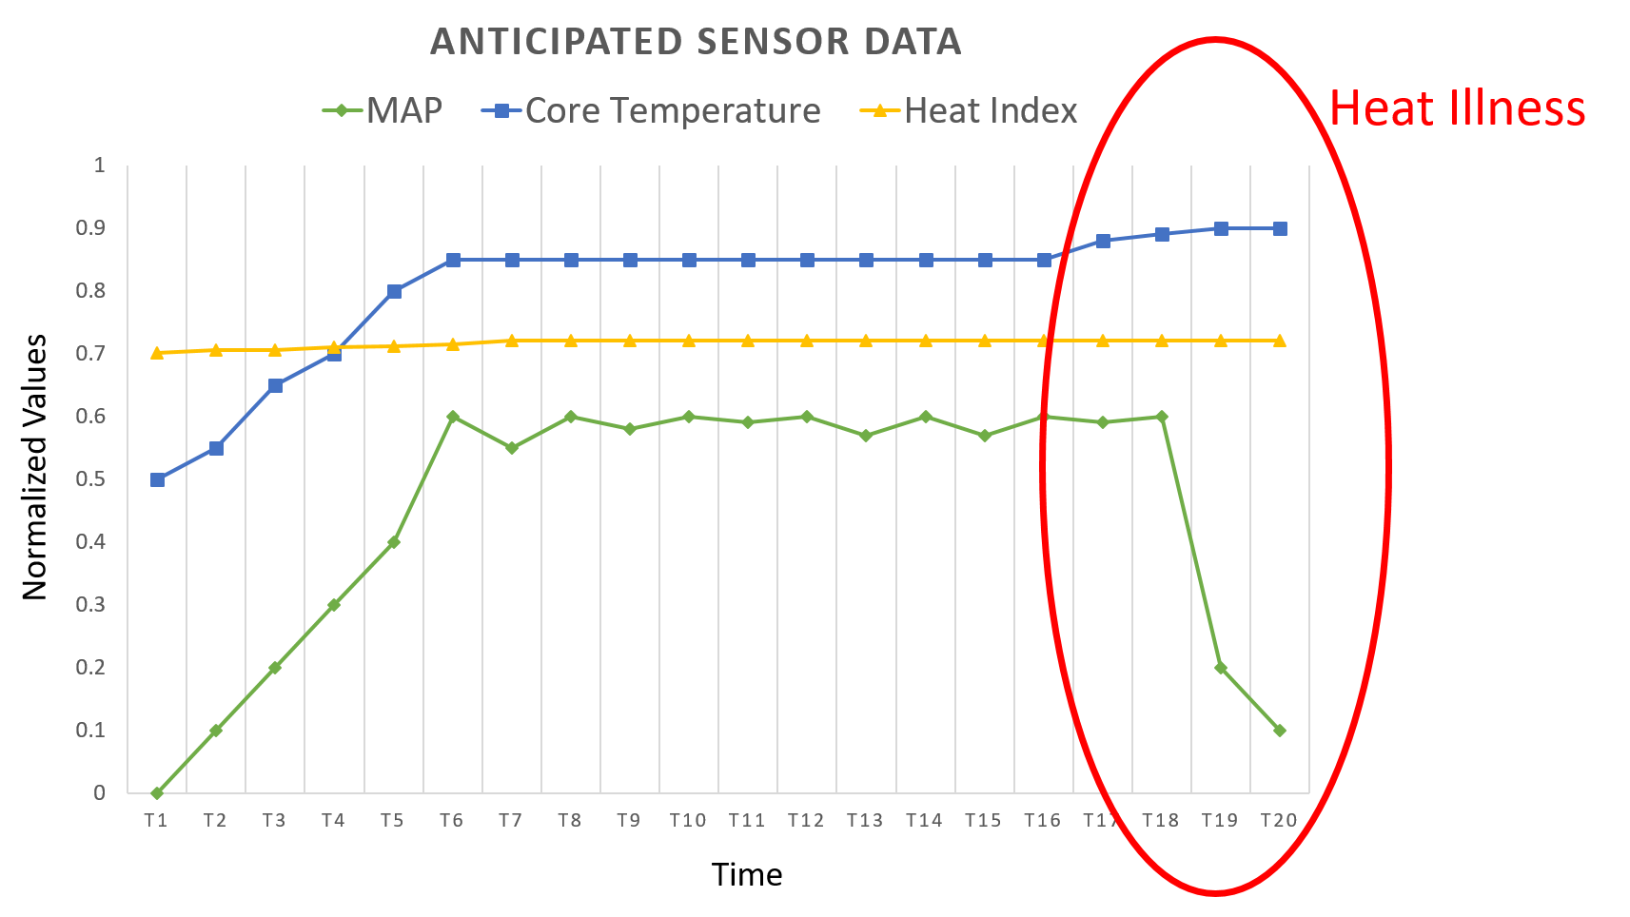
Trends
Notes:
Raj

Slide 8
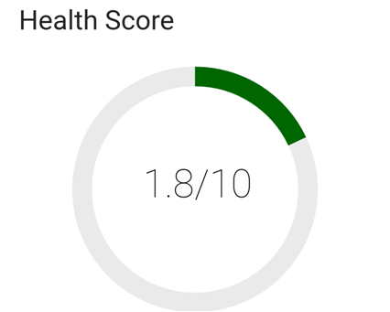
Design Process: Heat Level Score
Heat level ranges from one to ten
Notes:
Raj

Slide 9
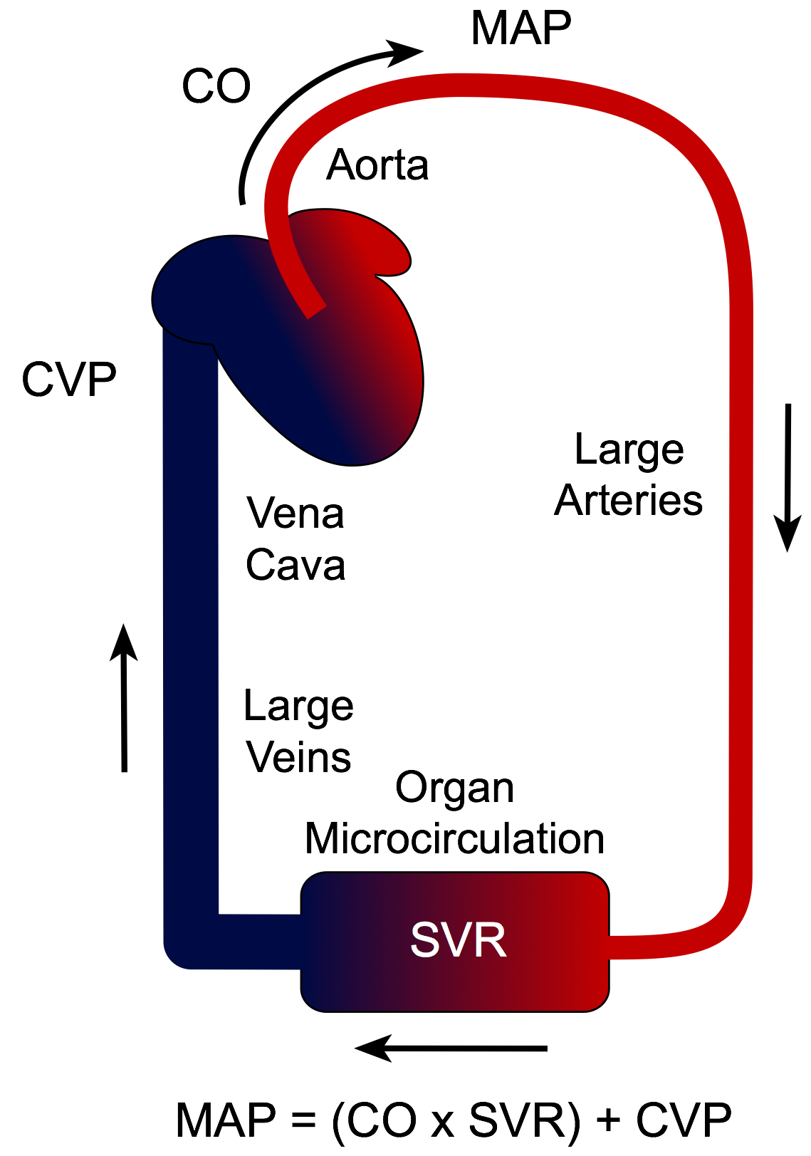
Design Process: Medical Research
Heat Stress -> Body produces excess heat through muscle contractions
Clinical Definition of Heat Stroke
  Core temperature of 40°C+
Thermoregulation through cardiovascular system
Notes:
Tyler
Heat stress student school athletes

Slide 10
Design Process: Sensing Data
Problem: Core Temperature is not sufficient to solely determine heat illness early
Solution: Team focused on Cardiac Output
  Currently done in lab using Co2 or sweat output
PPG to Blood Pressure as cardiac output estimator
  Directly maps arterial pressure curve and thus can be used as cardiac output estimator
We expect to see BP decline over time as body cannot sustain thermo regulation indefinitely
Notes:
Tyler
Physiological parameters that can be sensed on the head -> Tympanic, Arterial Pressure. Could use Skin temperature using Venous occlusion plethysmography but not ideal for dynamic setting
PPG as cardiac output estimator -> Sensing trends after reaching peak. Mapping the Arterial Pressure Curve as Cardiac Output increases. Watching for downward trends as onset of heat exhaustion occurs.
Core temperature as secondary cardiac output estimator -> watching for spikes in core temperature, also watching for clinical definition threshold

Slide 11
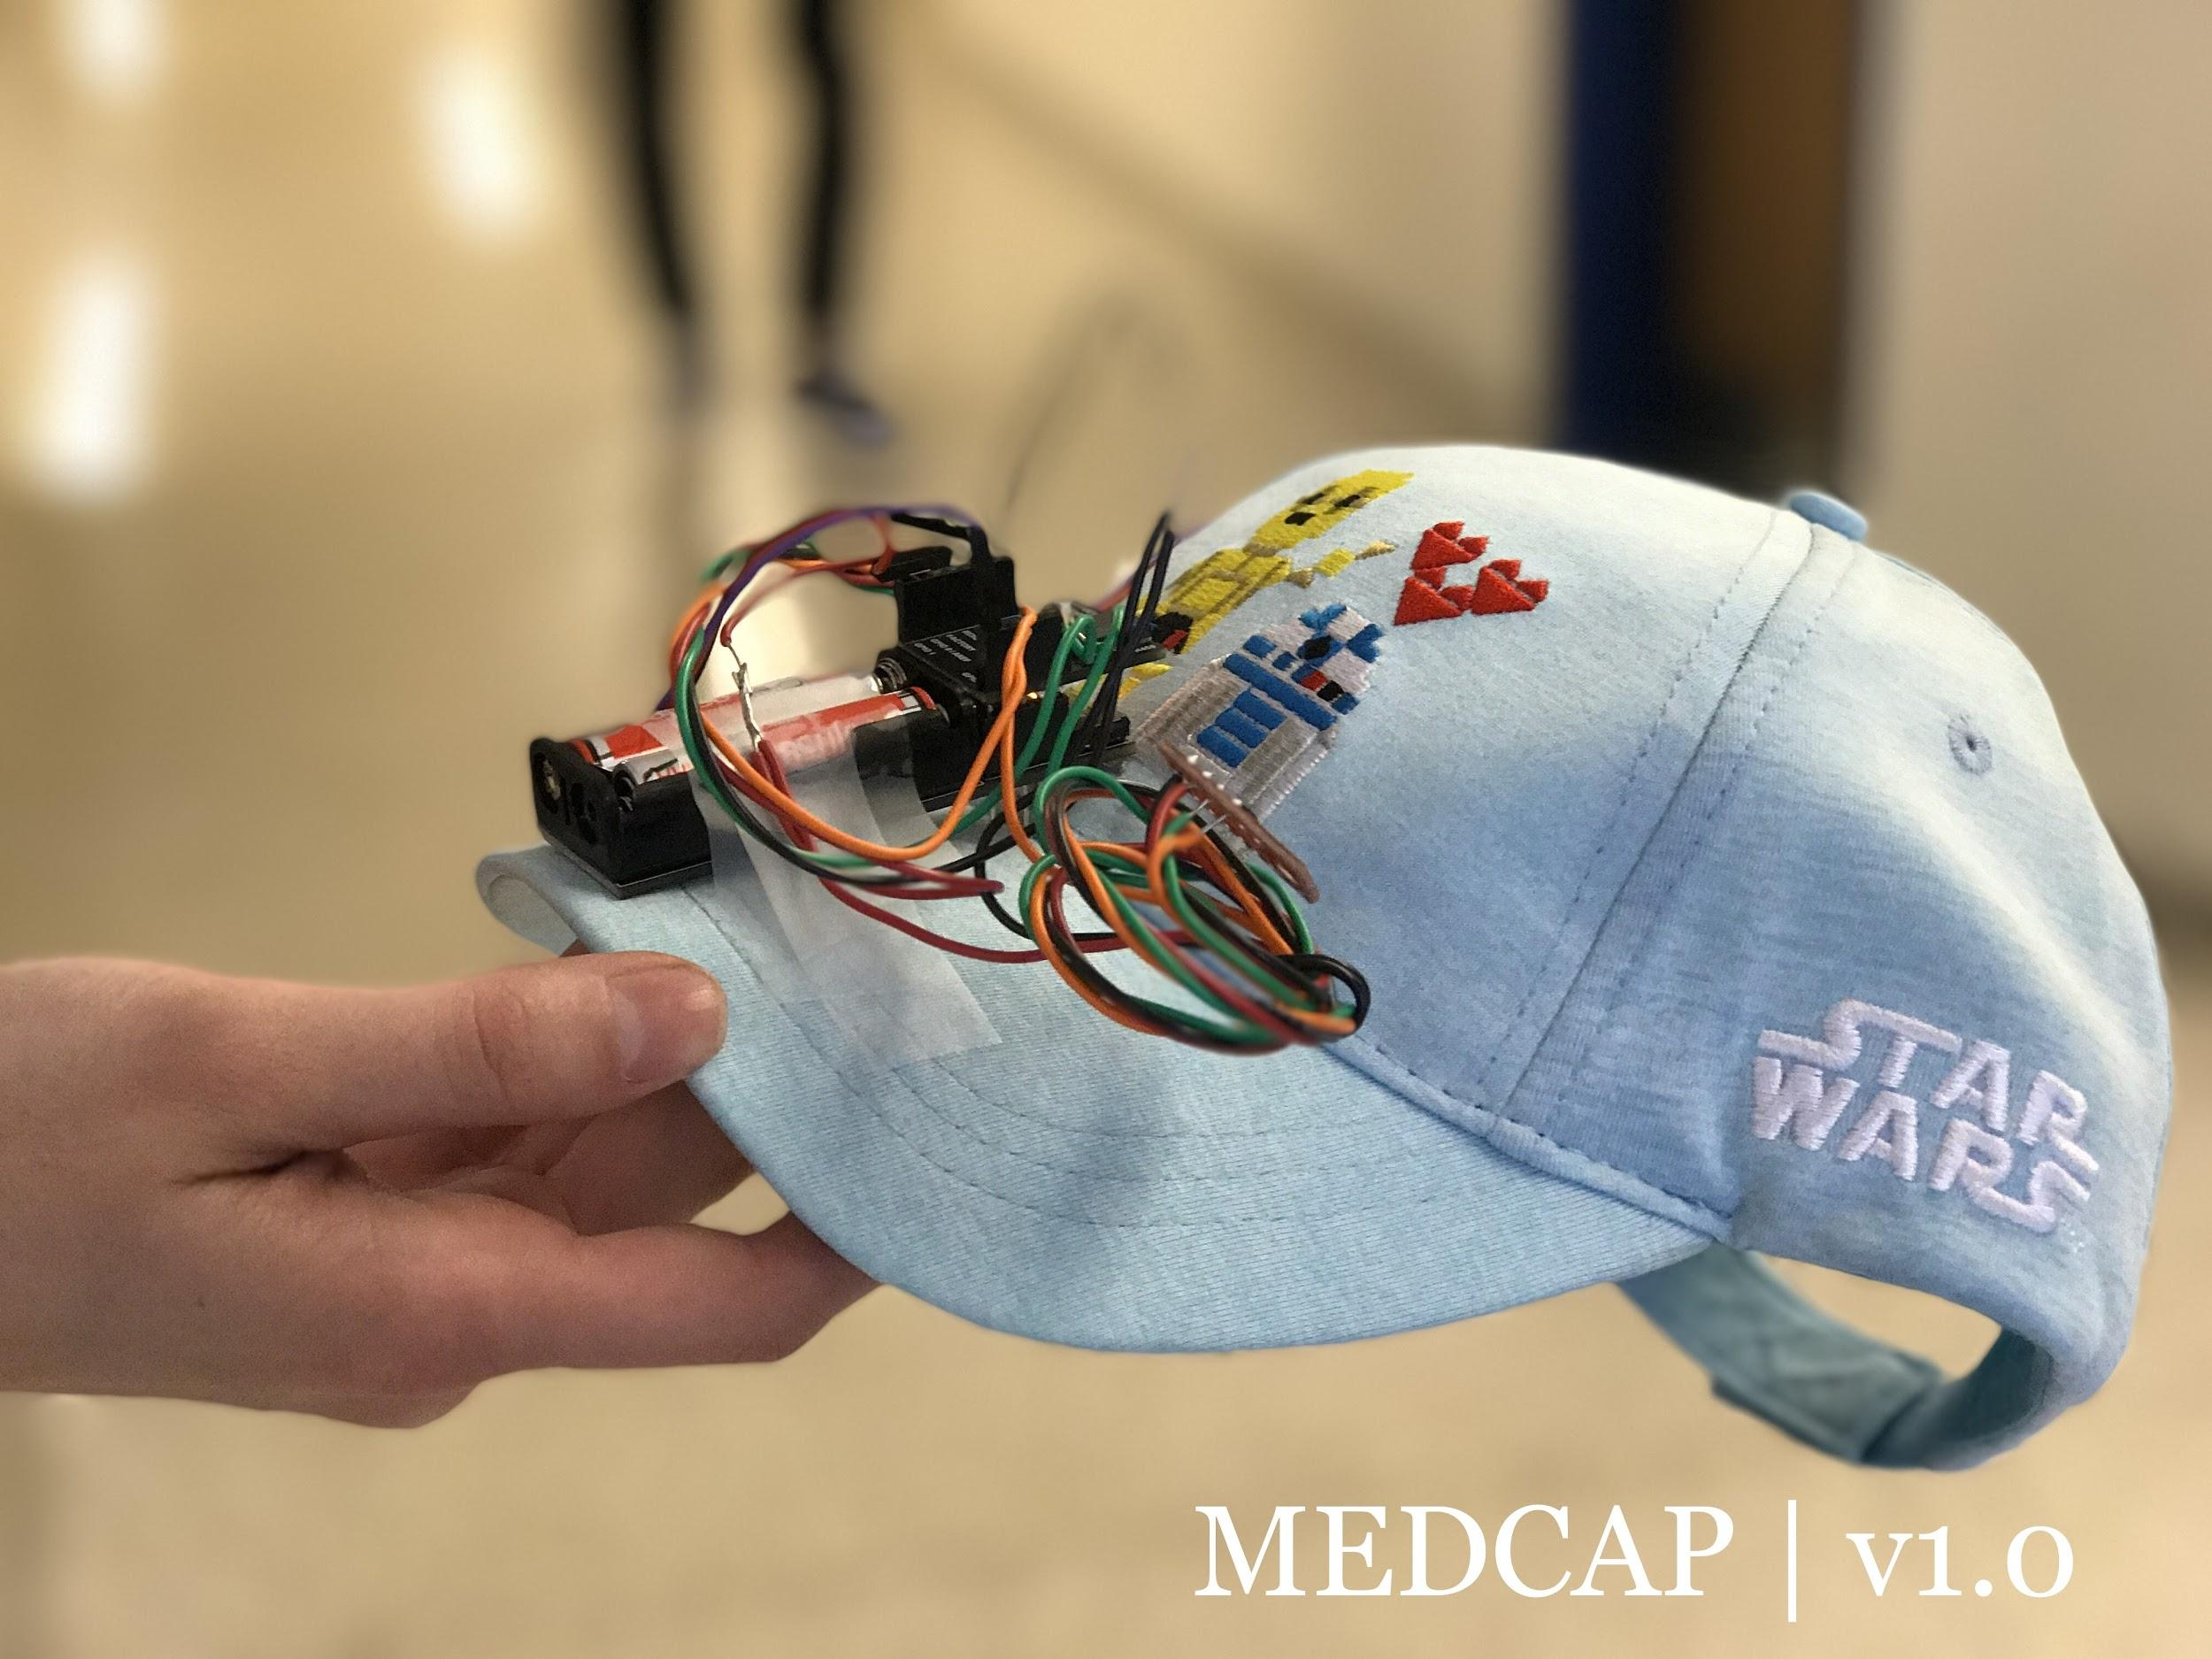
Product Stage - Version 1

Slide 12
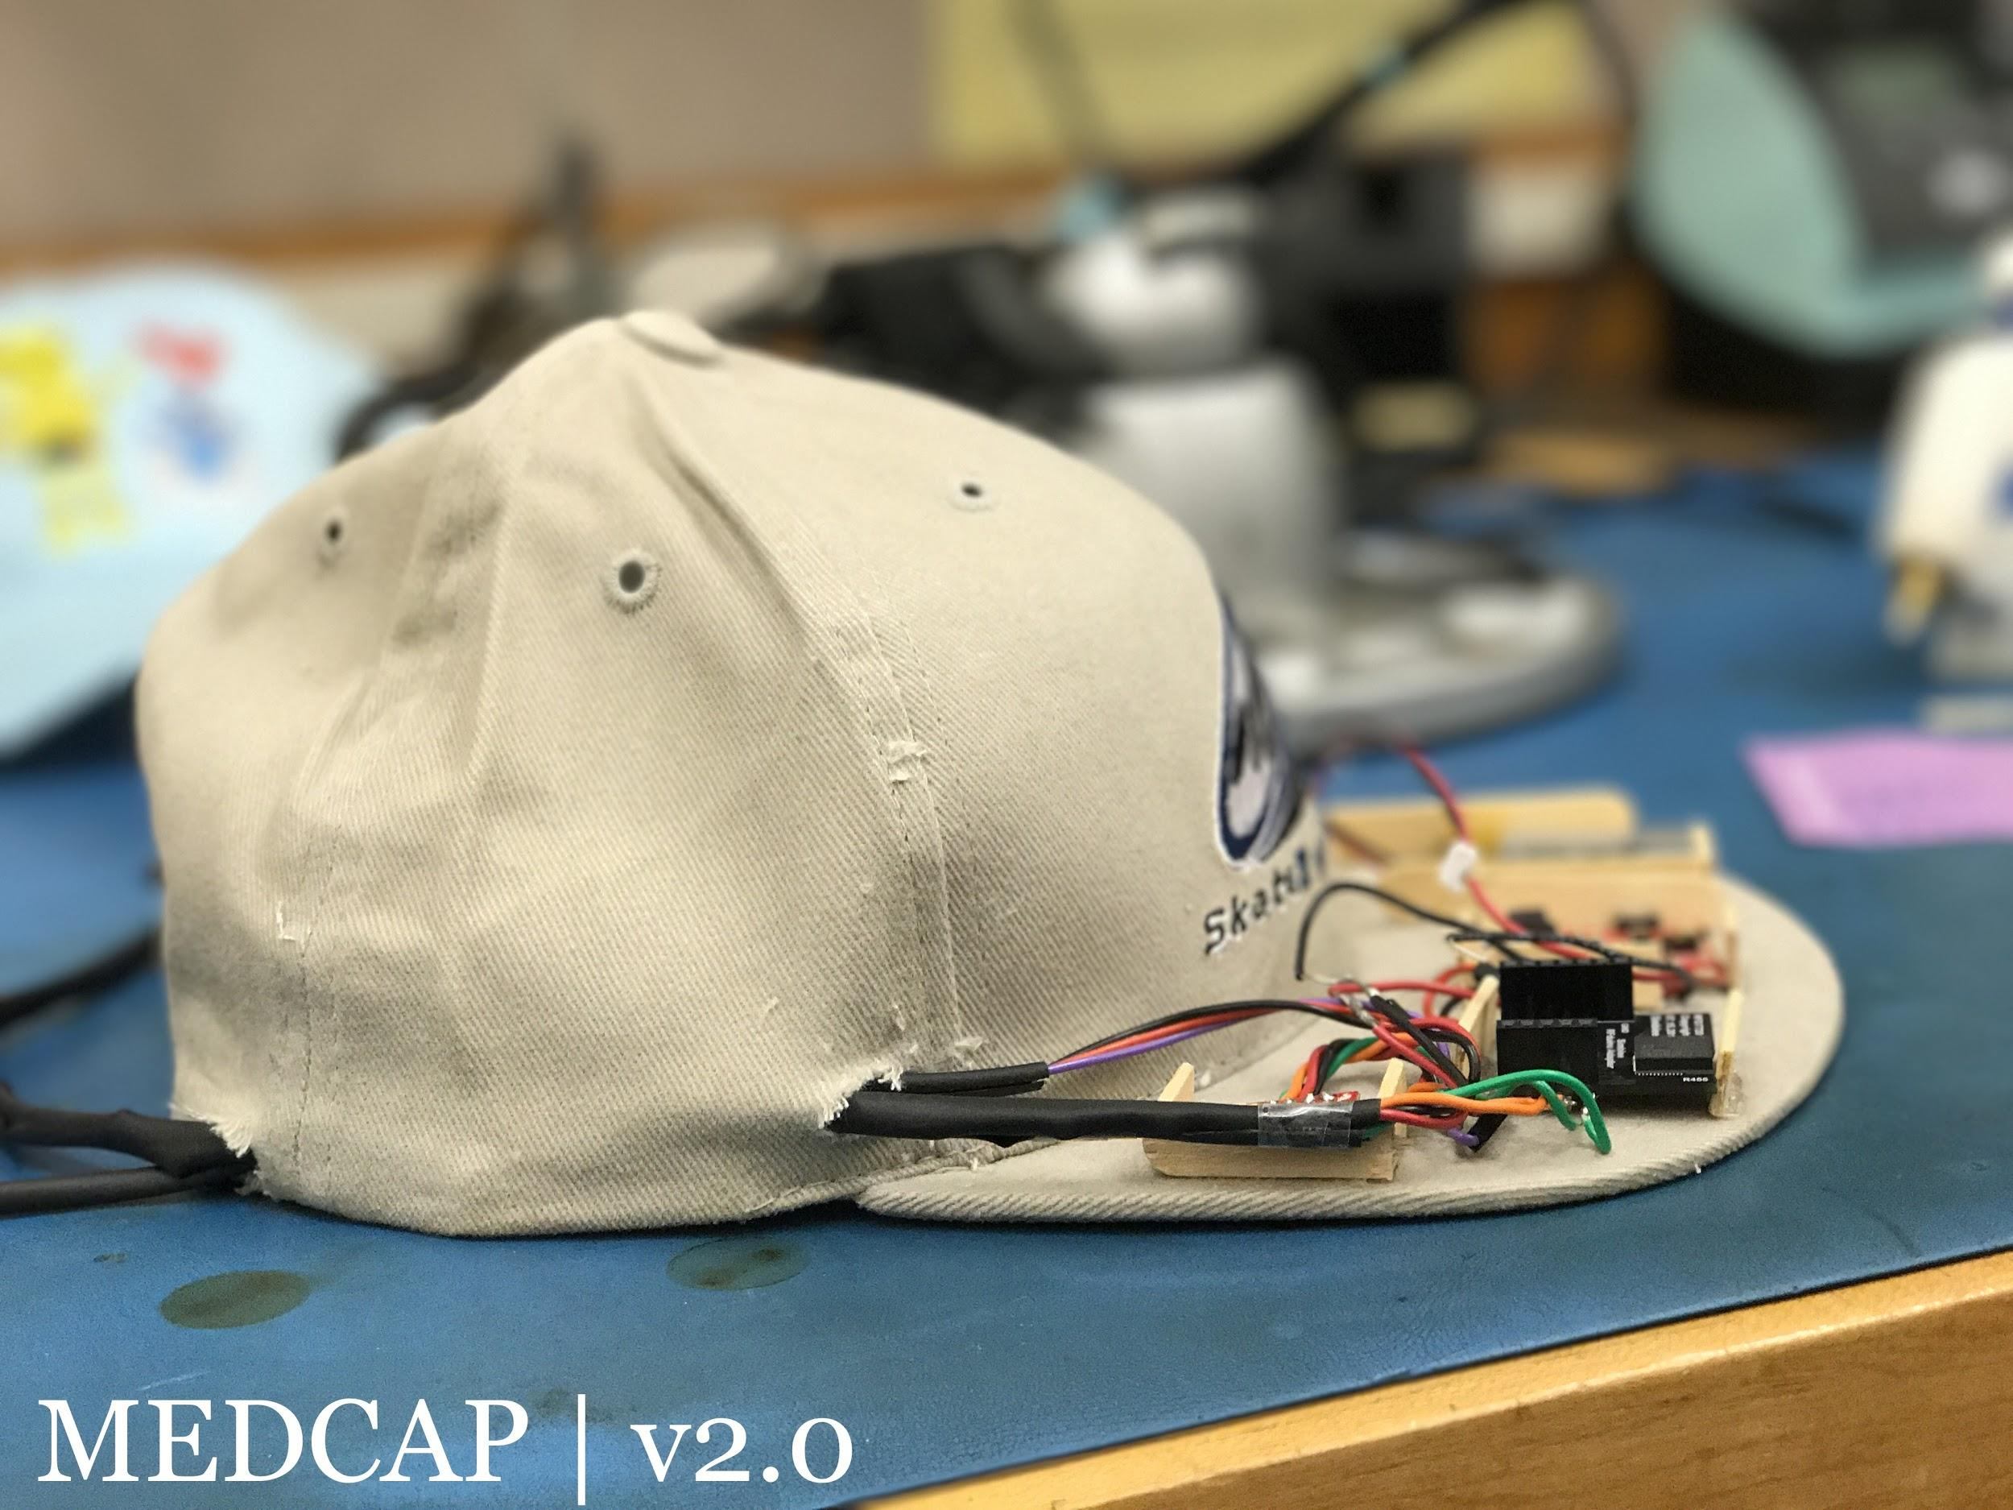
Product Stage - Version 2

Slide 13
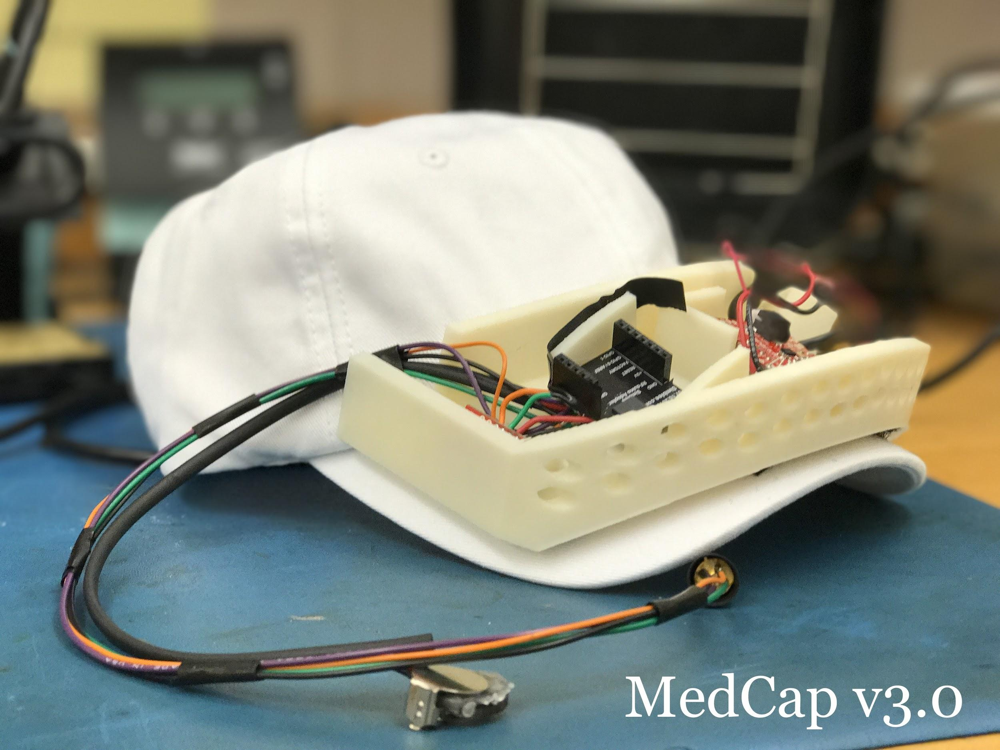
Product Stage - Version 3

Slide 14
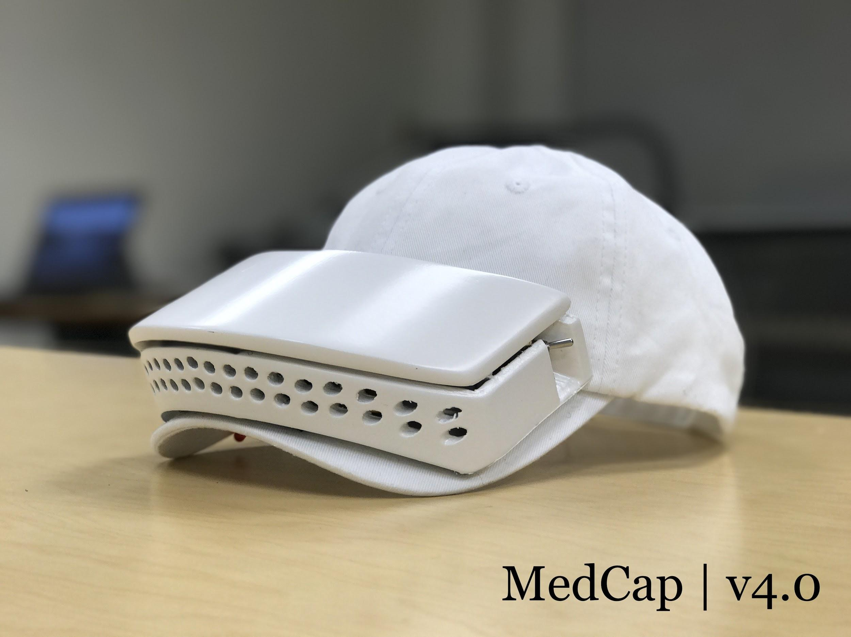
Product Stage - Version 4 (Final)

Slide 15
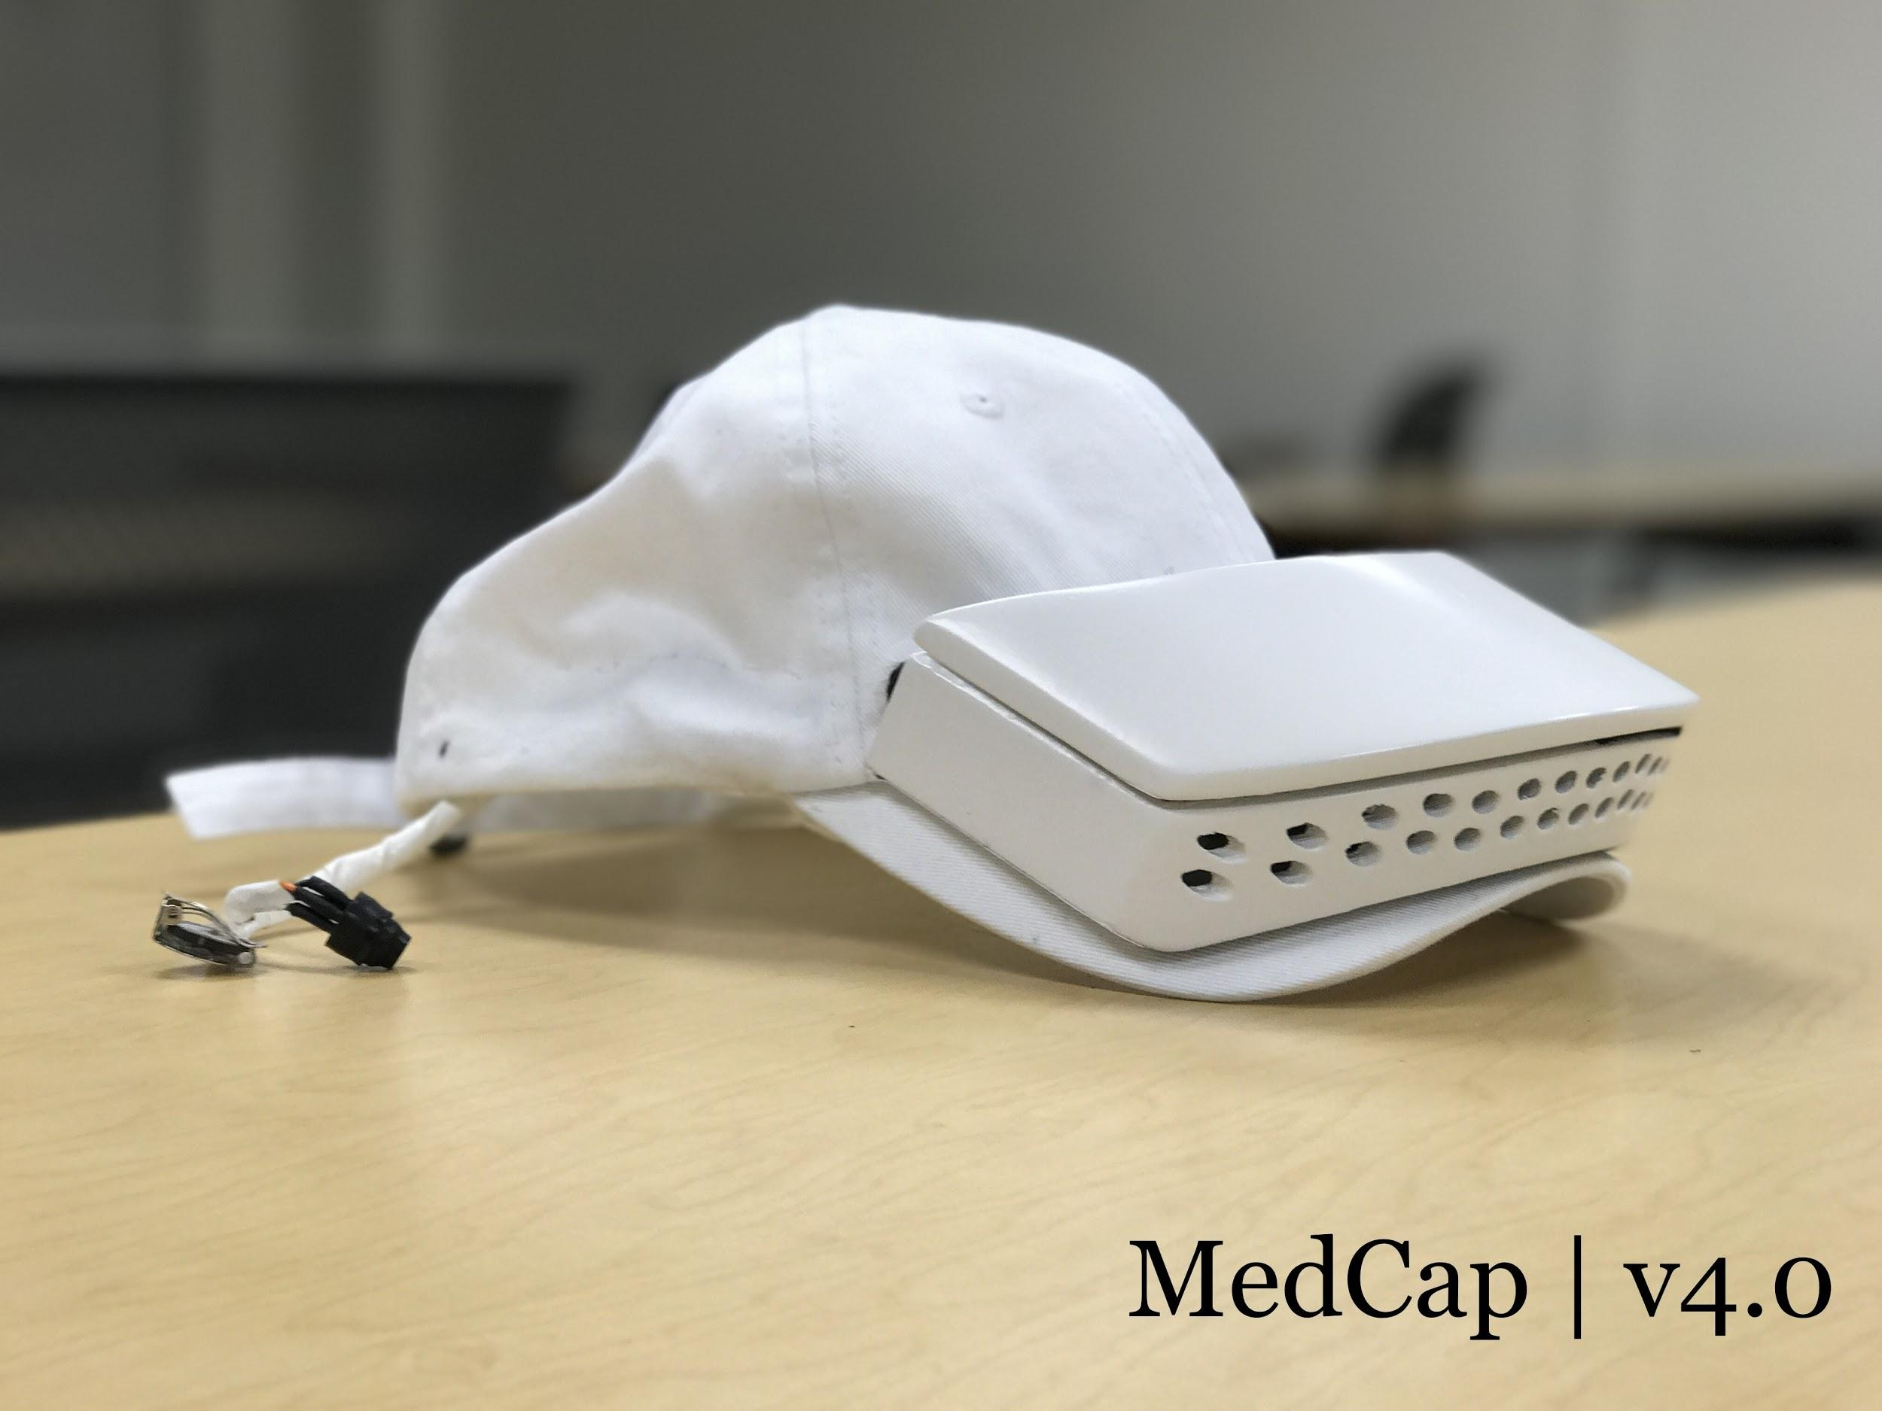
Product Stage - Version 4 (Final)

Slide 16
Design Process: Cap Design
Can be added to any hat with minimal modification
Soft cap compatibility
One-size-fits-all
3-D Printed Enclosure
LED Indicator
Notes:
Michael
All about the physical design of cap
Show CAD and real hat
Highlight features-e.g. Ventilation holes, switch hole, wire hole
Ear piece-headphone thing

Slide 17
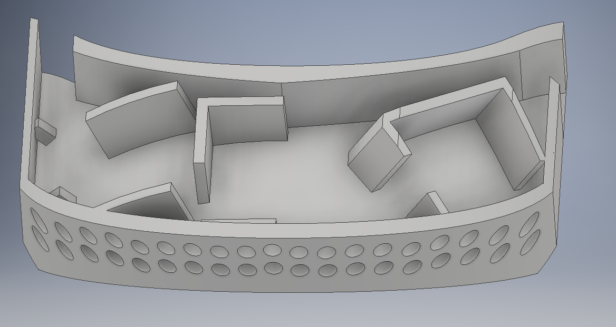
Housing CAD

Slide 18
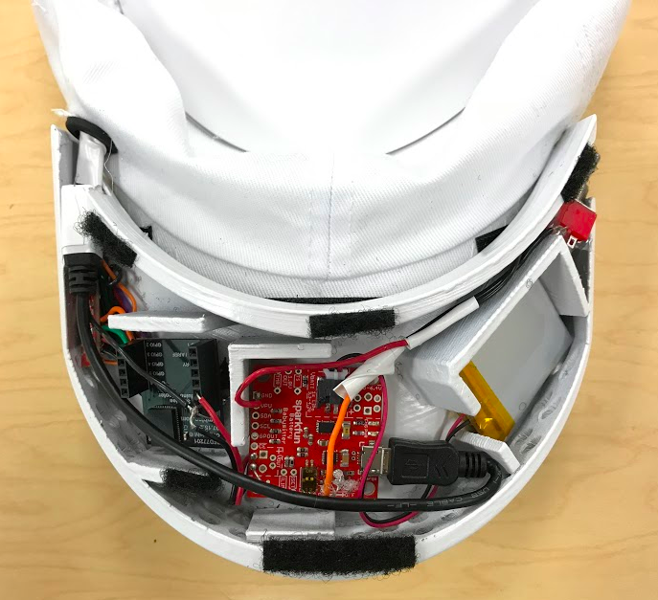
Printed Housing

Slide 19
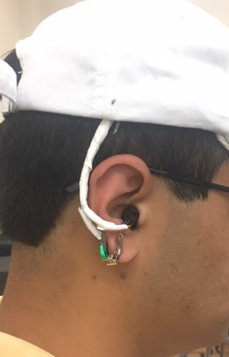
Ear Piece

Slide 20
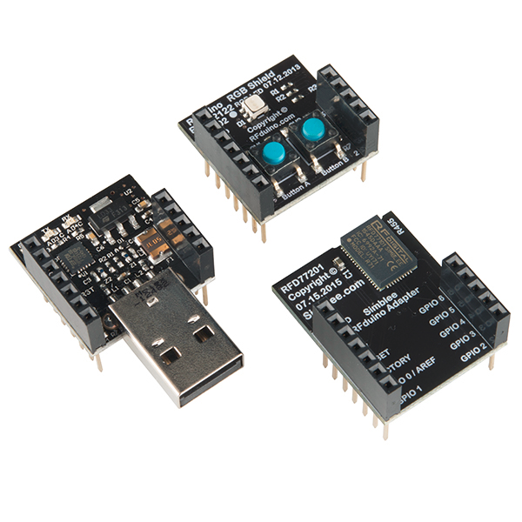
Design Process: Microcontroller
7 configurable GPIO pins
  DI/DO, I2C, etc
I2C capability on all GPIO pins
Removable development module
10-bit analog input capable
Built in BLE antenna w/ ~ 100m range
  2.4-2.48 GHz band
Notes:
Matt
Microcontroller selection and features-# of GPIO, includes BLE antennea
Power consideration-battery life 7.2mA of current
Battery babysitter-how it works (charging, etc)
Switch

Slide 21
Design Process: Battery/ Power
Circuit pulls 7.2mA → fully loaded
Lithium-ion battery powers the circuit
  850mAh
  Rechargeable
  Low profile
Battery Life: ~118 hour battery life (minimum)
ON/OFF switch electrically extended for ease of use

Slide 22
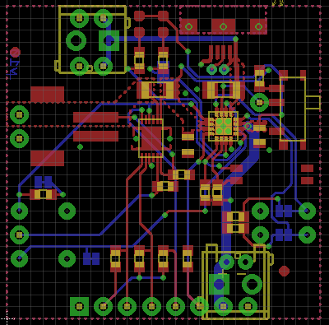
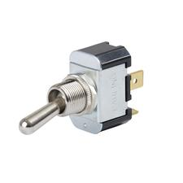
Design Process: Switch extension

Slide 23
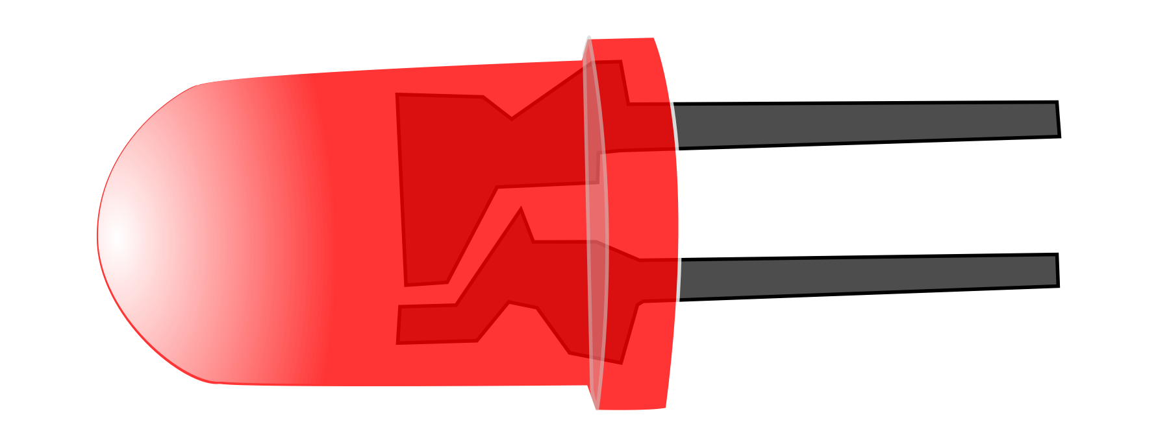
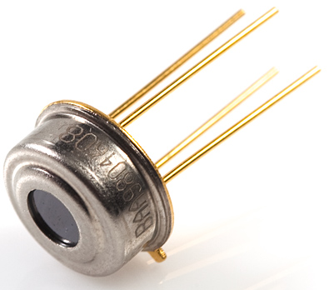
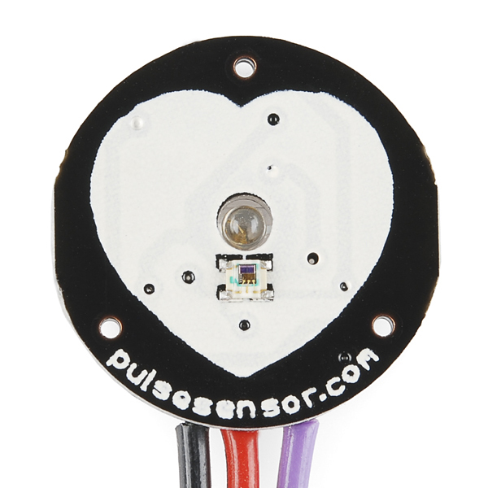
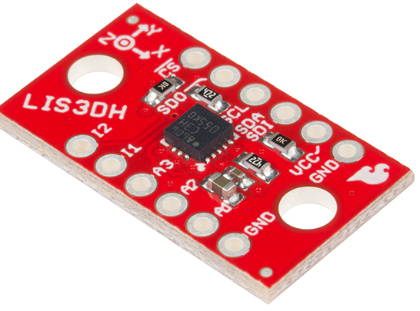
Design Process: Electrical Sensors/Design
Sensor Selection
  I2C Bus and Analog Signal Types
How and Why Do the Sensors Communicate
  Bluetooth Low Energy
Alerting User with Red LED
Notes:
Nicole
Hardware: electrical design
Why we choose these sensors, layout of sensors, signal types
How these sensors communicate over BLE
Wire layout?

Slide 24
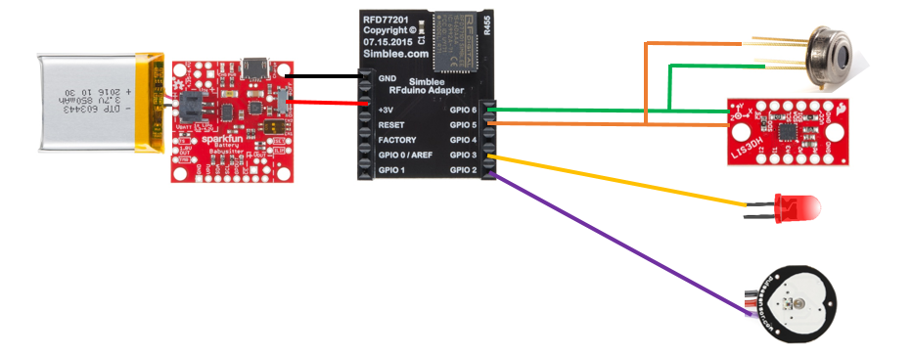
Wiring Diagram
Notes:
Nicole

Slide 25


Building Security into MedCap
Enforced 256-bit encrypted data link between mobile device and cloud
Enforced unique sequence numbered messages
Leveraged HIPAA compliant Amazon Web Services
  EC2 and DynamoDB
Separated SPI (Sensitive Personal Information) from health metrics
  Relationship between SPI and health metrics via user aliasing
Notes:
Raj
Source: http://www.connectria.com/cloud/hipaa_aws.php

Slide 26
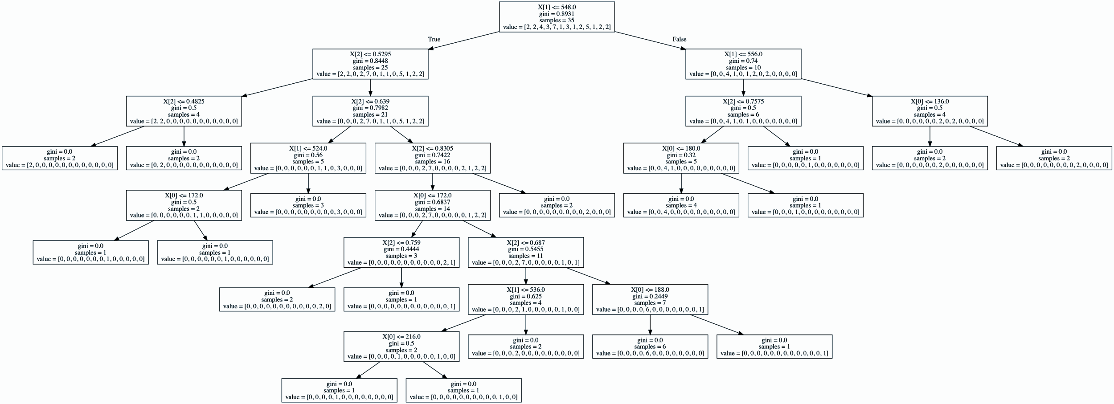
Design Process: Mapping PPG to Diastolic BP
Initially researched linear relationship: 30% accuracy
Progressed to clustered machine learning: 30% accuracy
Finalized on decision tree machine learning: 85% accuracy
Notes:
Raj

Slide 27
Design Process: Data Processing
Raw data points received by MedCap Mobile Application
  REST API
Input into unprocessed database table
Analytics framework pulls from unprocessed data queue
  Poll from the last n seconds
  Scan for differences and values
Gather processed data and consolidate time intervals
Input into processed data queue
Processed data available to MedCap Mobile Application
Notes:
Raj

Slide 28
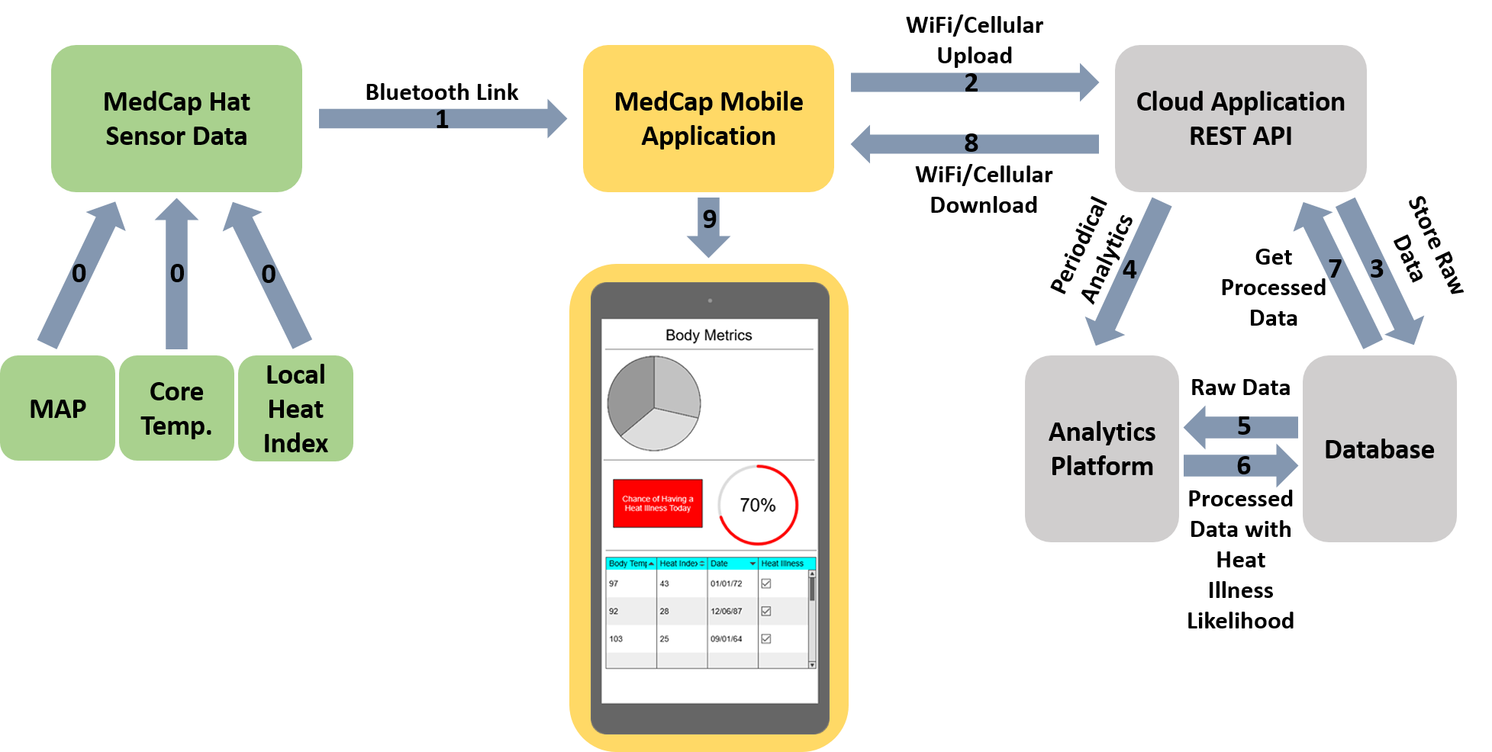
Data Flow and Cloud Architecture
Notes:
Raj

Slide 29
Design Process: User Interface
Ionic
  Reusable components, multiple platforms
Open-Sourced Bluetooth Integration Modules
UI/UX will be derived from Fitbit’s mobile application
  Graphs, Tables, and Interactive Flowcharts
  Minimalistic
User Profile
  Login
  Handle multiple users
Notes:
Miheer

Slide 30



Design Process: Real-Time Data
Every 10 Seconds
Every 10 Seconds
Receive and Send

Slide 31
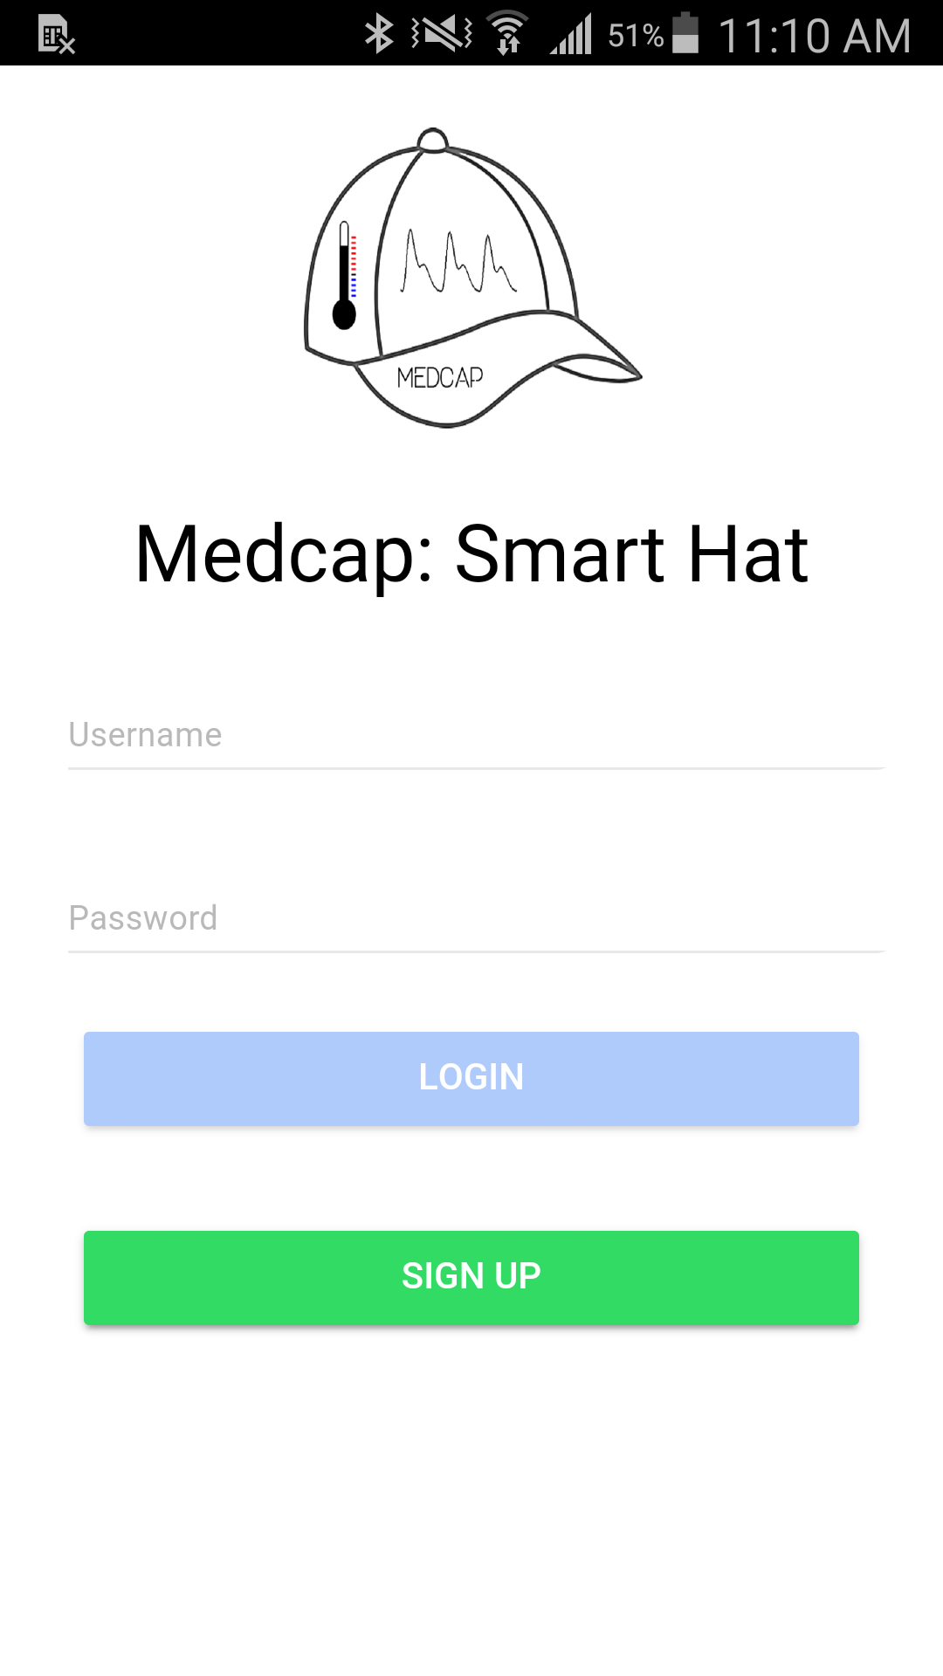
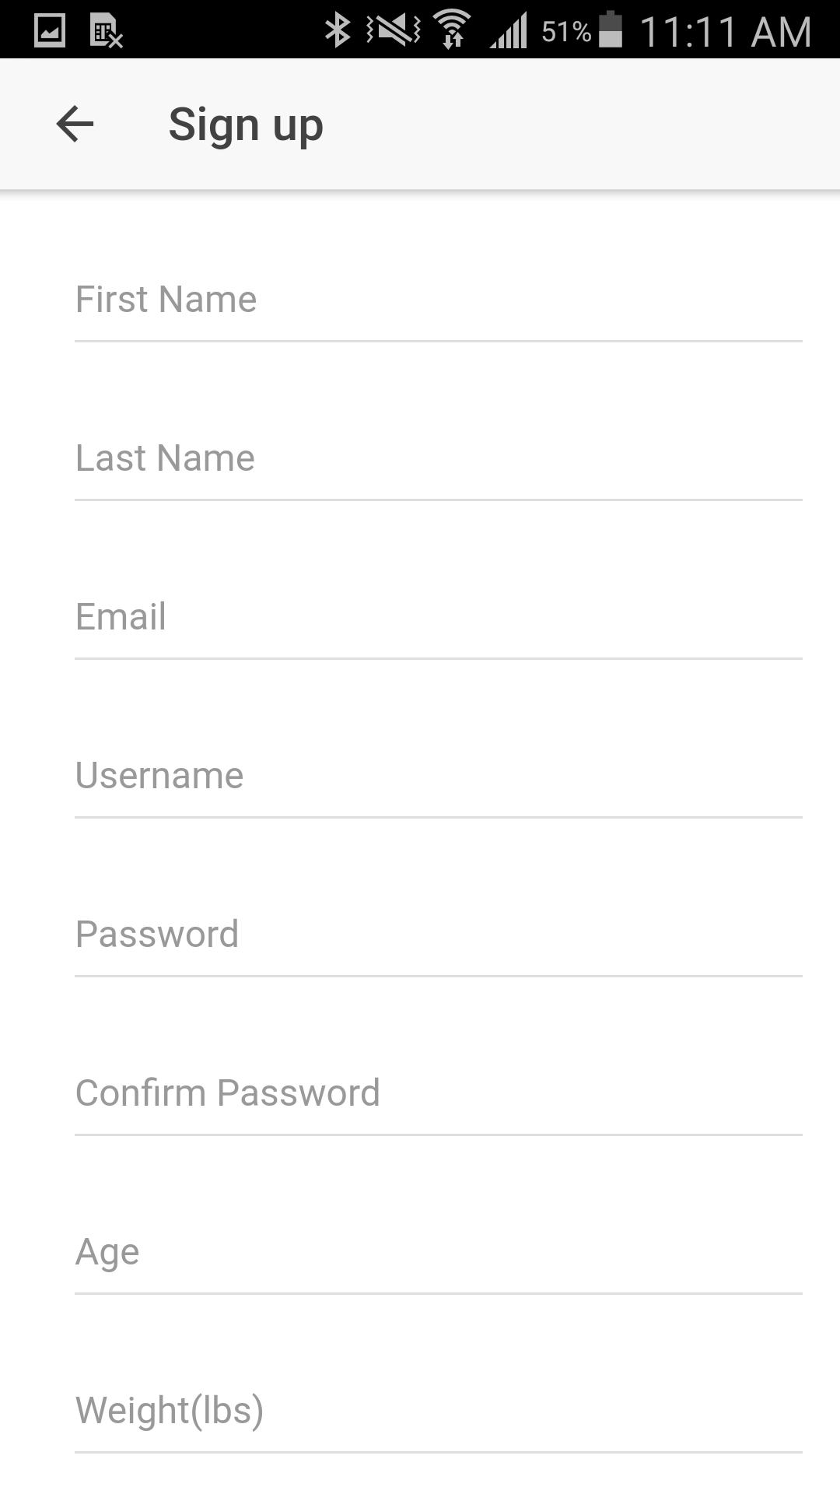
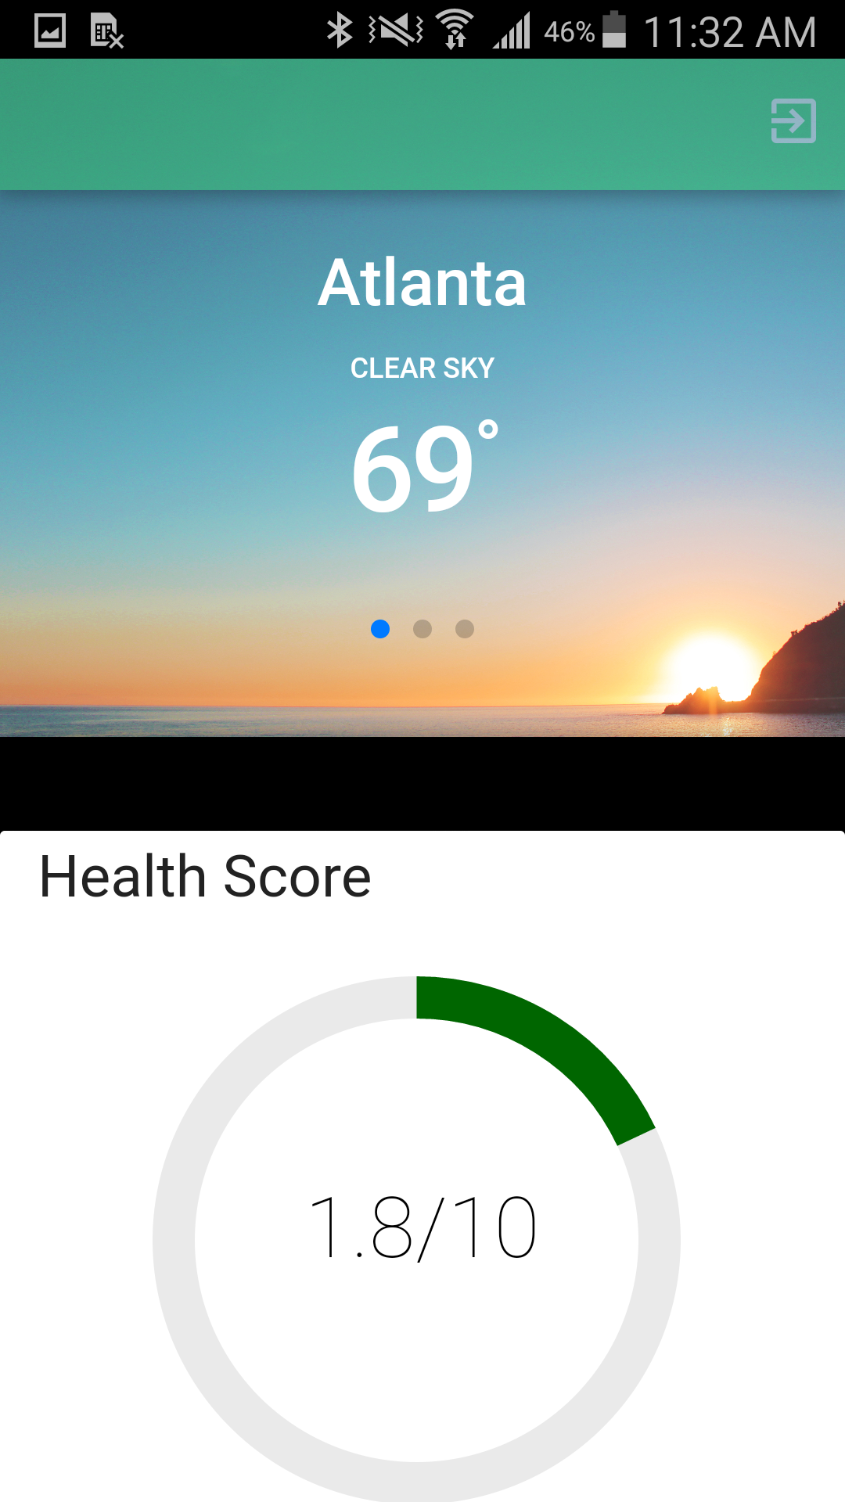
Notes:
Miheer

Slide 32
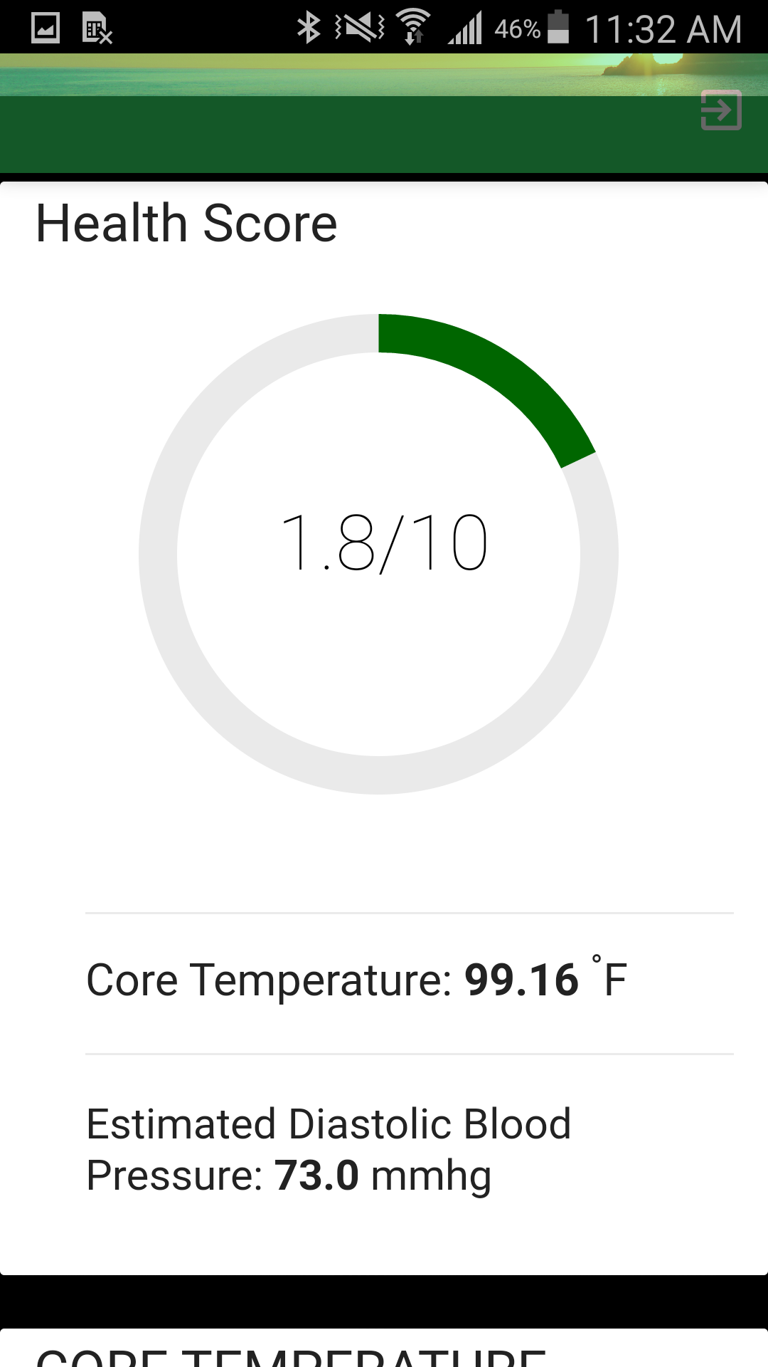
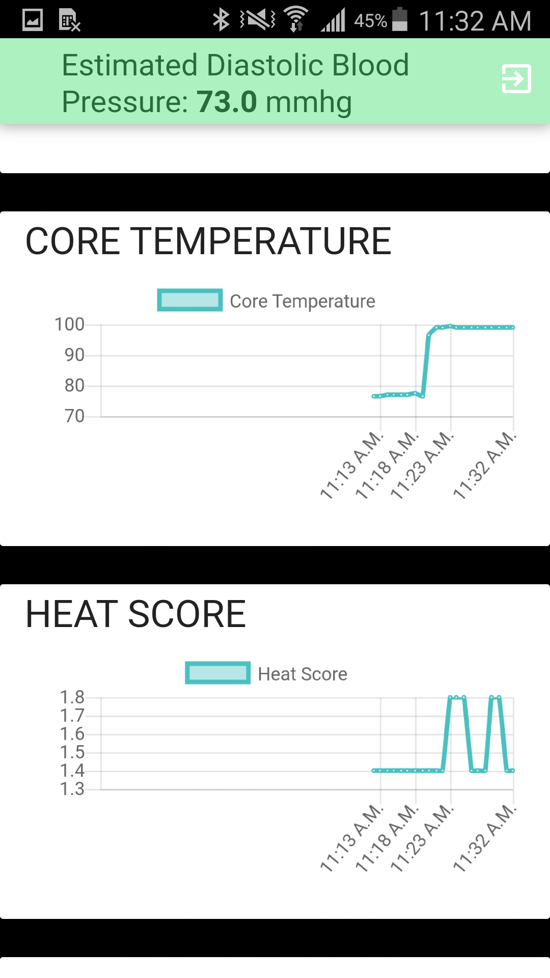
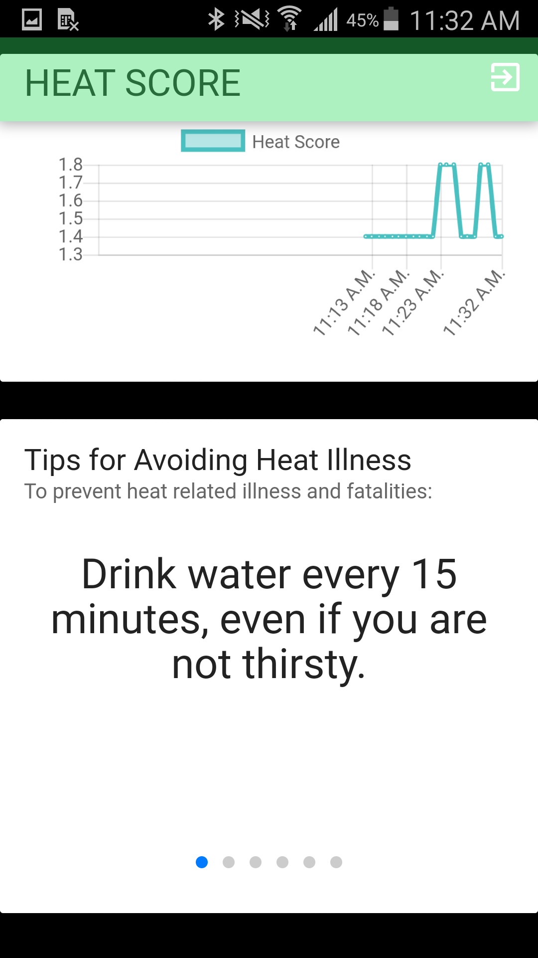

Slide 33
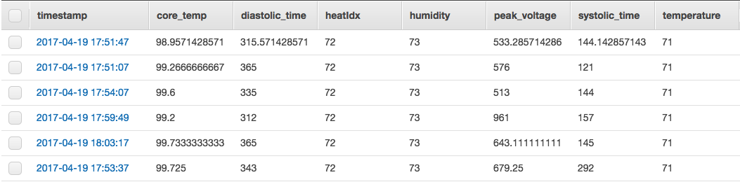
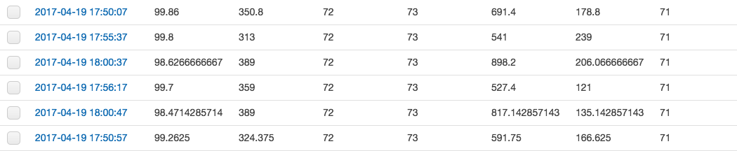
Results: Raw Data
Notes:
Raj

Slide 34
Results: Processed Data
Notes:
Miheer

Slide 35
Future Improvements
Design PCB to make electrical design cleaner/ wiring simpler
More evenly distribute weight on hat
Improve pulse oximeter clip
Leverage a medical environment to create specific machine learning training set
  Use-case specific: Heat Illness
  MedCap + EKG → More Viable Machine Learning Training
  Gather data and set thresholds for alerting
Notes:
Matt/Tyler -- Both from HW and SW respectively and then product as a whole.

Slide 36
Challenges
Software
Bluetooth Integration
API Integration with Security
API Endpoint Errors
Hardware
Switch Extension
Earpiece
Wiring
CAD/3D Printing
Notes:
Michael/Miheer

Slide 37
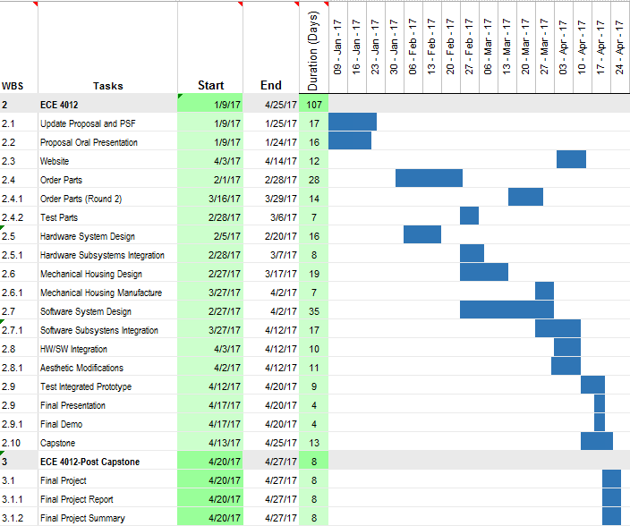
Schedule
Notes:
Nicole

Slide 38
Thank You!
Questions?

Slide 39
Team Member Responsibilities
Matt → Electrical Design, Power and Wiring
Michael → Mechanical Design and Layout
Nicole → Electrical Design, Communication and CAD Expertise
Miheer → User Interface and Team Site
Tyler → Medical Research and Data Validation
Raj → Embedded Processing, Cloud Architecture and Data Analytics

