Slide 1
Free Throw Form Analytics
Edison Carrick, Adam Jackson, Kyle Kizirian, Patrick Miller, Mickeal Taylor

Slide 2
Introduction - Adam/Edison
~15% of points scored in NBA Games are Free Throws
Average Free Throw Percentages
  NBA - 75%
  NCAA - 69%
  Highschool - 55%
Studies show that the best free throw shooters, are those with the most consistent form.
Without a coach present, there is no way for these players to practice their free throws with consistent, good form.
Amateuer basketball players are in need of a product which they can use to train their free throw shooting to improve their form

Slide 3
Introduction
How can we give feedback to users in order to train more intelligently?
The system must be
  Portable
  Easy to use
  Low-cost
  Non-intrusive
One solution is cameras but...

Slide 4
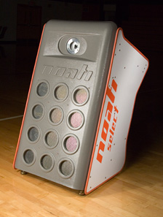
Introduction
Cameras are
  Expensive
  Not easily portable
Noah Select is a basketball system that utilizes cameras to measure shot angle and shot depth
  Costs several thousand dollars with a $100 monthly fee
  Only measures ball movement, not shooting form
We want a product that is affordable to players and easy to use anywhere
Noah Select from Noah Basketball

Slide 5
Introduction
Proposed Solution -
Create a wearable device that will track the motion of a shooter’s free throw shots and provide feedback on their form
This will allow the players to receive feedback on their form without the need for a coach to be there
Target Audience - High school Basketball Players
Cost - affordable for the serious high school basketball player

Slide 6
Design Considerations
Technology needs to monitor free throw form during individual practice for reinforcement of positive motions
Current technologies for motion tracking commonly use external systems such as cameras and ultrasonic sensors to track motion
Applications of these technologies in sports are limited to professionals and organizations
Need a low-cost, mobile solution for individualized form analysis: Inertial Measurement Unit sensors on a wireless wearable sleeve

Slide 7
Qualitative Goals - Edison
The system shall:
be wearable and wireless,
not restrict arm movement,
fit a young adult male,
be controlled by a button,
display an RGB LED for status,
be powered by a rechargeable battery,
maintain and save data.
The system will:
allow visual comparison of data,
operate in real time,
be accessible from any browser.

Slide 8

Design Approach - Overview
IMU
Data Management
Raw Data
IMU
Microcontroller
Data Analysis
Form Selection
IMU
Results
IMU
Feedback
Battery
Local Hardware
Processing
Display/Interface

Slide 9
Design Approach - Hardware
Lightweight battery and microcontroller - wireless enabled
IMUs spaced to focus on joints/arm segmentation
Will develop a testing rig for calibration of hardware using predictable data

Slide 10
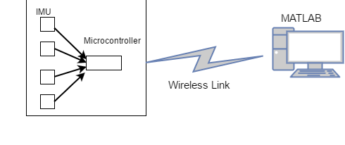
Design Approach - Hardware Integration
Device Language | Lua
Comm Link | Wireless (wired development possible)
Develop software to interface and control the sensors, push buttons, and the RGB LED.
Local pushbutton for start/stop data collection and RGB LED for status (ready, recording, low battery)
Data communication method developed: starting wired, developing wireless.

Slide 11
Design Approach - Data Analysis
Primary focus is providing a platform for comparing multiple sets of “form data”
Provided arm dimensions and sensor locations create a framework for sensors in reference to each other
Analysis will calculate elbow position, joint velocities, release speed, time of shot, etc. for comparison parameters
Coaches/players can look at the shot as a whole or focus on specific shooting parameters
Long term goal of calculating positional data and developing model for visual representation

Slide 12
Design Approach - User Interface
Web app interface for managing previous data and viewing current feedback
Look and feel of UI will depend heavily on results of data analysis package
  Comparison of parameters
  Use of historical data for statistics
  Visual display using parameters to estimate
  Full model for visual playback of form
Incoming data will automatically be compared to a user-selected “ideal” data set for fastest availability

Slide 13
Schedule - Mickeal
Included in project folder

Slide 14
Status - Mickeal
Currently working on getting our proposal approved so we can be released to buy parts
  The group has already identified the IMU’s and microcontrollers for purchase and included them in the proposal
Researching data transmission and storage solutions for sensor data
  Considering JSON, HTTP, and Firebase as a possible solution for data storage and transmission
Researching software solutions for data analytics and graphics
  Considering Matlab for possible modeling
Discussing component placement options, taking into consideration sample rate and wearer comfort

Slide 15
Current Concerns - Mickeal
Concerns around component placement are currently being addressed. The group is worried that wire distance and wire capacitance may hinder collection of data in certain circumstances
Battery placement for non-invasive use is another concern. This also determines style of battery used
There are concerns that possible latency variations may hinder data collection speeds. Research into human movement modeling and sampling is currently being done.

Slide 16
References
https://www.teamrankings.com/nba/stat/percent-of-points-from-free-throws
http://www.noahbasketball.com/blog/basketball-shooting-percentages-and-statistics

