Slide 1
Free Throw Form Analytics
Edison Carrick, Adam Jackson, Kyle Kizirian, Patrick Miller, Mickeal Taylor

Slide 2
Introduction/Motivation
How can we give feedback to users in order to train more intelligently?
The system must be
  Portable
  Easy to use
  Low-cost
  Non-intrusive

Slide 3
Introduction
Objective was to create a wearable device that will track the motion of a shooter’s free throw shots and provide feedback on their form
This will allow the players to receive feedback on their form without the need for a coach to be there
Target Audience - High school Basketball Players
Cost - affordable for serious high school basketball players

Slide 4

Design Approach - Overview
IMU
Data Management
Raw Data
IMU
Microcontroller
Data Analysis
Form Selection
IMU
Results
IMU
Feedback
Battery
Local Hardware
Processing
Display/Interface

Slide 5
What Happened
Created lightweight, portable, and easy-to-use sleeve
Met goals on data collection, battery life, and feedback to users
Created user interface for users to obtain feedback on free throw shot

Slide 6
Data Collection
Used sensor datasheet to build data collection and transmission software
Early functionality tried to read, convert, filter, and transmit
First major obstacles: memory limit, sampling speed, clock speed
Final code for microcontroller is optimized for data collection speed - nothing occurs during recording beyond collecting sensor data and writing to flash
System connects to wifi on first button click, and records on second

Slide 7
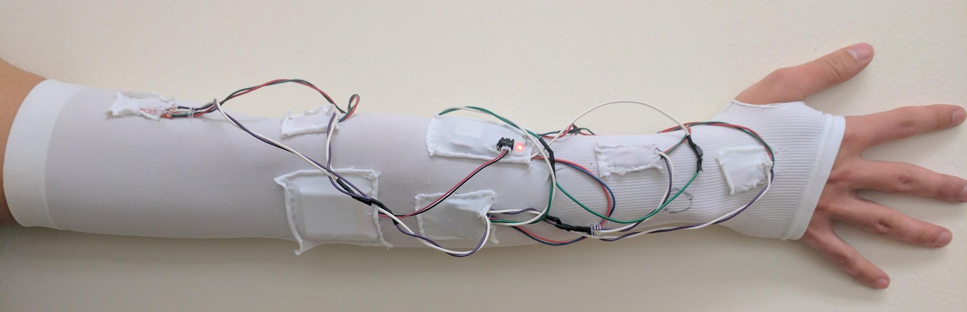
Sleeve Construction
Item | Quantity | Cost
Sleeve | 1 | $8.50
IMU | 4 | $14.95
Microcontroller | 1 | $15.95
Multiplexer | 1 | $6.95
Battery | 1 | $9.95
Total |  | 101.15
Pockets used to hold components allow for expanding
Markings for wrist bone and elbow to have consistent IMU Placement
Battery position
Sewing on pockets easier with manakin or wearing arm
Future: wrap components in plastic to limit sleeve deterioration, elastic thread
Measurements for sensor position

Slide 8
Data Processing
Data is first filtered using a low pass filter to remove noise
Scans for a moment in which all sensors are parallel to the ground and motionless
Gyroscope bias is removed, and initial position and orientation are calculated based on the data from that moment
Velocity and orientation are then calculated using Euler discrete integration

Slide 9
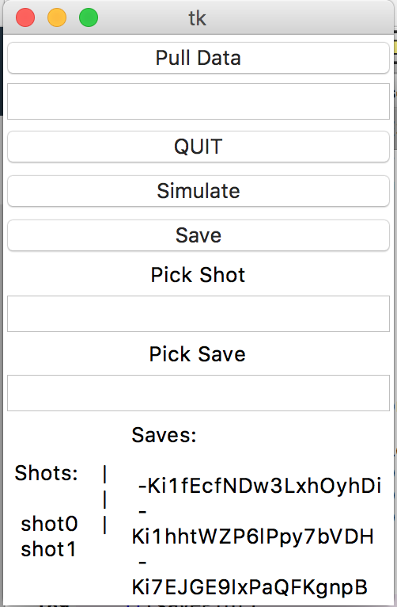
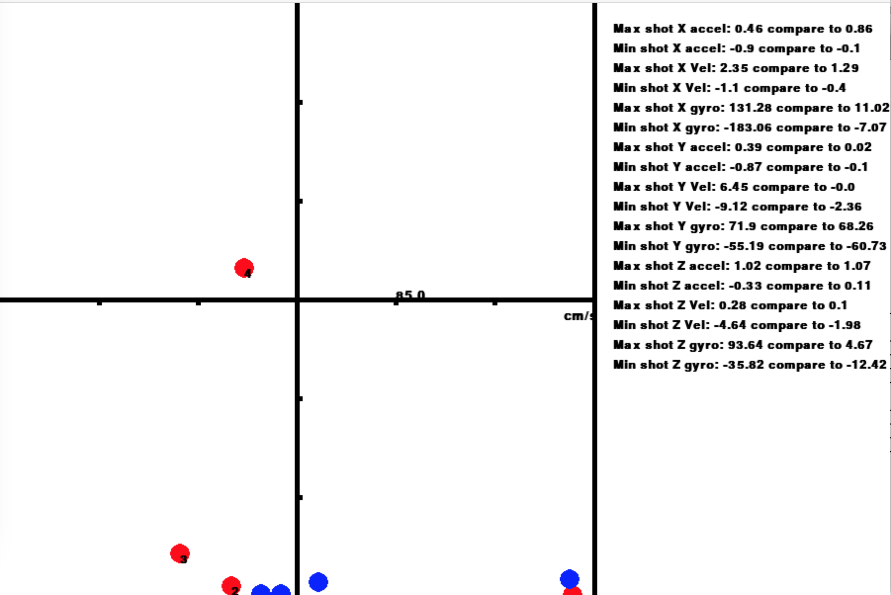
Creating User Interface - Mickeal

Slide 10
Meeting Specifications
Attribute | Proposed Specification | Prototype Specification
Battery Life | >2 hrs | >3.5
Sampling Rate | 30-60 Hz | 33 Hz
Linear Acceleration Range | ±15 g | Up to ±15 g
Linear Acceleration Accuracy | ± 1 mg | ± 1 mg
Rotational Velocity Range | ± 1500 dps | Up to ±2000 dps
Rotational Velocity Accuracy | ± 100 mdps | ± 100 mdps
Spatial Data Points | 4 | 4 IMUs
Sensor Communication | I2C | I2C
Interface | Web Application | Python Software Application

Slide 11
Meeting Specifications
Proposal Shall | Result
be a wearable sleeve | Sleeve is fully functional and wireless.
fit average young adult males | 13 inches (flexed) [1], sleeve expands to 25 inches
transmit data from the sleeve wirelessly | Sleeve Transmits Via Wi-Fi (802.11 b/g/n)
not restrict normal arm movement in any considerable way | Range of motion tests passed from physical therapy checklist [2]
start and stop shot recording with the press of a button | Prototype has button for control
be built with a wireless enabled microcontroller package | Microcontroller has built-in Wi-Fi
[1]"Are You an Average Man?", Elitefeet.com, 2017. [Online]. Available: http://www.elitefeet.com/are-you-an-average-man.
[2]Washington State DSHS, "Range of Joint Motion Evaluation Chart", 2014.

Slide 12
Meeting Specifications
Proposal Shall | Result
display an RGB LED that provides device status indication | RGB found to be unnecessary, on-board LED used instead
be powered using a rechargeable lithium ion battery | Prototype uses 800 mAh lithium ion battery
operate for a minimum of 2 hours | Tested to operate at least 3.5 hours
operate from -20°C to 60°C | All components rated -20°C to 60°C minimum operating rage. (Battery charging minimum 0°C)
save form data locally for future comparison | Software application saves shots into cloud database
allow users to select a primary comparison form | Software application allows users to compare any two shots

Slide 13
Wills
allow the user to visually compare free throw forms
Partially met.
operate in real time
Not met.
save data to the cloud for the user to access from any device
Met.
provide feedback accessible on any browser
Not met.

Slide 14
Challenges
Had to write library to communicate with sensors from datasheet directly
Original data reading was very slow, had to optimize code for reading sensors
Microcontroller only supports slower I2C speeds
Microcontroller only has 44 kb of RAM, had to optimize for storage

Slide 15
Challenges
Not able to collect data quickly enough to use acceleration to recreate position
Ideal would be better sampling rate or IMUs without gravity
Special Euclidean groups combine position and orientation to estimate each sensor’s configuration, and then gravity is removed from acceleration measurements based on sensor orientation
Inherent error and low sampling rate cause error to build in orientation estimate; position calculations suffer from gravity itself as well as the attempt to correct for it

Slide 16
Scheduling
Hardware to Hardware integration took much longer than anticipated
Hardware issues caused increased shipping time and multiple parts orders
This slowdown in production made it difficult to correct late stage issues
Tried to create software and hardware in parallel but software production reached a bottleneck when actual shot data was necessary
Creation of useful metrics became a challenge with time constraints
Notes:
https://hangouts.google.com/call/ujf6w4qb45brtoua2glzeyenjiu

Slide 17
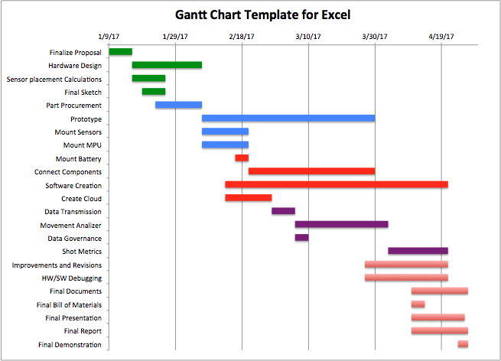

Slide 18
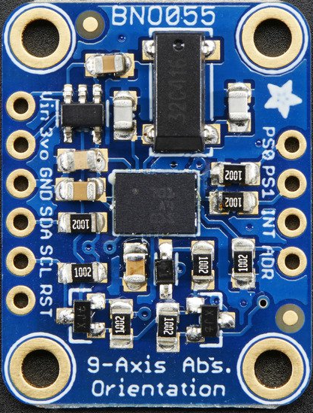
Future Work
We believe challenges that we faced in recreating position can be solved with better hardware
Recommend future teams looking into IMUs that report linear acceleration and remove gravity bias in hardware
Recommend a microcontroller that supports faster I2C speeds for better sampling rate
Recommend having feedback supported via web or mobile app so users can obtain instant feedback
Adafruit IMU with Linear Acceleration Capability

Slide 19
Future Work
Many additional possibilities exist for motion tracking using IMUs
Once some of these challenges are overcome, can easily be expanded to additional sports
Great possibilities in medical, veterinarian, and physical rehabilitation applications

