Slide 1
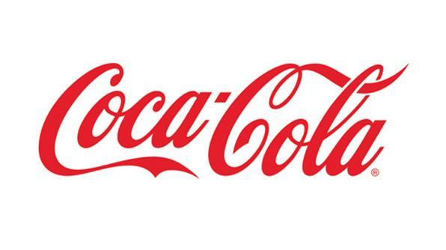
Coca-Cola Light Up Interactive Packaging
Dr. James Kenney, Georgia Tech
Dr. Jasmeet Kaur, Coca-Cola Company
Alex Plager - japlager@gmail.com
Fan Chen - fchen63@gatech.edu
Hamim Nigena - hamimnigena@gatech.edu
Mitcham Tuell - mitchamtuell@gatech.edu
Varun Malhotra - varun.doom@gmail.com
Notes:
Mitch

Slide 2
Introduction
A package for Coca-Cola beverages that interacts with users by lighting up when activated
Proposed prototyping cost: $56.78
Notes:
We are, as you know, developing an interactive package for Coke that lights up when activated by the user. The team is requesting $56.78 to develop a number of prototypes of said package. Hamim will have more information on this cost breakdown in later slides.

Slide 3
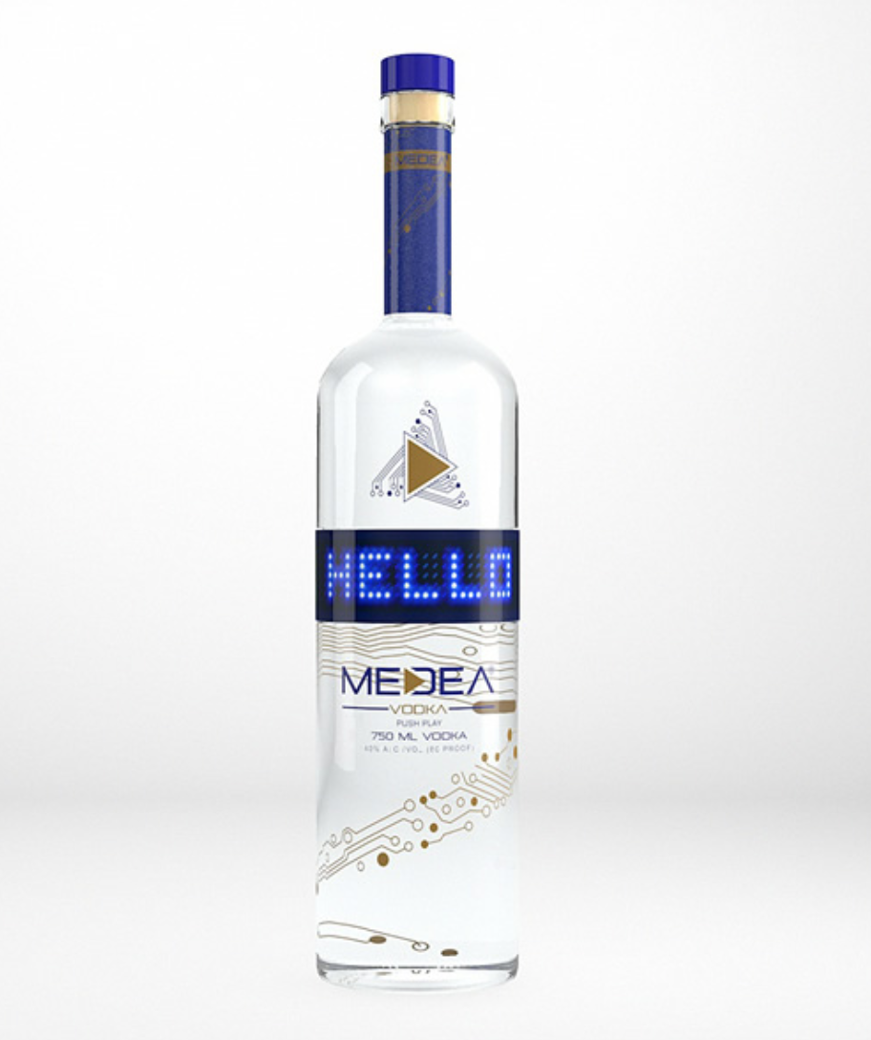
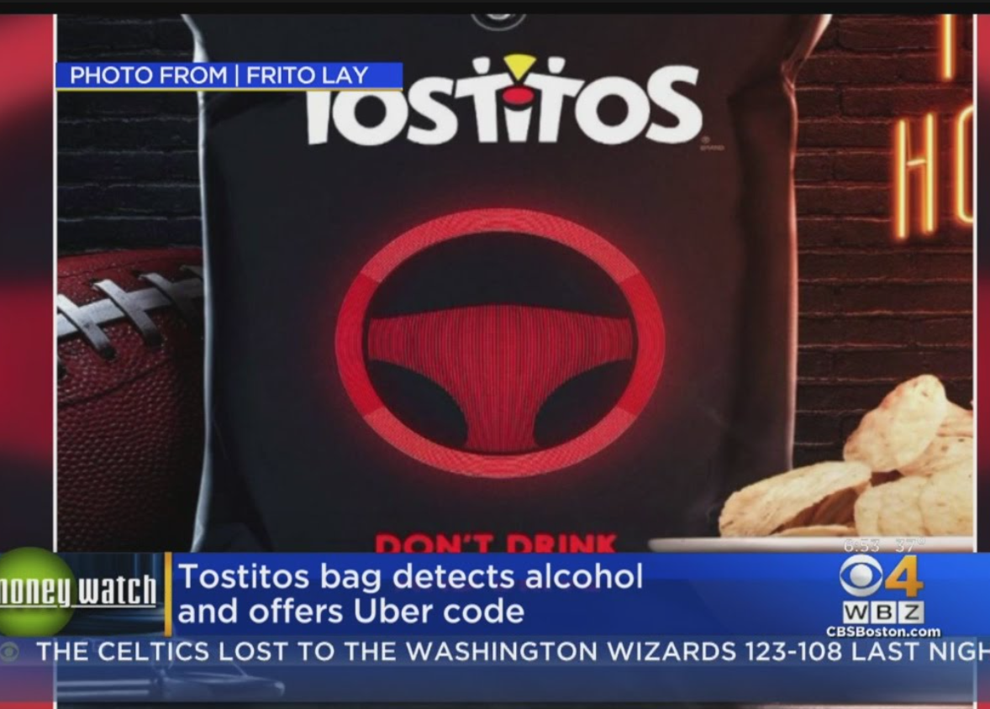
Background
$$$ NFC

Slide 4
Motivation
New concept
Customer connection
Brand image

Slide 5
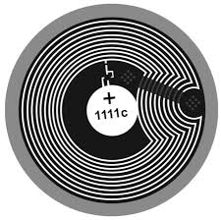
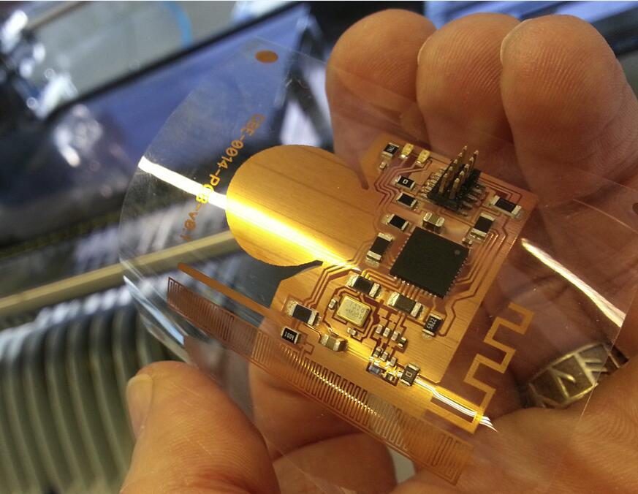
Approach Overview
Base Station
Notes:
Fan Chen (mention fall back and reach options)
RF antenna

Slide 6
Project Specifications
Temperature Range | 2˚C to 35˚C
Water Resistance | IPX4
Drop Resistance | 1.5m
Active Duration | 30 sec
Storage and Shipping Life | 4 weeks
Cost (approx., million-unit scale) | $6
Luminous Intensity | 500 mcd
Weight | 20g
Form Factor | +8mm to bottle radius +0mm to bottle height
Notes:
Mitch

Slide 7
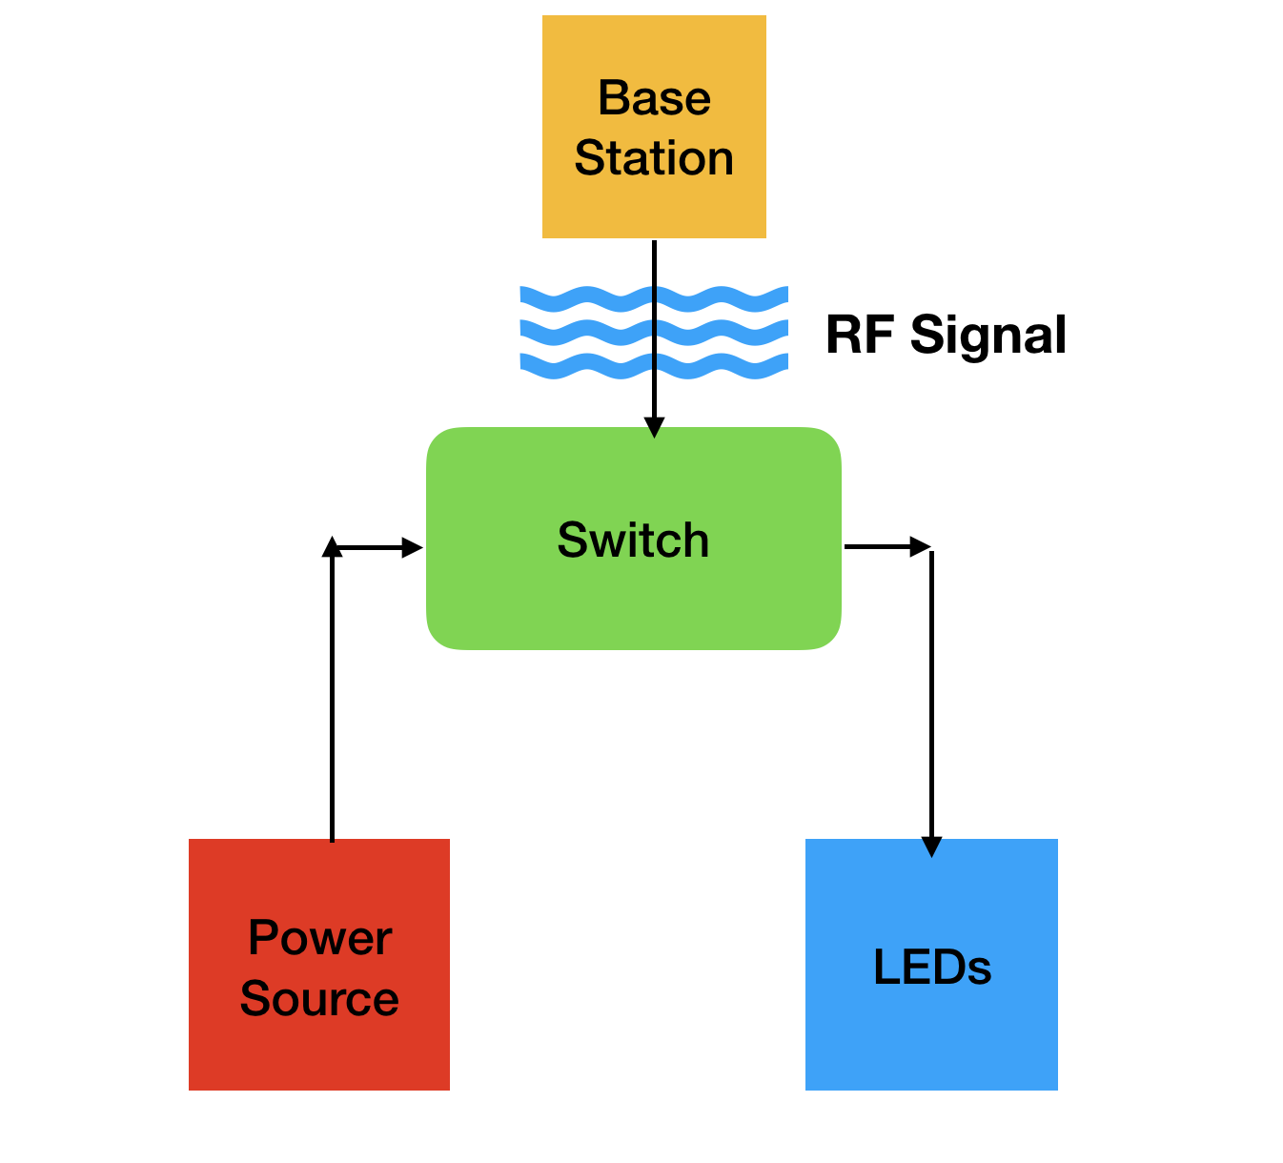
Design Proposal Overview
Switch
Power Source
Lighting (LEDs)
Notes:
Varun

Slide 8
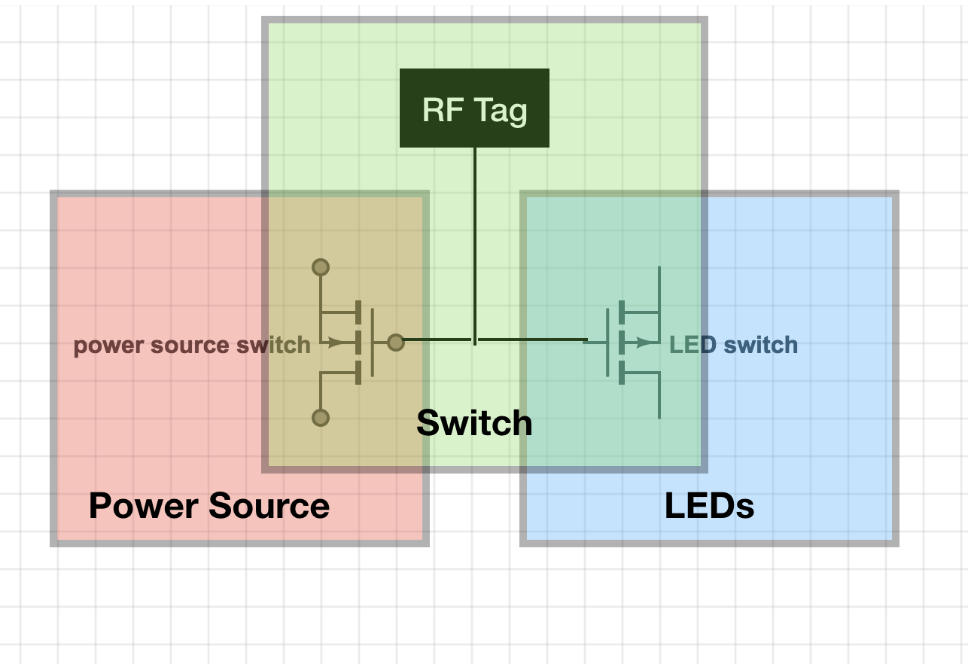
Switch
P type MOSFET for Power Source
N type MOSFET for LEDs
Notes:
Varun

Slide 9
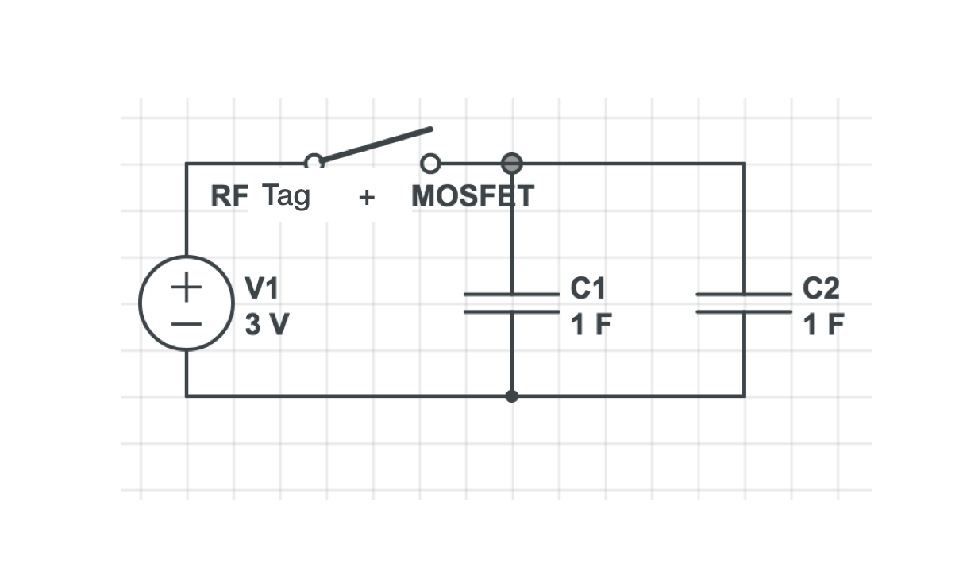
Power System
One coin cell battery
Two 1F Supercapacitors
One p-type MOSFET
Notes:
Varun

Slide 10
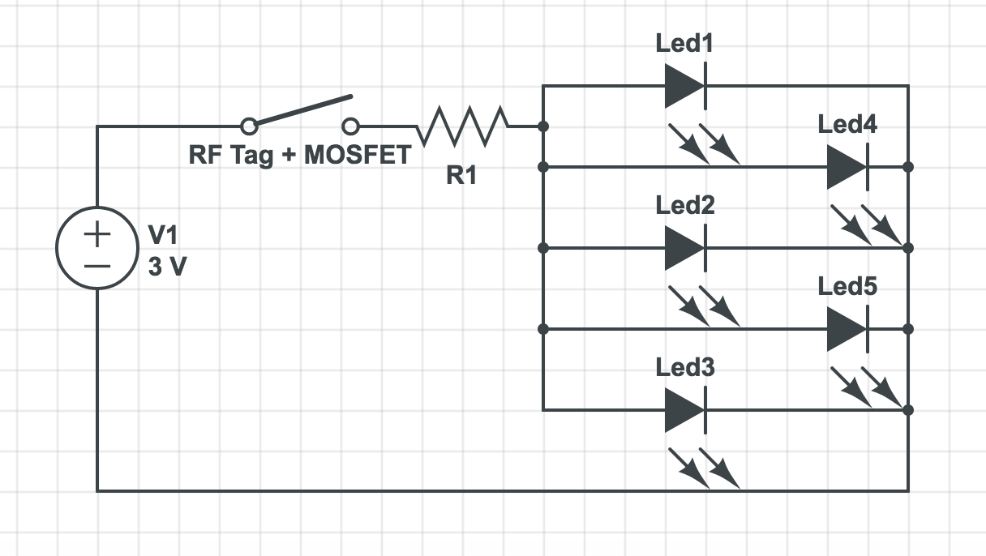
Lighting (LEDs)
Five red LEDs
Total luminous intensity of 500 mcd
Voltage drop of 1.9V
Current draw 100mA
Notes:
Varun

Slide 11
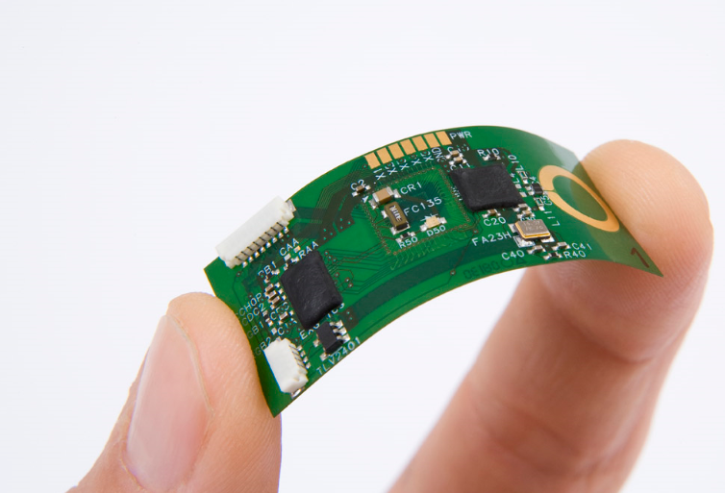
Flexible PCB
The team intends to work with Dr. Tentzeris
Components are silver epoxied to board
Laminate to waterproof
Notes:
Mitch

Slide 12
Alternative Approaches: Power
AAAA battery
Reliable power supply
Relatively Cheap(~$0.4 @2500 units)
Additional part
Form factor
Flexible Solar panel
Form factor
Environmental concern
Cost($20 on Amazon)
Limited performance in low light conditions
Notes:
Fan

Slide 13
Alternative Approach: Saralon
Saralon Saralillu
Pre-made, fits most specs
Computing aspect
Cost can be an issue
Young company - scale issues
Is it still senior “design”?
Notes:
Fan

Slide 14
“Fallback” Design
Force sensitive resistor controls LEDs - no RF
Simpler implementation
Less interesting interaction
May be more expensive
Notes:
Mitch

Slide 15
“Reach” Design
Use NFC protocol to turn on and off lights in a pattern - maybe a 7-segment display
More interesting interaction
More complicated implementation
More expensive (microcontroller)
Notes:
Mitcham

Slide 16
Environmental Considerations
Bottle is no longer recyclable
E-waste facility not usually easily accessible
During campaign, Coke must collect waste for processing
Customer incentive ($ deposit)
Removable E-label?
Notes:
Mitcham

Slide 17
Components Cost for prototyping
1F Capacitor x2 | $3.69 x 2 = $7.38
Red LED x5 | $0.76 x 5 = $3.80
3V Coin cell battery | $0.33
MOSFET, SMD x2 | $0.15 x 2 = $0.30
Resistor, SMD x3 | $0.15 x 3 = $0.45
Total, three prototypes | $36.78
Shipping & Unforeseen costs | $20
Grand Total | $56.78
Notes:
Hamim
Prototyping cost

Slide 18
Approximate Large Scale Components Cost
1F Capacitor x2 | @5,000 | $1.52 x 2 = $3.04
Red LED x5 | @48,000 | $0.21 x 5 = $1.05
3V Coin cell battery | @2,000 | $0.173
N-channel MOSFET, SMD | @6,000 | $0.147
P-channel MOSFET, SMD | @6,000 | $0.147
Resistor, SMD x3 | @48,000 | $0.011 x 3 = $0.033
Flexible PCB | @1,000 | $0.40
Total | $4.99
Notes:
Hamim
The cost will be significantly lower in million parts
The flexible PCB might be +, but the unexpected expenses facture that in and even the cost out

Slide 19
Key Project Milestones
Ordering Parts (end of next wk)
Develop flex PCB with Dr. Tentzeris (End of Sept.)
First Round of Prototyping (First week of Oct.)
Final Round of Prototyping (End of Oct.)
Test fallback/reach alternatives
Finalize Costs (Middle of Nov.)
Senior Design Expo (Dec. 5)
Notes:
Alex
Test “reach”/”fallback” alternatives

Slide 20
Conclusion
Expect to meet specifications with primary proposed design
User interaction is simple, but engaging
Build three prototypes for about $57
Notes:
Hamim

Slide 21
References
LED: [1]"HSMC-C170-T0000 Broadcom / Avago | Mouser Europe", Mouser Electronics, 2017. [Online]. Available: http://www.mouser.com/ProductDetail/Broadcom-Avago/HSMC-C170-T0000/?qs=sGAEpiMZZMseGfSY3csMkUxhMwy8qEyRukk7vOh2v5LuQQ9qbvLioQ%3d%3d. [Accessed: 07- Sep- 2017].
Battery: [2]P. Battery, "CR2032 Panasonic Battery | Mouser Europe", Mouser Electronics, 2017. [Online]. Available: http://www.mouser.com/ProductDetail/Panasonic-Battery/CR2032/?qs=sGAEpiMZZMtEV04R3uo8Ft7CIhv2OyhLbn6MKq1Bh%252bU%3d. [Accessed: 07- Sep- 2017].
Resistors: [3]"ERA-6AHD150V Panasonic | Mouser Europe", Mouser Electronics, 2017. [Online]. Available: http://www.mouser.com/ProductDetail/Panasonic/ERA-6AHD150V/?qs=sGAEpiMZZMvdGkrng054t%252b2w5OgPkZzPc4aw7VJJ4yQ%3d. [Accessed: 07- Sep- 2017].
MOSFETs: [4]O. Fairchild, "FDD9411L_F085 ON Semiconductor / Fairchild | Mouser Europe", Mouser Electronics, 2017. [Online]. Available: http://www.mouser.com/ProductDetail/ON-Semiconductor-Fairchild/FDD9411L_F085/?qs=sGAEpiMZZMshyDBzk1%2fWizCV1caAEWch1roKOuDnjBgSlpqHxRoR%252bA%3d%3d. [Accessed: 07- Sep- 2017].
Capacitor: [5]"EEC-S5R5V105 Panasonic | Mouser Europe", Mouser Electronics, 2017. [Online]. Available: http://www.mouser.com/ProductDetail/Panasonic/EEC-S5R5V105/?qs=sGAEpiMZZMuDCPMZUZ%252bYly%2foiL97IAxmKSpk1f%252bXVAY%3d. [Accessed: 07- Sep- 2017].
[6]"Medea Vodka's interactive screen", Bevindustry.com, 2017. [Online]. Available: http://www.bevindustry.com/articles/85559-medea-vodka-s-interactive-screen. [Accessed: 07- Sep- 2017].
[7]T. Nudd and T. Nudd, "Tostitos' New Party Bag Knows When You've Been Drinking and Will Even Call You an Uber", Adweek.com, 2017. [Online]. Available: http://www.adweek.com/creativity/tostitos-new-party-bag-knows-when-youve-been-drinking-and-will-even-call-you-uber-175727/. [Accessed: 07- Sep- 2017].
[8]"Light Emitting Package - Saralon – Simplifying Electronics", Saralon – Simplifying Electronics, 2017. [Online]. Available: http://saralon.com/light-emitting-package/. [Accessed: 07- Sep- 2017].

