Slide 1
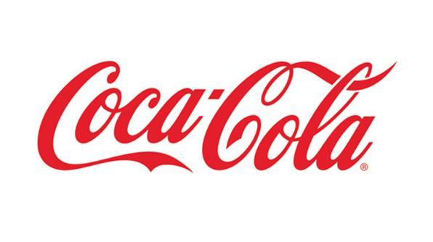
Coca-Cola Light Up Interactive Packaging
Dr. James Kenney, Georgia Tech
Dr. Jasmeet Kaur, Coca-Cola Company
Alex Plager - japlager@gmail.com
Fan Chen - fchen63@gatech.edu
Hamim Nigena - hamimnigena@gatech.edu
Mitcham Tuell - mitchamtuell@gatech.edu
Varun Malhotra - varun.doon@gmail.com
Notes:
Mitch

Slide 2
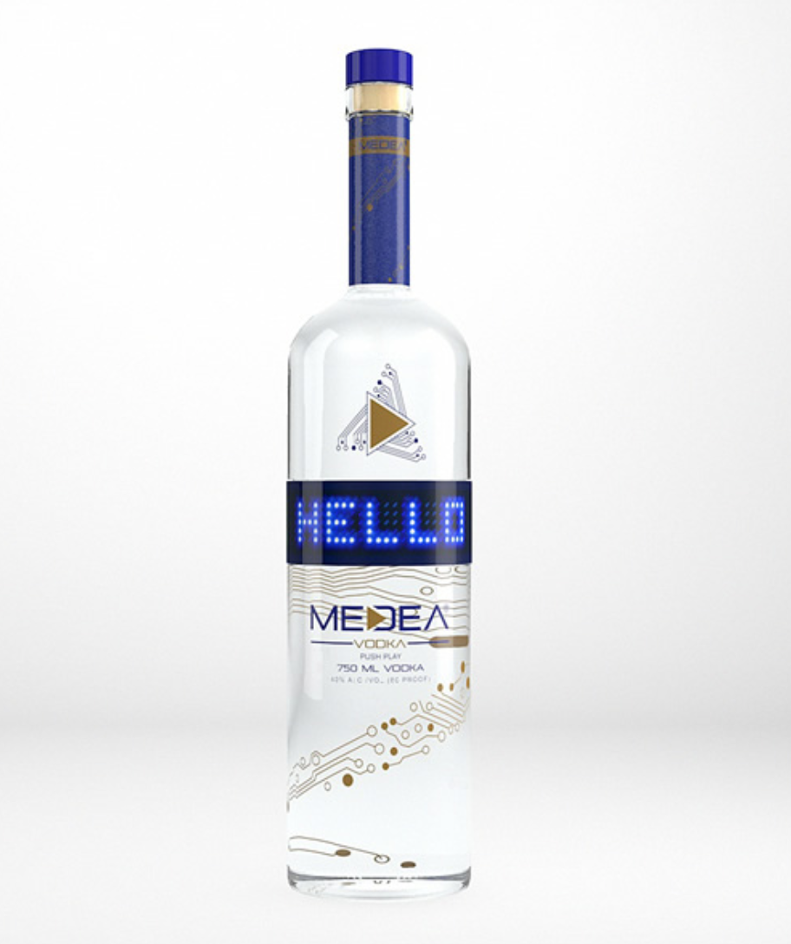
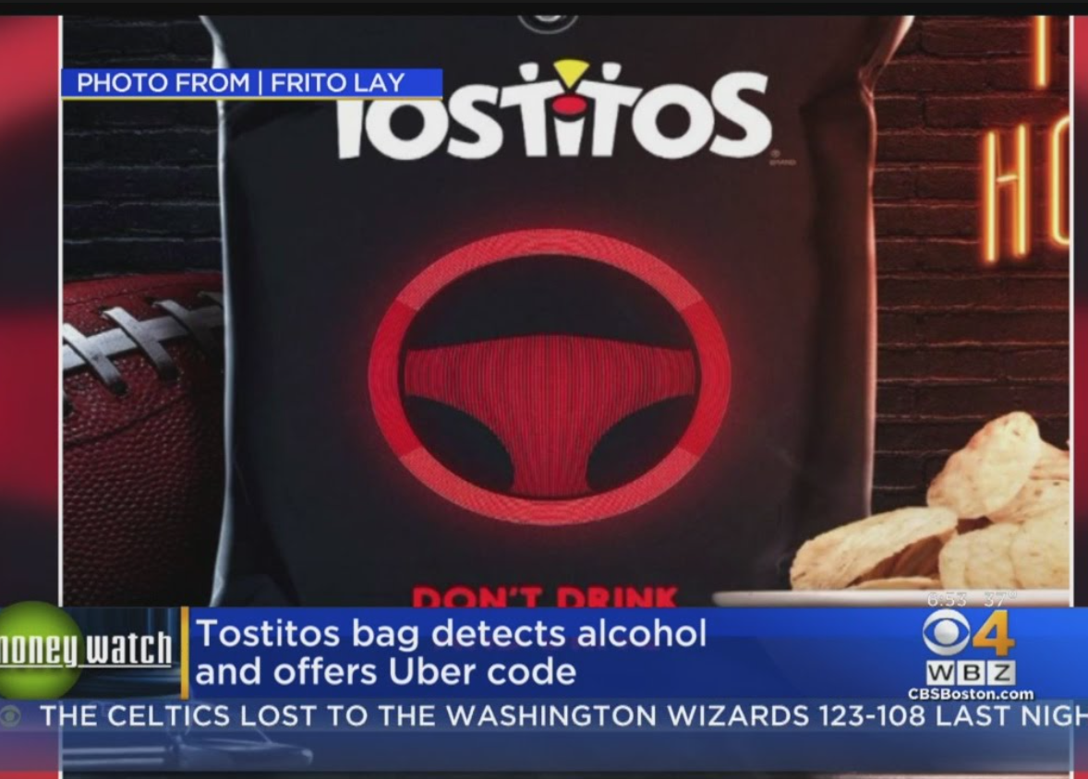
Background
$$$ NFC
Notes:
Alex

Slide 3
Introduction
A package for Coca-Cola beverages that interacts with users by lighting up in different patterns when activated
Total prototyping cost: $795
Approximate production cost @10000: $9.192/unit
Notes:
We are, as you know, developing an interactive package for Coke that lights up when activated by the user. The team is requesting $56.78 to develop a number of prototypes of said package. Hamim will have more information on this cost breakdown in later slides. (Alex)

Slide 4
Motivation
New concept
Customer connection
Brand image
Notes:
Alex

Slide 5
Designs Explored
Using an FSR to light LEDs
FSRs are expensive ($5 - $7)
Using NFC as a switch
Too simple for Senior Design
Using NFC to send data (with a microcontroller)
Adds complexity, more interactive
Notes:
Micth

Slide 6
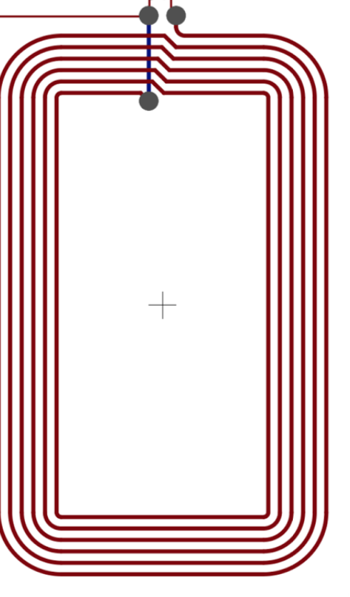
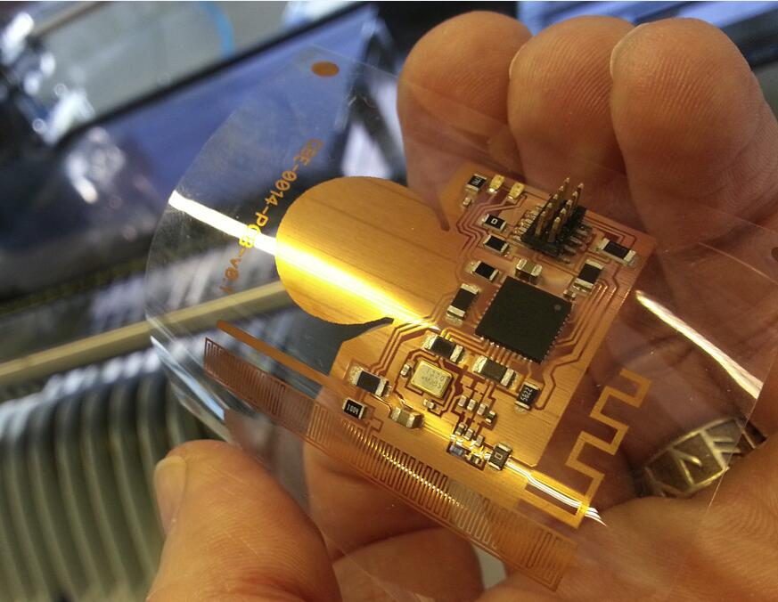
Approach Overview
NFC Enabled Phone
Notes:
Mitch

Slide 7
Project Specifications
Temperature Range | 2˚C to 35˚C
Water Resistance | IPX4
Drop Resistance | 1.5m
Active Duration | 30 sec
Storage and Shipping Life | 4 weeks
Cost (approx., million-unit scale) | $10
Luminous Intensity | 500 mcd
Weight | 20g
Form Factor Light Interactivity Removability | +2.5mm to bottle radius +0mm to bottle height Wireless eLabel is easily removed w/o tools
Notes:
Mitch

Slide 8
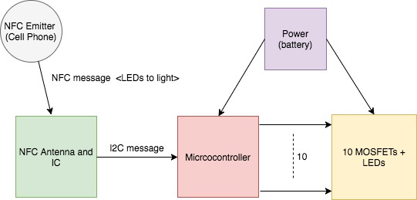
Design Overview
Power
NFC Antenna and IC
Microcontroller
Lighting (LEDs)
Notes:
Mitch

Slide 9
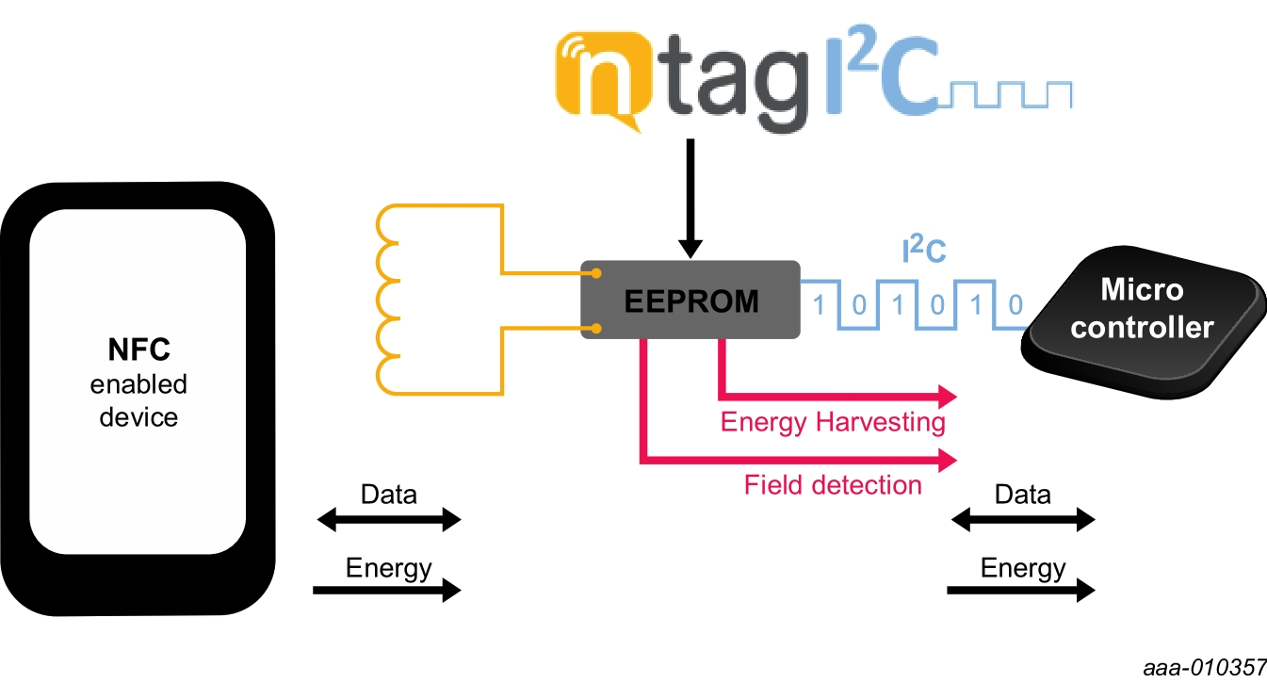
NFC Antenna and IC
NXPs NTAG
RF to I2C
Notes:
Varun

Slide 10
Power
Flexible Lithium Ion Battery
Table 2. Battery Specifications
Item | Specification
Output Voltage | 3V
Current Draw (max) | 200 mA
Capacity | 600 mAh
Size | 50.5 mm X 50.5mm
Thickness | 1.5mm
Notes:
Fan

Slide 11
Microcontroller
LPC812
ARM Cortex-M0+ processor
I2C Capabilities
PMU
Table 2. MCU Specifications
Item | Specification
Input Voltage (Min) | 1.8 V
Current Draw | 5 µA
Notes:
Varun

Slide 12
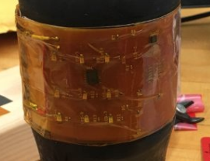
Lighting (LEDs)
9 red LEDs
3x3 array
Voltage drop of 1.9V
Max Current draw 20mA
Notes:
Hamim

Slide 13
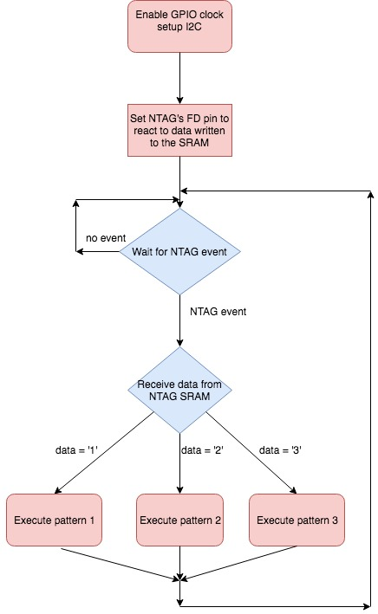
Firmware Design
Notes:
Varun

Slide 14
Firmware Design
Firmware written in C
lpcxpresso IDE
LPC-Link2 used for flashing
Notes:
Varun

Slide 15
Hardware Design
Schematic and layout done in eagle
2-sided board
Antenna design from NXP demo board
Notes:
Fan

Slide 16
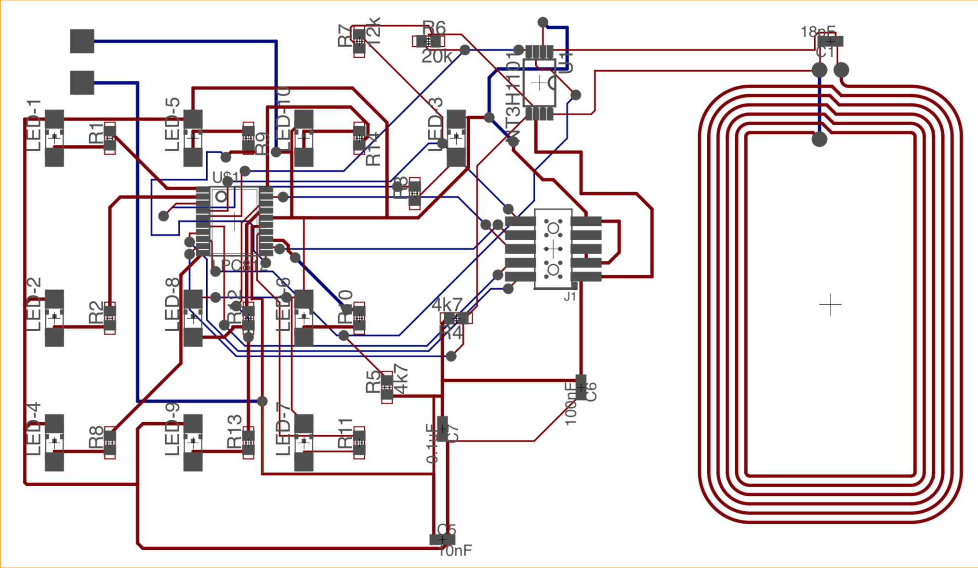
Notes:
Fan

Slide 17
Development stages
Rigid board testing
FR4 Bendable board
Outside Vendor for full-flex board
Milled in a lab on campus
FR4 too thin, the machine can’t remove copper completely
$17 for 3 rigid board
Proof of concept
$250 for prototyping 7 boards
Fully flexible, high quality
1
2
3
Notes:
Mitch

Slide 18
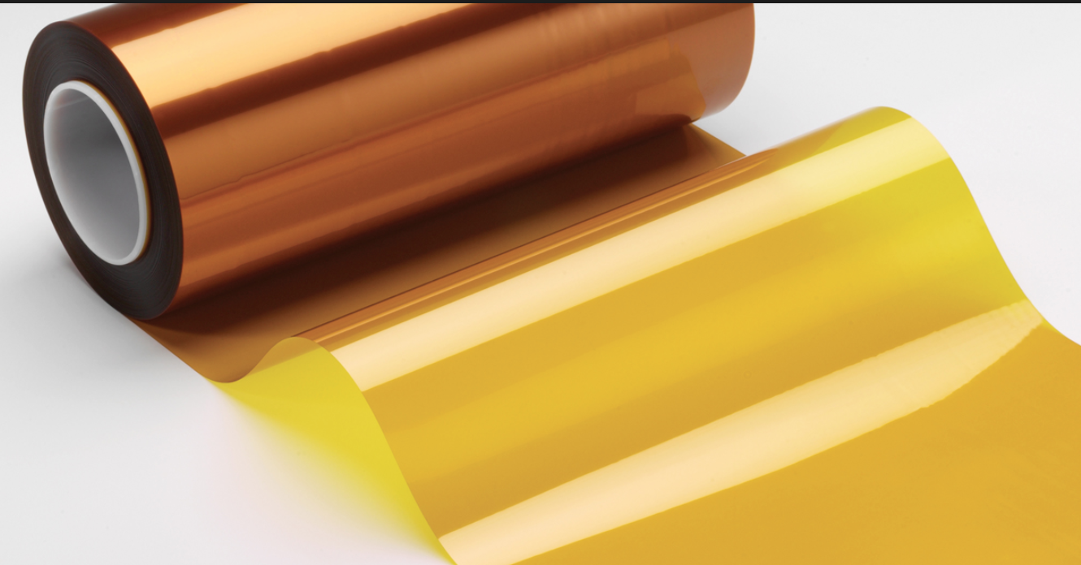
Prototype Hardware Assembly
Water resistance: Kapton Tape to cover both sides of the board
Battery soldered to the board by jumper wires
“Hidden” under the label
Notes:
Fan

Slide 19
Environmental Considerations
Bottle is no longer recyclable
E-waste facility not usually easily accessible
During campaign, waste can be collected for processing
Customer incentive ($ deposit)
Removable E-label?
Notes:
Mitch

Slide 20
Components Cost for Prototyping
Rigid PCBs x 3 | $73
Flexible PCBs x 7 | $250
FR4 sheets x 2 | $44
NTAG demo-kit | $18.69
Linker board | $22.48
3V Li-ion batteries x 15 | $75
Xpresso Development board | $18.75
NXP Microcontrollers | $25
Components (LEDs, resistors, caps, connectors, fuses... ) | $150
Grand Total ( Including shipping) | $795
Notes:
Hamim
Prototyping cost

Slide 21
Approximate Large Scale Components Cost
FR4 sheets (for PCB) | @1 | $20/4 (-1 for approx 10000) = $4
Red LED x 9 | @10,000 | $0.04 x 5 = $0.2
NXP Microcontroller | @10,000 | $0.60
Capacitors, SMD x 7 | @15,000 | $0.002 x 7 = 0.014
NTAG chip | @10,000 | $0.35
Li-Ion flat battery | @1 | $5 (-1 for approx 10000) = $4
Resistor, SMD x14 | @15,000 | $0.002 x 14 = $0.028
Total | $9.192
Notes:
Hamim
The cost will be significantly lower in million parts
The flexible PCB might be +, but the unexpected expenses facture that in and even the cost out

Slide 22
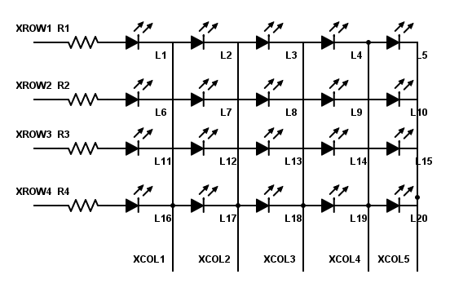
Future Improvements---Software
Variations on LEDs
Array (upto 20)
pattern
Additional programming features
Notes:
Varun

Slide 23
Future Improvements---Hardware
Power Solution
Energy harvesting through antenna
E-ink battery
Add a fuse and a switch
Water Resistance method suitable for mass production
LEDs arranged to illuminate Coke logo
Notes:
Fan

Slide 24
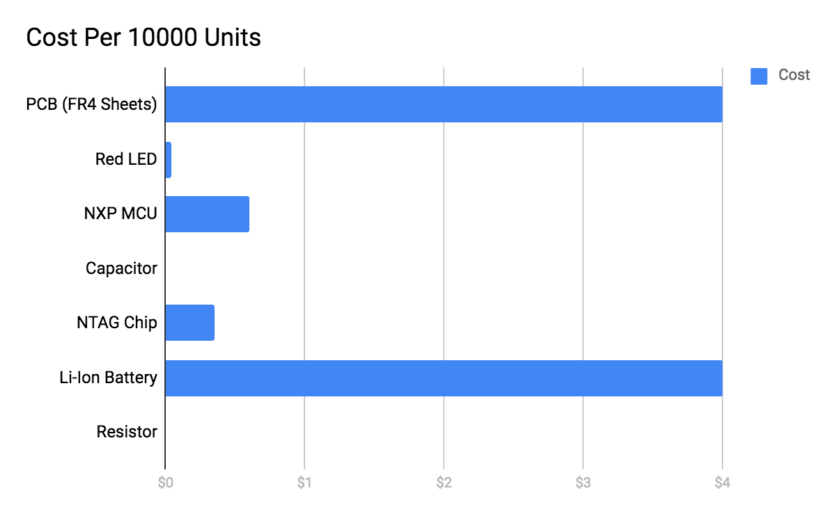
Future Improvements---Cost
Get rid of the battery (energy harvesting)
Notes:
Alex

Slide 25
Questions?
Website Link:
http://ece4012y2017.ece.gatech.edu/fall/sd17f12/

Slide 26
References
LED: [1]"HSMC-C170-T0000 Broadcom / Avago | Mouser Europe", Mouser Electronics, 2017. [Online]. Available: http://www.mouser.com/ProductDetail/Broadcom-Avago/HSMC-C170-T0000/?qs=sGAEpiMZZMseGfSY3csMkUxhMwy8qEyRukk7vOh2v5LuQQ9qbvLioQ%3d%3d. [Accessed: 07- Sep- 2017].
Battery: [2]P. Battery, "CR2032 Panasonic Battery | Mouser Europe", Mouser Electronics, 2017. [Online]. Available: http://www.mouser.com/ProductDetail/Panasonic-Battery/CR2032/?qs=sGAEpiMZZMtEV04R3uo8Ft7CIhv2OyhLbn6MKq1Bh%252bU%3d. [Accessed: 07- Sep- 2017].
Resistors: [3]"ERA-6AHD150V Panasonic | Mouser Europe", Mouser Electronics, 2017. [Online]. Available: http://www.mouser.com/ProductDetail/Panasonic/ERA-6AHD150V/?qs=sGAEpiMZZMvdGkrng054t%252b2w5OgPkZzPc4aw7VJJ4yQ%3d. [Accessed: 07- Sep- 2017].
MOSFETs: [4]O. Fairchild, "FDD9411L_F085 ON Semiconductor / Fairchild | Mouser Europe", Mouser Electronics, 2017. [Online]. Available: http://www.mouser.com/ProductDetail/ON-Semiconductor-Fairchild/FDD9411L_F085/?qs=sGAEpiMZZMshyDBzk1%2fWizCV1caAEWch1roKOuDnjBgSlpqHxRoR%252bA%3d%3d. [Accessed: 07- Sep- 2017].
Capacitor: [5]"EEC-S5R5V105 Panasonic | Mouser Europe", Mouser Electronics, 2017. [Online]. Available: http://www.mouser.com/ProductDetail/Panasonic/EEC-S5R5V105/?qs=sGAEpiMZZMuDCPMZUZ%252bYly%2foiL97IAxmKSpk1f%252bXVAY%3d. [Accessed: 07- Sep- 2017].
[6]"Medea Vodka's interactive screen", Bevindustry.com, 2017. [Online]. Available: http://www.bevindustry.com/articles/85559-medea-vodka-s-interactive-screen. [Accessed: 07- Sep- 2017].
[7]T. Nudd and T. Nudd, "Tostitos' New Party Bag Knows When You've Been Drinking and Will Even Call You an Uber", Adweek.com, 2017. [Online]. Available: http://www.adweek.com/creativity/tostitos-new-party-bag-knows-when-youve-been-drinking-and-will-even-call-you-uber-175727/. [Accessed: 07- Sep- 2017].
[8]"Light Emitting Package - Saralon – Simplifying Electronics", Saralon – Simplifying Electronics, 2017. [Online]. Available: http://saralon.com/light-emitting-package/. [Accessed: 07- Sep- 2017].

