Slide 1
Smartphone Solar Tracker
Chidi Imala, Asier Isayas,
Yusuf Ziya Kuris, Gideon Odogwu

Slide 2
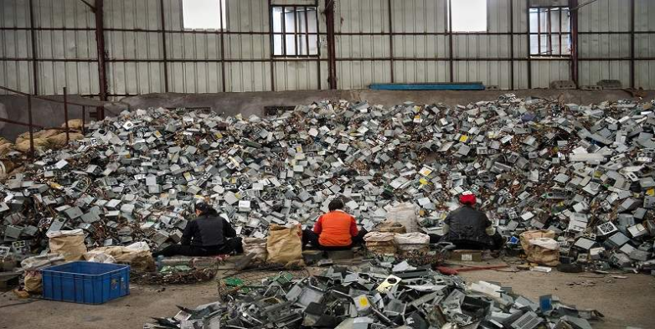
Introduction
According to the EPA, 141 million mobile phones were discarded in 2009 and only 12 million of those were collected for recycling.
Old smartphones in most cases end up on an offshore landfill, according to a study from the Basel Action Network, a nonprofit that opposes shipping waste from rich to poor countries. More than 80% of e-waste is exported to Asia where workers break down electronic devices for metals, particularly gold and silver.

Slide 3
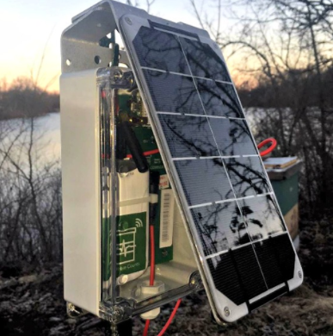
Smartphone Solar Tracker
What is Smartphone solar Tracker ?
Why do we need this product?
Homeowners
Promoting Sustainability and reuse
Reengineering

Slide 4
Qualitative Goals
An Android OS application:
Reads in ambient light sensor and camera data
Locates the sun with sensor data
Calculates azimuth and zenith angles for the location
Sends manual data or manual move commands to the panel
A motor/servo controller system:
Receives commands from the Android OS application
Moves the solar panels to desired azimuth and zenith angles

Slide 5
Qualitative Goals
A wood structure:
Rigorous frame that houses the motors, solar panel and smartphone
Gears that allow motion of azimuth and zenith angles
Solar panel:
Output of the solar panel powers a circuit: charges the smartphone or lights a LED.

Slide 6
Quantitative Specifications
Physical attributes and output:
Specification | Value
Weight | 20 lbs
Dimensions | 15” x 15” 15”
Solar panel size | 11” X 8.5”
Solar panel output | 1 W at 6 V (average day-long insolation)

Slide 7
Quantitative Specifications
Motion range, accuracy, device requirements:
Specification | Value
Azimuth range* | 0° - 360°
Zenith range** | 0° - 90°
Pointing accuracy | ±0.5°
Operating System | Android 4.4 (KitKat) or above
Sensors | Ambient light sensor, Camera (> 5 MP), Accelerometer

Slide 8
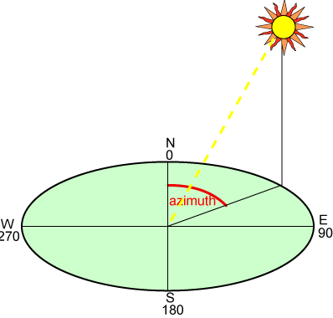
Quantitative Specifications
*: North is 0° , East is 90°, South is 180° and West is 270°.
**: 0° is plane parallel to ground and 90° is plane normal to ground.

Slide 9
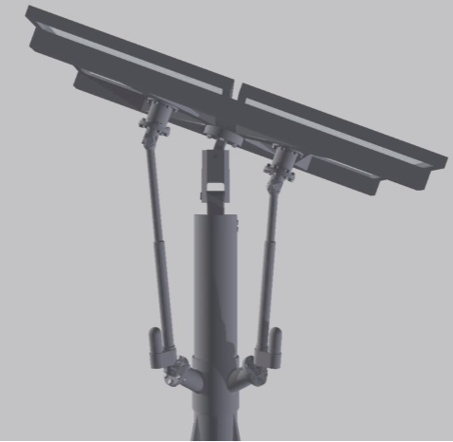
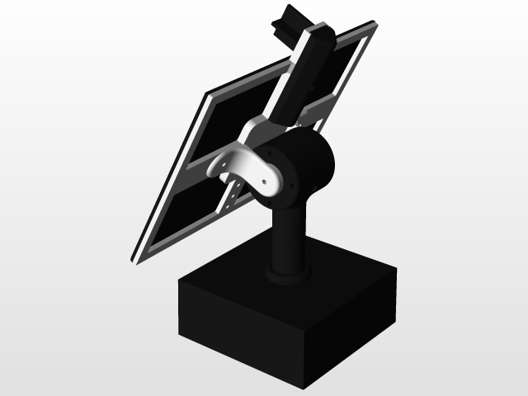
Design Approach
Frame Design
Dual Axis for effective tracking
Linear actuators or motors ?
Motors
Less degrees of freedom

Slide 10
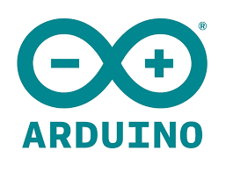
Design Approach
Micro-Controller Choice
Task Complexity ; Memory, Processing speed
Prototyping / Scalability

Slide 11
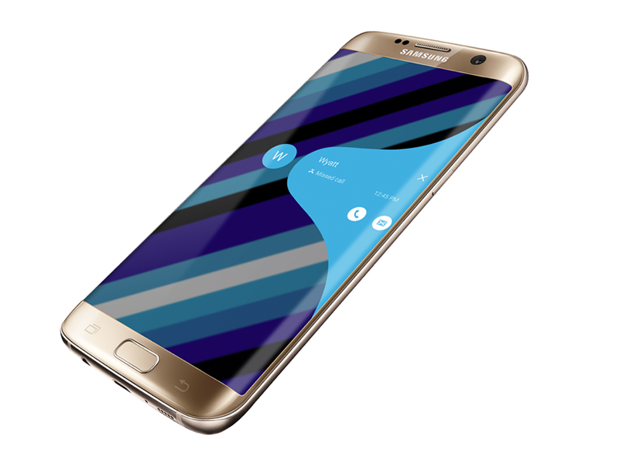
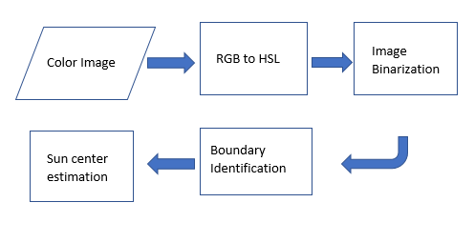
Design Approach
Ambient light sensor to constrain sun’s location
Camera to improve accuracy of the estimated sun location

Slide 12
Design Approach
Smartphone application
Interface for manual and automatic control of solar panel using sensors
Android based app (Java)
Bluetooth capability for sending data
Smartphone sensors
Ambient light sensor
Camera

Slide 13
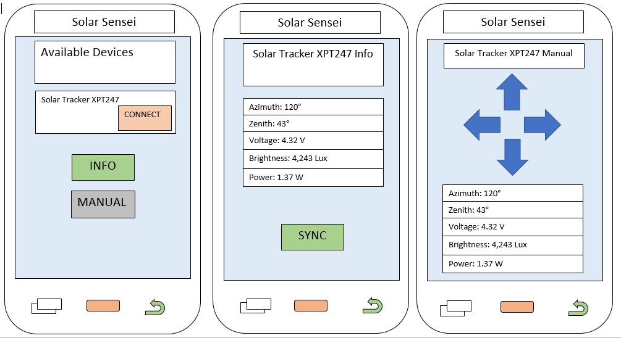

Slide 14
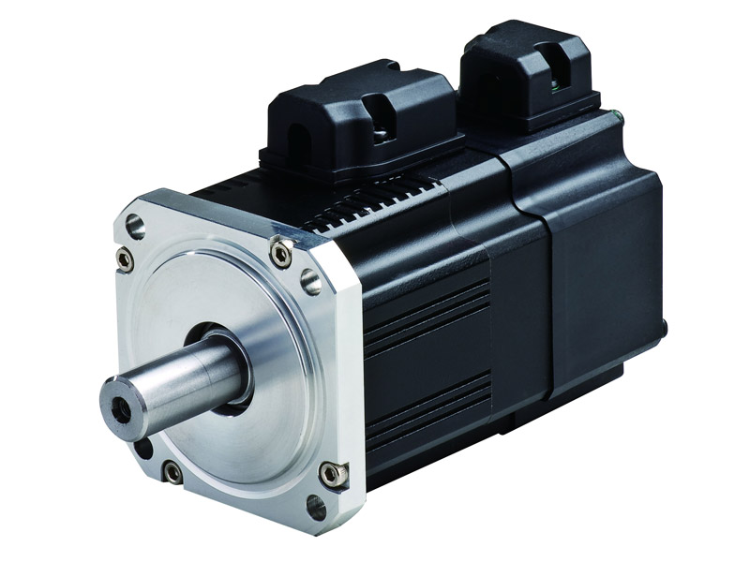
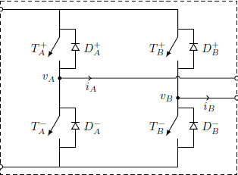
Design Approach
Motor and motor controller
Stepper motor or Brushless DC motor
Closed loop control or open loop control ?
Motor controller or H-bridge ; Dependent on type of motor

Slide 15
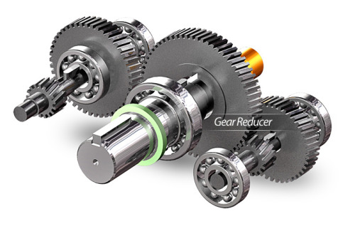
Design Approach
Gear Boxes
High Torque required to move motors
Most motors deliver high speed and relatively low torque
Use gearbox to increase torque

Slide 16
Design Approach
Constraints
Energy Efficient
Low Cost
Portable
Trade Offs
Power Consumption vs Accuracy
Cost vs Durability (Materials)

Slide 17
Cost Analysis
Table 5. Cost of Components
Product components | Quantity | Price ($) | Total Price ($)
Motor driver circuit | 1 | 300 | 300
Phone | 1 | 150 | 150
Micro- Controller | 1 | 60 | 60
Wooden Frame | 20 board feet | 3.25/board foot | 64
Motors | 2 | 56 | 112
Gear Boxes | 2 | 49 | 98
Total Cost |  |  | 784

Slide 18
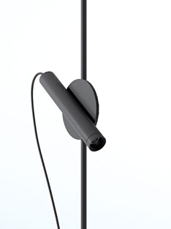
Project Demonstration
Exterior testing ; Moveable frame
Solar panel moves with change in frame position in order to orient itself in direction of sun
Internal testing ; Moveable light source
Solar Panel moves with change in position of lighting.

Slide 19
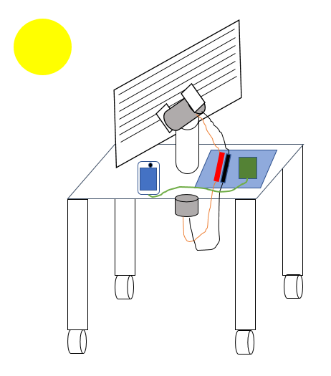
Project Demonstration
Part | Description
Motors | Gray cylinder
Circuitry | Blue parallelogram
Phone | Blue screen
Solar panel | Striped parallelogram
Structure | White shapes

Slide 20
Flow Diagram

Slide 21
Schedule
What have we done?
Android Application design.
Create UI that displays sensor output.
Present status
Exploring algorithms to calculate the sun’s intensity.
Creating solid work design.
Challenges and Solutions
Android Application design.
Solid work design.

Slide 22
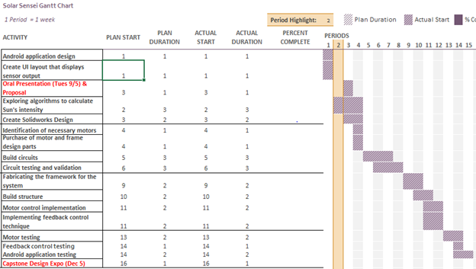

Slide 23
Status
Chidi
Researching algorithms for estimation of sun direction using camera image
Asier
Configuring bluetooth connectivity between Android device and mBed

Slide 24
Status
Gideon
Learning CAD to design the wood structure
Researching power electronics to implement in the solar panel circuitry
Yusuf
Prototyping a mBed demo that uses a servo and C++ code

Slide 25
Thank you!
Any Questions?

