Slide 1
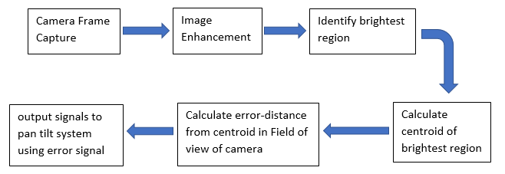
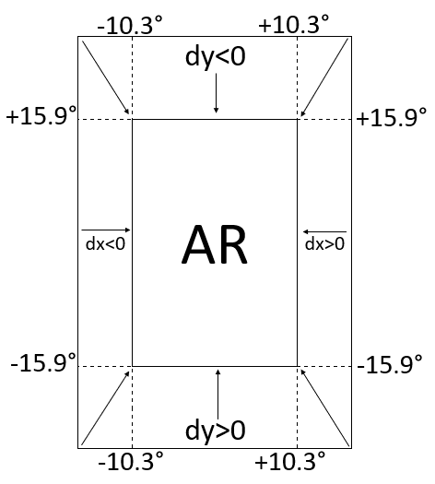
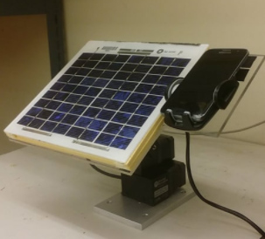
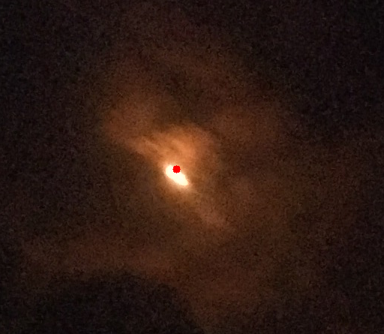
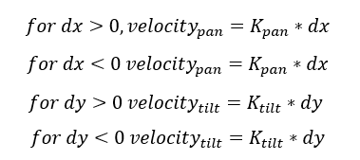
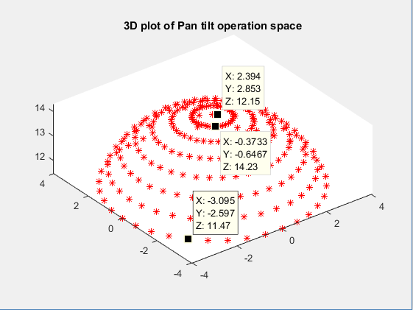
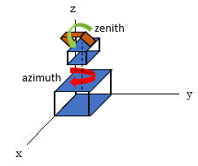
Smart Phone Solar Tracker
Chidi Imala, Asier Isayas, Yusuf Z. Kuris, Gideon Odogwu Advisor: Prof. Chris James
{cimala3, aisayas3, ykuris3, idogwu3 }@gatech.edu
Introduction
Our project utilizes a smartphone camera and an android application to track the sun’s position.
The motivation of this project is to have a self-sustainable system that can function in remote areas with no network access. The advantages of this project are its low cost and utilization of available resources.
Methods
Image Processing
Android App
STEP 1 - Serial communication
Via a UsbSerial driver library and OTG Cable, the Android phone scans for USB devices
Once the pan/tilt is detected, instructions are sent
STEP 2 - Agnostic Search
Pan/tilt sweeps the azimuth and zenith angles incrementally, searching for the light source
STEP 3 - Sun Tracking
Once the light source is within scope, the program checks whether the light source is within the acceptable region (the middle 60% of the screen)
Brightest point found by the image processing algorithm
Specifications
Future Work
Reducing AR area to increase accuracy
Generating optimal trajectory for motion of pan tilt system using centroid position on screen to reduce tracking time.
Self powered system that can charge the phone and move the pan/tilt
Using power output as a feedback to find optimal position
Specification | Proposed | Achieved
Dimensions (m) | 0.38 * 0.38 * 0.38 | 0.36 * 0.24 * 0.25
Azimuth range* | 0° - 330° | 0° - 318°
Zenith range** | 0° - 90° | 0° - 120°
Pointing accuracy | ±0.5° | ~±5.1° azimuth ~±6.7° zenith
Operating System | Android 4.4 (KitKat) or above | Android 4.4 or above
Sensors | Ambient light sensor, Camera (> 5 MP), Accelerometer | Camera
Performance | Specification
Longest Search | ~10 s
Tracking Error | maximum 266 pixel (different for other phones)

