Slide 1
Molecular Communication over the Air
Proposal Presentation
Notes:
Constance

Slide 2
The Team
Team Member | Role
Jacob Callahan | Lead hardware engineer, PCB designer
Nick Fahrenkrog | Expo coordinator, receiver
Constance Perkins | Lead firmware engineer, webmaster, transmitter
Zhongyang Shi | Documentation coordinator, receiver
Jun Xiang | Lead signal processing engineer
Siyan Yu | Lead embedded systems software engineer, transmitter
Notes:
Constance

Slide 3
Purpose and Background
Prototype and test a new system of communication
For use in situations where EM waves cannot propagate
Develop on architecture of an existing prototype
Expected budget: $300
Notes:
Constance, figures/ pics/ diagrams

Slide 4
Project Goals
Successfully transmit a binary-encoded message from the transmitter to the receiver
Transmitter will be a spray bottle and the receiver will be an alcohol detector
System will be controlled by microcontrollers
Make the prototype accessible and reproducible
Minimize cost
Make data easy to collect and distribute
Notes:
Jacob
Successfully transmitting a message from transmitter to receiver
Building prototype easily and spending a smaller amount on parts
Making the platform so the data collected is easily accessible for others to use for research

Slide 5
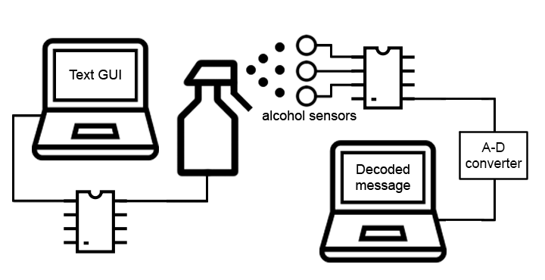
Block Diagram of Overall System
Notes:
Jacob

Slide 6
Step One
Building the system

Slide 7
Input Text GUI
Graphical User Interface to collect messages from the user
Send message to serial port connected to Arduino in the transmitter
C# implementation
Responsibility of Siyan and Constance
Notes:
Siyan

Slide 8
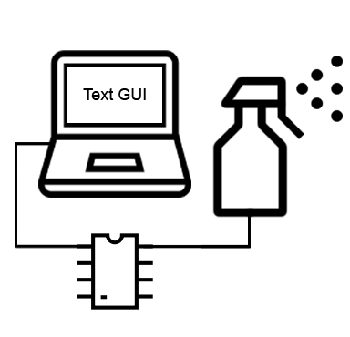
The Transmitter
Encode message characters to binary sequences according to the International Telegraph Alphabet No. 2
Send digital signals to circuit board connected to electrical sprayer
Spray a custom amount of chemical
Responsibility of Siyan and Constance
Additional hardware support from Jacob
Notes:
Siyan

Slide 9
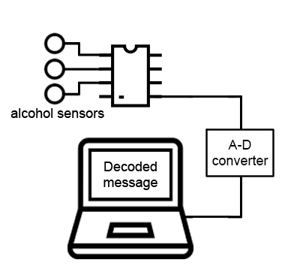
The Receiver
3 sensors connected to an Arduino Uno microcontroller
Criterion for the sensors: highly sensitive, widely available, inexpensive
Be able to detect the signalling chemical: isopropyl alcohol
Notes:
Zhongyang

Slide 10
The Receiver
Arduino Uno analog-to-digital conversion
Sensor data is processed by the detection and demodulation algorithms.
Data captured is fed to the decoder blocks
Nick, Jacob and Zhongyang will be in charge
Notes:
Zhongyang

Slide 11
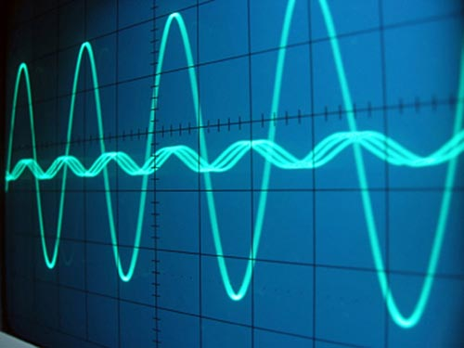
Signal Demodulation
Two alternating states: idle state and reception state
Idle state: no change of concentration is detected
Reception state: a surge of concentration detected
A concentration surge is demodulated as 1 and a concentration downfall is demodulated as 0.
Notes:
Jun: adjust font

Slide 12
Signal Decoding
ITA2 table (Partial)
Code | Letter | Figure
00000 | Null | Null
00100 | Space | Space
10111 | Q | 1
10011 | W | 2
00001 | E | 3
01010 | R | 4
10000 | T | 5
10101 | Y | 6
. . | . . | . .
After the recovered signals get segmented, one bit is extracted from each segment through averaging and thresholding.
Based on the ITA2 table, a binary-to-ASCII conversion can be hard-coded.
Responsibility of Jun
Notes:
Jun: redo the table, adjust font

Slide 13
Step Two
Testing the system

Slide 14
Testing Process
Matlab code and microcontroller code will be unit tested
Circuitry will include test points and be measured in hardware lab
Once the previous tests pass, a specific component will be tested (receiver, transmitter)
Once both the receiver and transmitter are physically working, the entire system will be tested
Once the process works, it will be measured to make sure it passes specifications (including testing with a semi-permeable membrane)
Notes:
Nick
Find max transmission speed
Find max distance between receiver and transmitter
Test with semi permeable barriers

Slide 15
Specifications to be a Success - Operational
Item | Specification
Min Transmission Speed | 0.01 bits/second
Min Distance Between Receiver/Transmitter | 100 cm
Min Thickness of Semi-Permeable Membrane to Penetrate | 800 Angstrom
Notes:
Nick
Find max transmission speed
Find max distance between receiver and transmitter
Test with semi permeable barriers

Slide 16
Specifications to be a Success - Receiver (w/o Computer)
Item | Specification
Max Height | 30 cm
Max Width | 11 cm
Max Length | 17 cm
Max Weight | 135 g

Slide 17
Specifications to be a Success - Transmitter
Item | Specification
Max Height | 30 cm
Max Width | 7 cm
Max Length | 18 cm
Max Weight (w/o fluid) | 250 g

Slide 18
Future Work
There will be three focuses of improvement after functional product:
Increasing transmission speed
Increasing distance between receiver and transmitter
Creating receiver that can process signals only using the microcontroller
Notes:
Nick

Slide 19
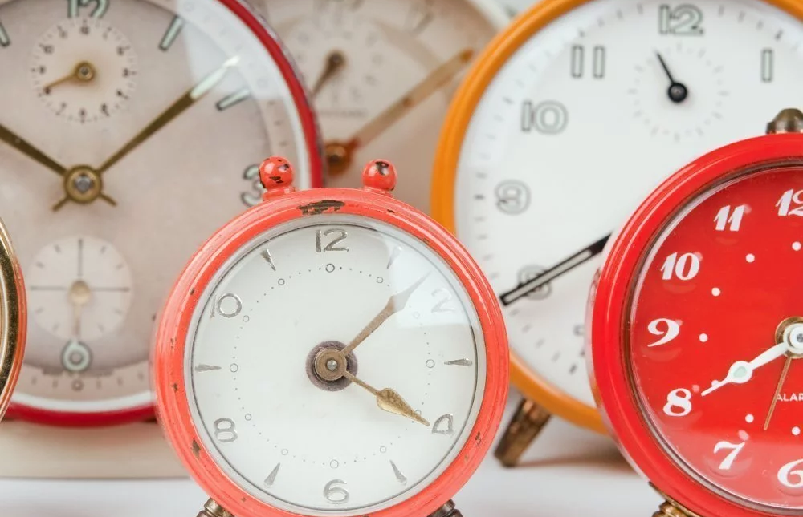
Time Projection
Transmitter, receiver, and, PC environment will be worked on in parallel (Deadline: End of October)
Two halves will then be tested together (Deadline: Mid November)
Run experiments and make improvements
Back-up plan: Manually run the system if automation fails

